Slide 1
AIRR Community Webinar Fundamentals of the Immune System Finish Chapter 3 Chapter 4: Orchestration of Immune Responses
Jamie K. Scott, MD, PhD
Professor Emerita
Simon Fraser University
Tuesday, 15 June 2021

Slide 2
Chapter 3, Section B
Signaling, activation, proliferation and differentiation of B-cells

Slide 3
Phases of the humoral immune response
Most isotype switching,
affinity maturation
(& somatic hypermutation),
memory & production of long-lived plasma cells (& their homing to the bone marrow)
involve follicular B cells that have been driven by T_{FH} cells in germinal center reactions
Notes:
Phases of the humoral immune response.
The activation of B cells is initiated by specific recognition of antigens by the surface Ig receptors of the cells.
Antigen and other stimuli, including helper T cells, stimulate the proliferation and differentiation of the specific B cell clone.
Progeny of the clone may differentiate into plasma cells that produce IgM or other Ig isotypes (e.g., IgG), may undergo affinity maturation, or may persist as memory cells (that have also typically undergone class switching and affinity maturation).
Abbas et al., Cellular and Molecular Immunology, 9th Ed. 2018, Elsevier.

Slide 4
Pathways of antigen delivery to follicular B cells
Notes:
Pathways of antigen delivery to follicular B cells.
Small antigens are delivered to B cells in follicles through afferent lymphatics and via conduits, and larger antigens by subcapsular sinus macrophages or by dendritic cells in the medulla.
Abbas et al., Cellular and Molecular Immunology, 9th Ed. 2018, Elsevier.

Slide 5
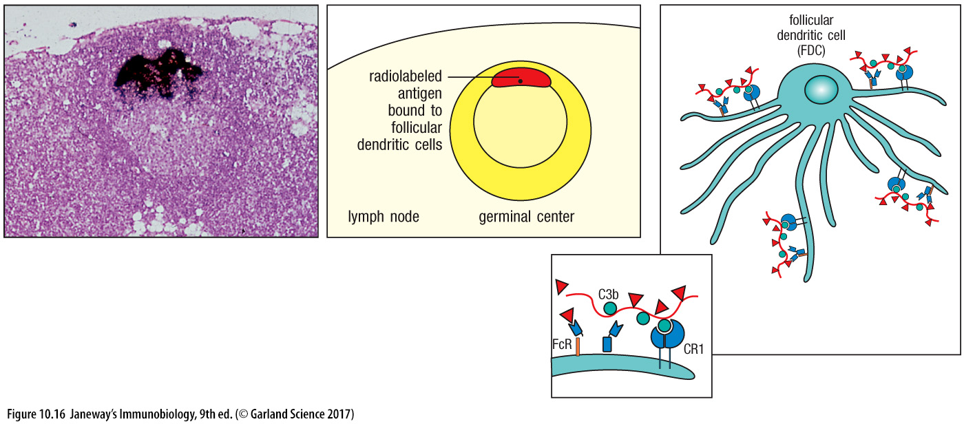
FDCs retain antigen in the form of immune complexes
FcγR activates FDCs to produce survival signals (APRIL & BAFF)
Immune complexes comprise antigen, antigen-specific IgG antibody, and complement

Slide 6
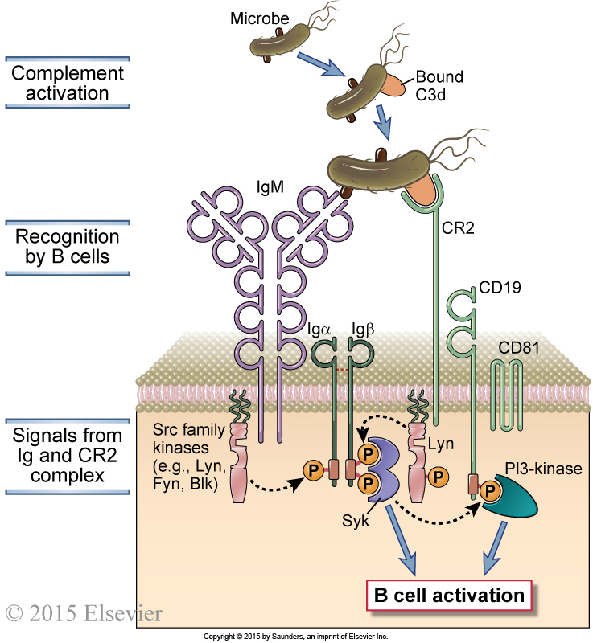
Complement helps activate B-cell signaling through the CD19 complex
END
Notes:
Role of complement in B cell activation.
B cells express a complex of the CR2 complement receptor, CD19, and CD81. Microbial antigens that have bound the complement fragment C3d can simultaneously engage both the CR2 molecule and the membrane Ig on the surface of a B cell. This leads to the initiation of signaling cascades from both the BCR complex and the CR2 complex, because of which the response to C3d-antigen complexes is greatly enhanced compared with the response to antigen alone.
Abbas et al., Cellular and Molecular Immunology, 9th Ed. 2018, Elsevier.

Slide 7
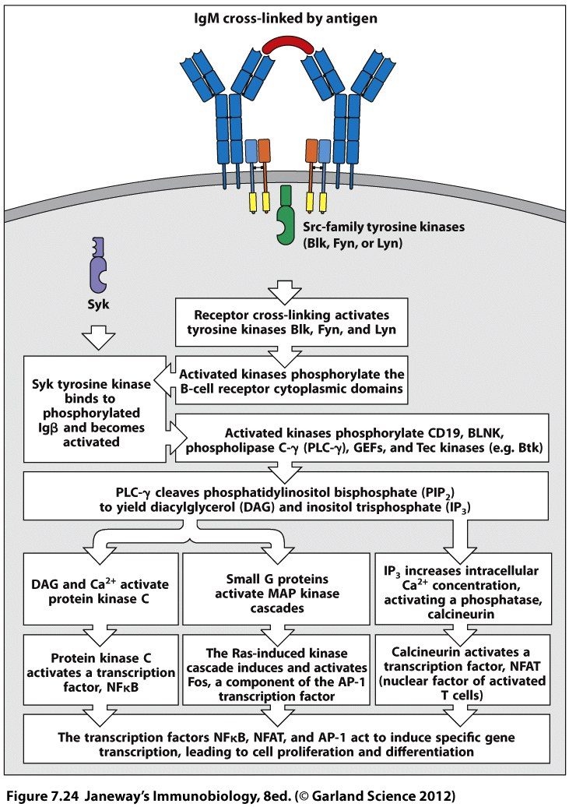
BcR signaling works with complement signaling and CD 40 signaling
FcγRIIb-ITIMs: Bind IgGs
to inhibit signaling
C3 fragments
CD40L Th cells
CD19, 81, 21
CD40
1st signal: BcR
2nd signal: CD40, CD19/21/81
3rd signal: cytokines (IL 21, IFNγ)
Lyn
PI3K
PI3K
“nonclassical”
NFkB pathway
Notes:
FcRIIb is an Fc receptor that specifically binds the Fc region of IgGs.

Slide 8
Sequence of events in humoral immune responses
to T cell–dependent protein antigens
Notes:
Sequence of events in humoral immune responses to T cell–dependent protein antigens.
A, Immune responses are initiated by the recognition of antigens by B cells and CD4+ T cells. The activated lymphocytes migrate toward one another and interact at the interface of T and B cell zones.
B, The initial T-dependent B cell proliferation and differentiation results in the formation of an extrafollicular focus, in which B cells proliferate, can undergo isotype switching, and differentiate into plasma cells (mostly short-lived). Some of the T cells that are activated in the extracellular focus develop into follicular helper T cells and migrate back into the follicles, together with some activated B cells, to form a germinal center.
The late events in B cell responses occur in germinal centers and include somatic mutation and the selection of high-affinity cells (affinity maturation), additional isotype switching, memory B cell generation, and the generation of long-lived plasma cells, described in later figures.
Abbas et al., Cellular and Molecular Immunology, 9th Ed. 2018, Elsevier.

Slide 9
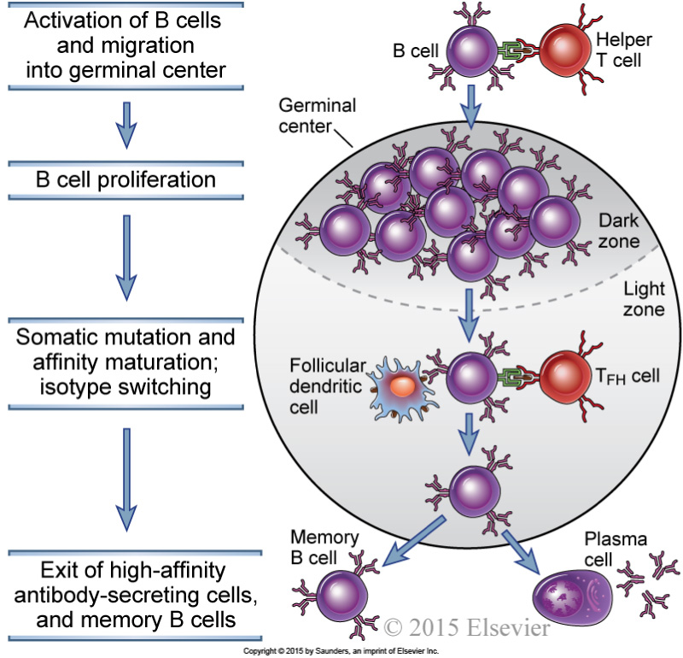
The germinal center reaction in a lymph node
involves expansion of antigen-specific T- and B-cell clones
Notes:
The germinal center reaction in a lymph node.
Activated B cells migrate into the follicle and proliferate, forming the dark zone of the germinal center.
These B cells undergo extensive isotype switching and somatic hypermutation of Ig V genes, and migrate into the light zone, where they encounter follicular dendritic cells displaying antigen and T_{FH} cells.
B cells with the highest affinity Ig receptors are selected to survive, and they differentiate into antibody-secreting cells and memory B cells.
The antibody-secreting cells leave and reside in the bone marrow as long-lived plasma cells, and the memory B cells enter the recirculating lymphocyte pool.

Slide 10
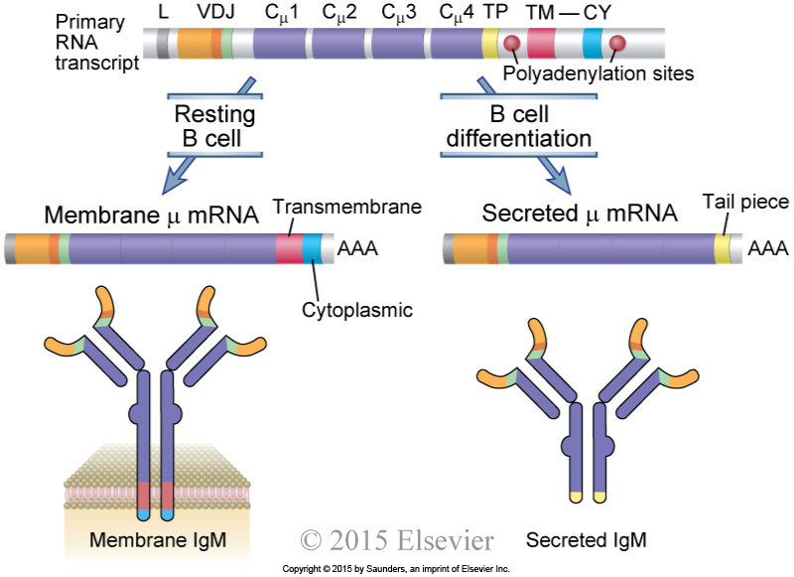
Germinal center reactions produce “central” memory B cells and antibody-secreting plasmablasts (destined to become plasma cells)
The BcR becomes a secreted antibody
Notes:
Production of membrane and secreted µ chains in B lymphocytes.
Alternative processing of a primary RNA transcript results in the formation of mRNA for the membrane or secreted form of the µ heavy chain.
B cell differentiation results in an increasing fraction of the µ protein produced as the secreted form.
TP, TM, and CY refer to tail piece, transmembrane, and cytoplasmic segments, respectively.
Cµ1, Cµ2, Cµ3, and Cµ4 are four exons of the Cµ constant gene region.
Abbas et al., Cellular and Molecular Immunology, 9th Ed. 2018, Elsevier.

Slide 11
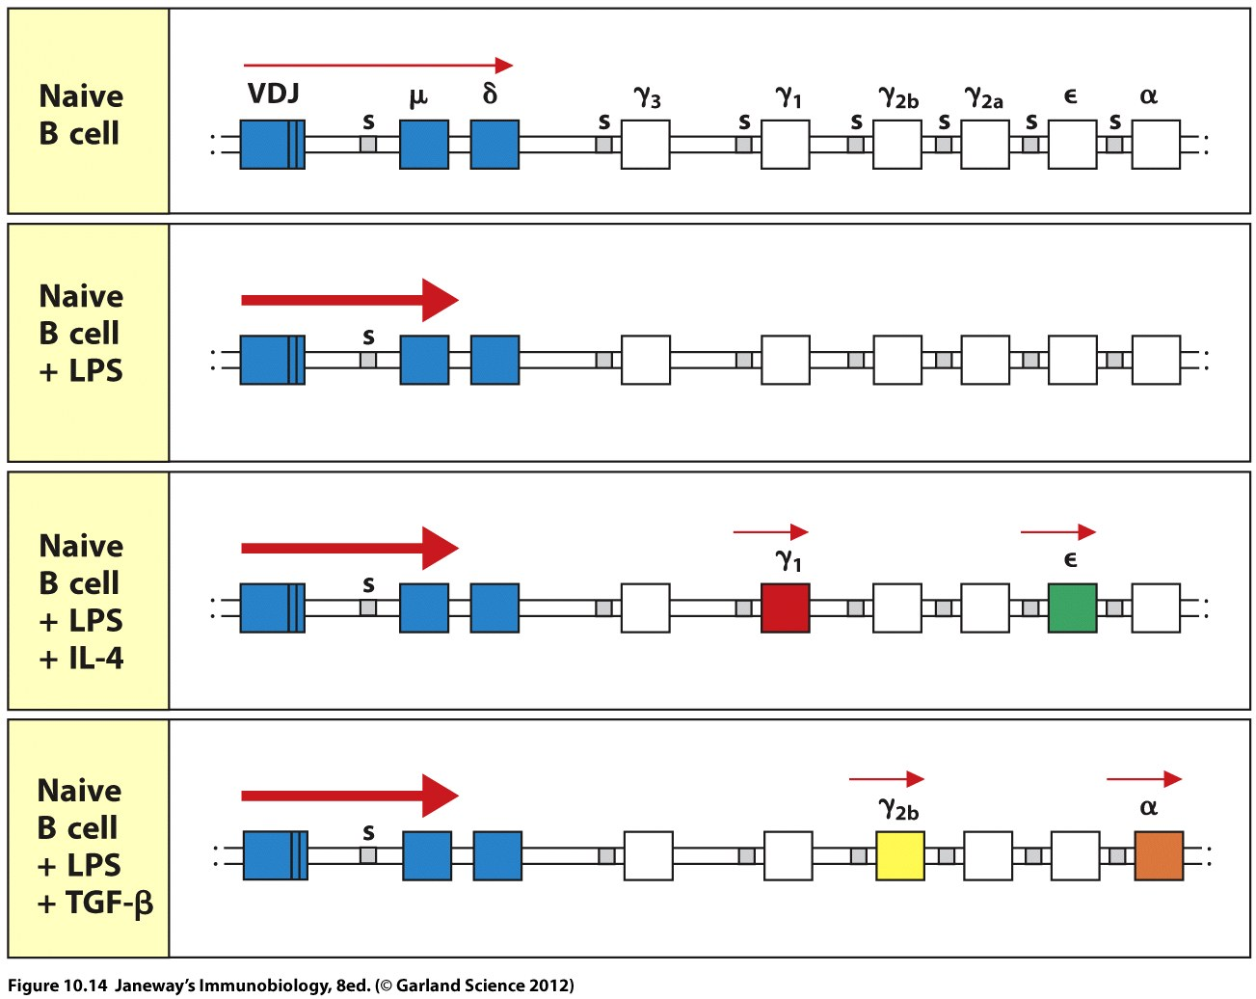
Class switching requires CD40L & is mediated by LPS and cytokines
Mice: IgG1, 2a, 2b (2c) and 3. Humans: IgG 1-4

Slide 12
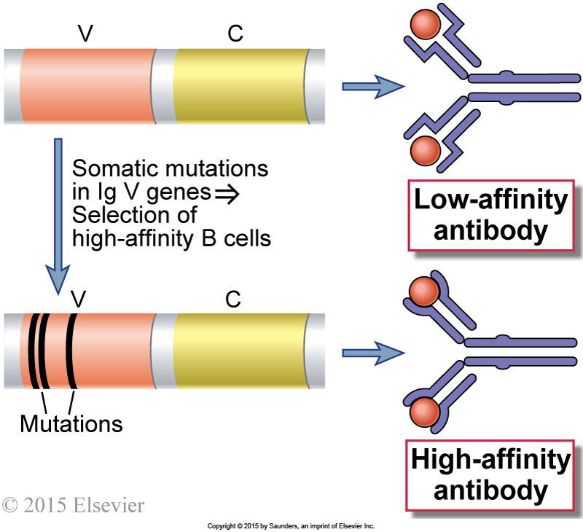
Affinity maturation
When antigen is limiting, B cells bearing high-affinity antibodies are selected over their lower-affinity counterparts in the light zones.
Thus B cells bearing lower affinity antibodies die off, and “drop out” of the antibody response.
Somatic mutations are produced by activation-induced cytosine deaminase, the same enzyme that mediates class switching!
Notes:
An overview of affinity maturation.
Early in the immune response, low-affinity antibodies are produced.
During the germinal center reaction, somatic mutation of Ig V genes and selection of B cells with high-affinity antigen receptors result in the production of antibodies with high affinity for antigen.
Abbas et al., Cellular and Molecular Immunology, 9th Ed. 2018, Elsevier.

Slide 13
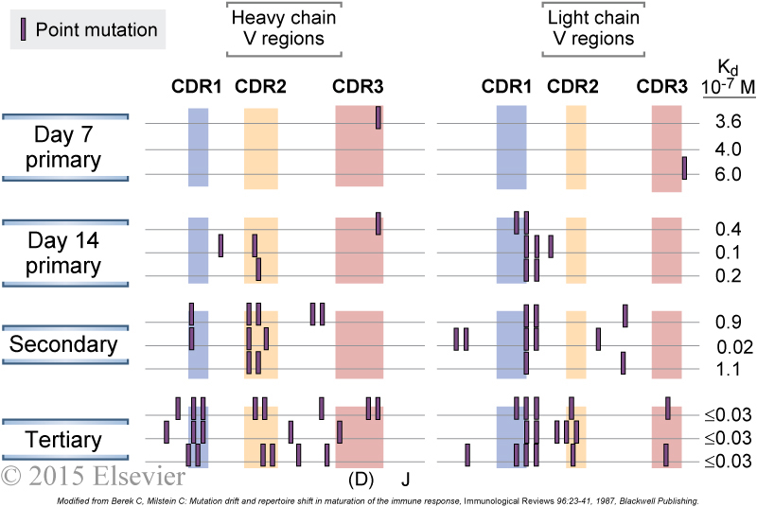
Progression of clonal lineages based upon somatic mutations
accumulating in unmutated, recombined Ig V genes
Lineages of B cells can be traced by analyzing their SHM patterns compared to their germline V, D and J gene segments, and building phylogenetic trees of their lineages.
This example used a hapten for cloning hapten-specific MAbs from immunized mice. That is why it is not a “poly-clonal” response but instead is dominated by a single VH gene.
Normally, there would be an initial polyclonal IgM response against multiple determinants on an antigen, with the lower-affinity clones dropping out as the GC reaction progresses, multiple somatically mutated lineages would arise over time.
AIRR-sequencing allows assessment of multiple clonal lineages;
but depends on knowing the germline V, D and J genes of the individual!
Notes:
Somatic mutations in Ig V genes.
Hybridomas were produced from spleen cells of mice immunized 7 or 14 days previously with a hapten, oxazolone, coupled to a protein and from spleen cells obtained after secondary and tertiary immunizations with the same antigen.
Hybridomas producing oxazolone-specific monoclonal antibodies were produced, and the nucleotide sequences of the V genes encoding the Ig heavy and light chains were determined.
Mutations in V genes increase with time after immunization and with repeated immunizations and are clustered in the complementarity-determining regions (CDRs).
The location of CDR3 in the heavy chains is approximate.
The affinities of the antibodies produced also tend to increase with more mutations, as indicated by the lower dissociation constants (Kd) for hapten binding.
(Modified from Berek C, Milstein C: Mutation drift and repertoire shift in maturation of the immune response, Immunological Reviews 96:23-41, 1987, Blackwell Publishing.)
Abbas et al., Cellular and Molecular Immunology, 9th Ed. 2018, Elsevier.

Slide 14
AID-mediated recombination of gene fragments
into the heavy chain V region
Pepper & Cockburn 2017 Immunol & Cell Biol 95:862-863

Slide 15
Chapter 3, Section C
Role of co-stimulation in determining the type immune response generated
(including anergy/tolerance)

Slide 16
Mechanisms of helper T-cell-mediated B-cell activation
T cell is also activated by B cell’s B7 (binding to CD28) and ICOS ligand (binding to ICOS)
The local mix of cytokines drives class switching by B cells.
Notes:
Mechanisms of helper T cell–mediated B cell activation.
Helper T cells that are activated by recognizing antigens presented by B cells express CD40L, which binds to CD40 on B cells and stimulates B cell proliferation and differentiation.
Cytokines produced by the helper T cells also contribute to B cell responses.
Abbas et al., Cellular and Molecular Immunology, 9th Ed. 2018, Elsevier.

Slide 17
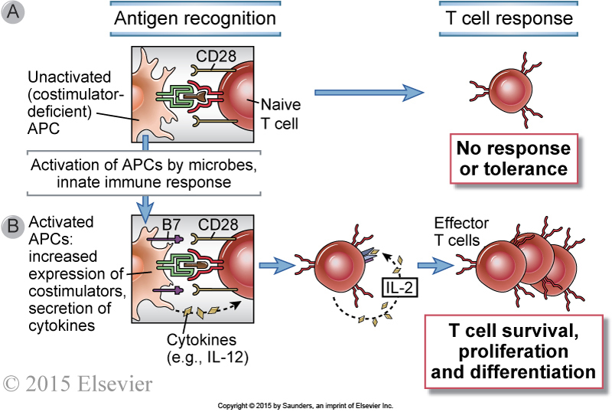
CD28 co-stimulation, via binding to an APC’s B7, helps activate T-cells
Notes:
Functions of costimulators in T cell activation.
A, The resting APC (typically dendritic cells presenting self antigens) expresses few or no costimulators and fails to activate naive T cells.
(Antigen recognition without costimulation may make T cells unresponsive [tolerant]; we will discuss this phenomenon in Chapter 15.)
B, Microbes and cytokines produced during innate immune responses activate APCs to express costimulators, such as B7 molecules.
The APCs (usually presenting microbial antigens) then become capable of activating naive T cells. Activated APCs also produce cytokines such as IL-12, which stimulate the differentiation of naive T cells into effector cells.

Slide 18
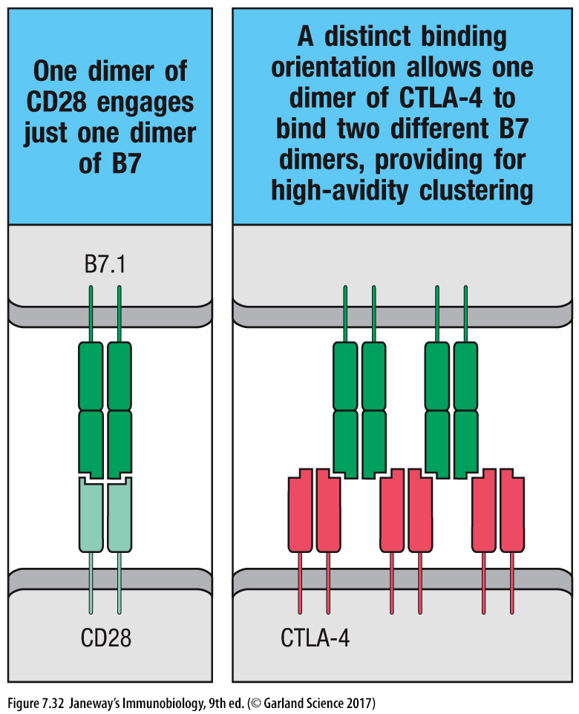
CD28 signaling through B7 is inhibited by CTLA-4
B cells are inhibited via FcγRIIb, and ITIM-containing IgG receptor

Slide 19
Therapeutic co-stimulatory blockade by a CTLA4-IgFc fusion
Notes:
The mechanism of therapeutic co-stimulatory blockade.
A, The normal T cell response induced by antigen recognition and costimulation mediated by B7-CD28.
B, A fusion protein consisting of the extracellular portion of CTLA-4 and the Fc tail of an IgG molecule is used to bind to and block B7 molecules, thus preventing their interaction with the activating receptor CD28 and inhibiting T cell activation.
Abbas et al., Cellular and Molecular Immunology, 9th Ed. 2018, Elsevier.

Slide 20
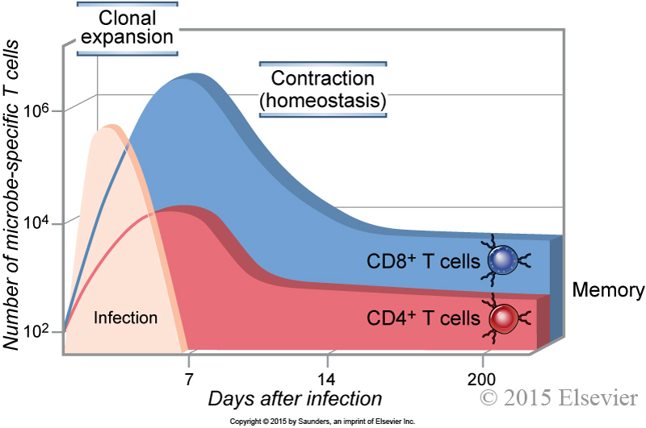
Clonal expansion and contraction of T-cell populations
Dominant memory B- and T-cell clones remain after contraction
Notes:
Clonal expansion of T cells.
The numbers of CD4⁺ and CD8⁺ T cells specific for microbial antigens and the expansion and decline of the cells during immune responses are illustrated.
The numbers are approximations based on studies of model microbial and other antigens in inbred mice
Abbas et al., Cellular and Molecular Immunology, 9th Ed. 2018, Elsevier.

Slide 21
Chapter 4
Orchestration of systemic and mucosal immune responses
A. Systemic immune responses
B. Mucosal immune responses
C. Roles of tolerance and inflammation
D. Examples of immune responses as variations on a common theme,
reiterating the dynamics of the immune response (with emphasis on the
role of AIRRs).
1. Vaccination
2. Viral infection
3. Cancer (can’t describe initiation)
4. Autoimmunity (can’t describe initiation)
5. Fit engineered immunotherapies into each subject
a. Therapeutic antibodies
b. Genetic engineering of autologous immune cells
i. CAR-T cells
ii. Dendritic-cell vaccines
iii. Other genetic engineering (including CRISPR)

Slide 22
Cellular homing
Naïve lymphocytes are primed in the secondary LTs
To proliferate and differentiate into effector and memory cells
And after release into the circulation, to home to specific tissues
As with lymphocyte entry into the lymph node, effector lymphocytes enter tissues via post-capillary venules
Homing depends on 3 type of cell surface molecule
Selectins that cause cells to “marginate” and start rolling along a vessel wall
Chemokine receptors that bind to chemokines secreted from the tissues
Integrins that stop the cell and allow it to begin crawling into the tissue, following the chemokine gradient.
Homing to a specific tissue depends on a specific combination of selectin, chemokine receptors and integrins

Slide 23
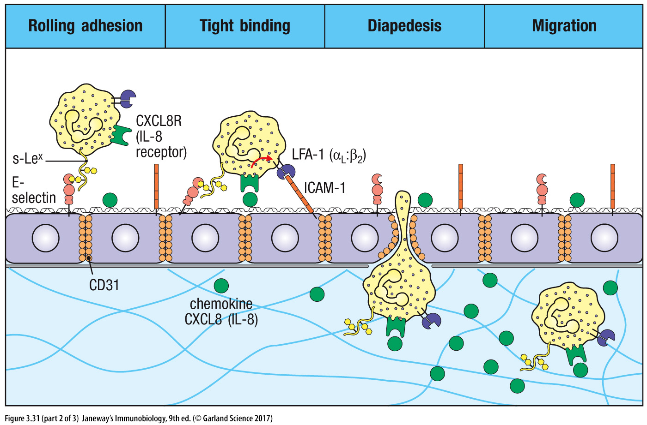
Selectin-Sialyl Lewis X interactions initiate rolling adhesion
Stopping is mediated by LFA-1-ICAM-1 interactions and
chemokine recognition, followed by diapedesis between cells and migration into the tissue
L-selectin
on cell
& P-

Slide 24
The underlying tissue controls what the leukocyte encounters in the post-capillary venule
CHEMOTAXIS
Chemokines bind to the extracellular matrix, forming a chemical gradient for chemotaxix
Notes:
Multistep leukocyte-endothelial interactions mediating leukocyte recruitment into tissues.
At sites of infection, macrophages that have encountered microbes produce cytokines (such as TNF and IL-1) that activate the endothelial cells of nearby venules to produce selectins, ligands for integrins, and chemokines. Selectins mediate weak tethering of blood leukocytes on the endothelium, and the shear force of blood flow causes the leukocytes to roll along the endothelial surface. Chemokines produced in the surrounding infected tissues or by the endothelial cells are displayed on the endothelial surface and bind to receptors on the rolling leukocytes, which results in activation of the leukocyte integrins to a high-affinity binding state. The activated integrins bind to their Ig superfamily ligands on the endothelial cells, and this mediates firm adhesion of leukocytes. The leukocytes then crawl to junctions between endothelial cells and migrate through the venular wall. Neutrophils, monocytes, and T lymphocytes use essentially the same mechanisms to migrate out of the blood.

Slide 25
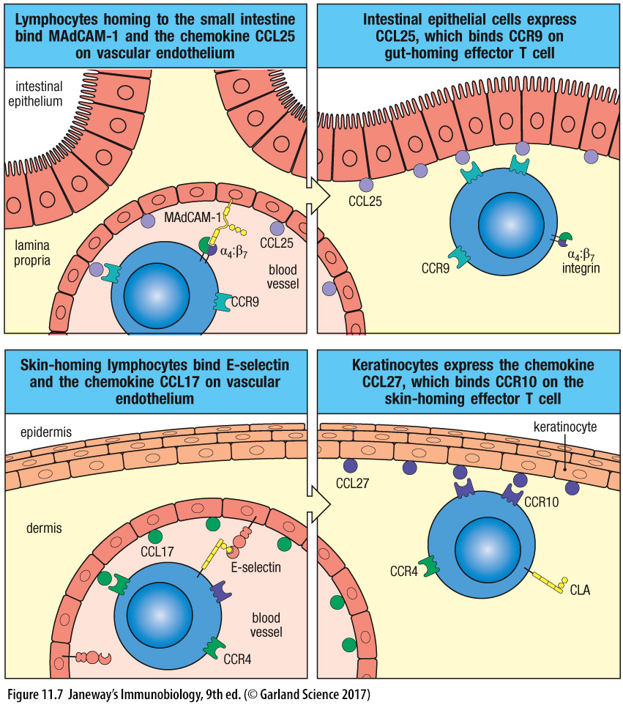
Effector T cells home to tissues using special selectins, adhesion molecules and chemokine receptors
L-selectin binds MAdCAM-1
via its sialyl-Lewis^{x}
CLA
Notes:
CLA is a fucose-containing carbohydrate moiety that is an induced modification of PGSL-1, a constiutive protein on T cells
Fuhlbrigge et al., 1997 Nature 389(6654):978-981 doi: 10.1038/40166

Slide 26
Chapter 4, Section A
Cutaneous immune response

Slide 27
Cells of the cutaneous immune system have specific locations
& other DCs
(Stratum basale containing stem cells)
- γ/δ T cells + CD103 Tissue-resident memory CD8 α/β
Basement membrane
Effector memory (circulating) & tissue-resident memory CD4 & CD8 T cells
Notes:
Cellular components of the cutaneous immune system.
The major components of the cutaneous immune system shown in this schematic diagram include keratinocytes, Langerhans cells, and intraepithelial lymphocytes, all located in the epidermis, and T lymphocytes, dendritic cells, and macrophages, located in the dermis.

Slide 28
DCs become activated in the epidermis, and “imprint” naïve T cells in the draining lymph node to migrate to the dermis and epidermis
Antibody responses begin with antigen collecting in the draining lymph node,
B and T cell responses and germinal-center formation, and antibody-secreting plasma cells in the lymph node and/or bone marrow.
From: http://www.biken.osaka-u.ac.jp/act/old/2008/act_hirata_e.php

Slide 29
Chapter 4, Section B
Mucosal immune response

Slide 30
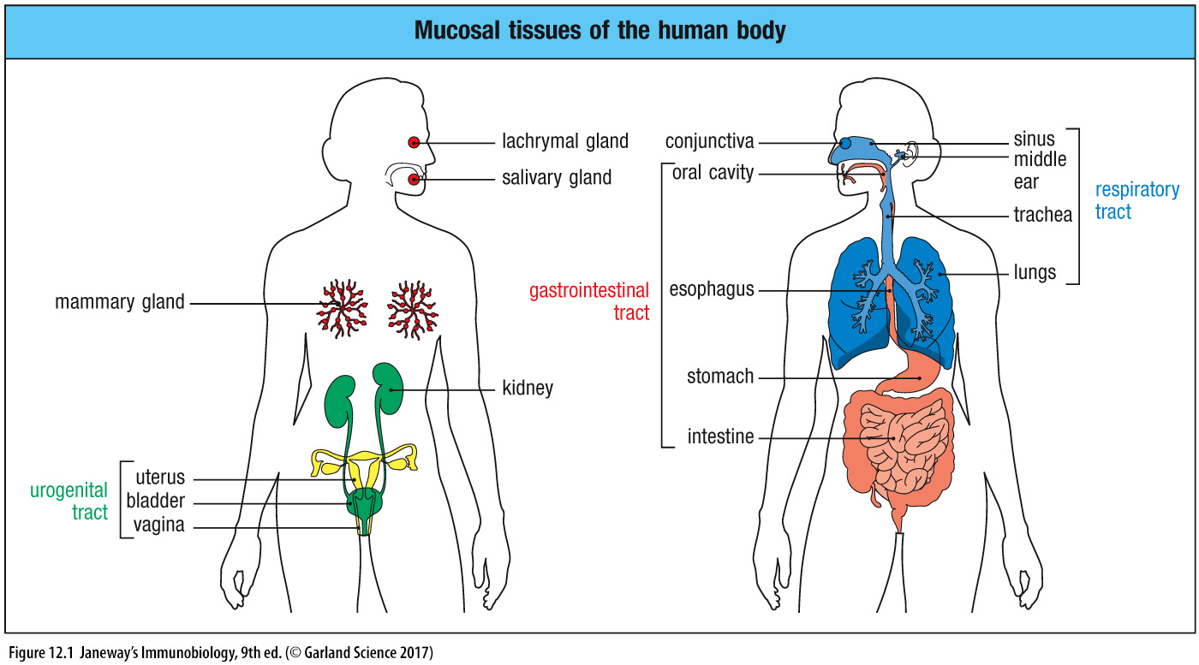
The mucosal tissues consists of all epithelial surfaces, except skin
(biliary tree &
pancreatic ducts)
Fallopian tubes of the UG tract open into the peritoneal cavity!

Slide 31
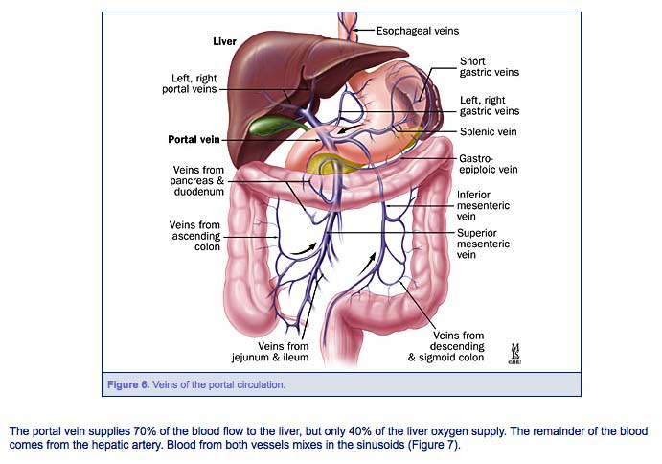
The gut and portal circulation
Venous blood from the GI tract, spleen and pancreas all drain into the liver
Small intestines not shown.

Slide 33
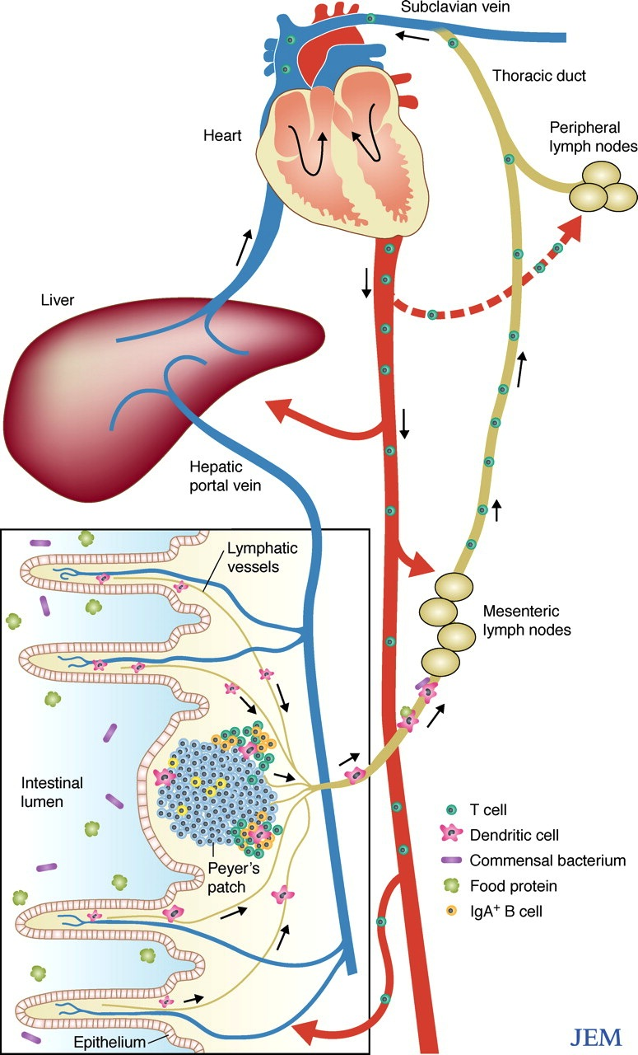
Circulatory circuits to and from the intestinal mucosa
Amino acids & sugars are absorbed
into the venous blood circulation, passing through the liver on the way to the heart.
Fats are absorbed
into the lymphatic circulation,
passing through the mesenteric lymph nodes
Cells activated in the mesenteric lymph nodes travel throughout the body, and home to the lamina propria of the GALT

Slide 34
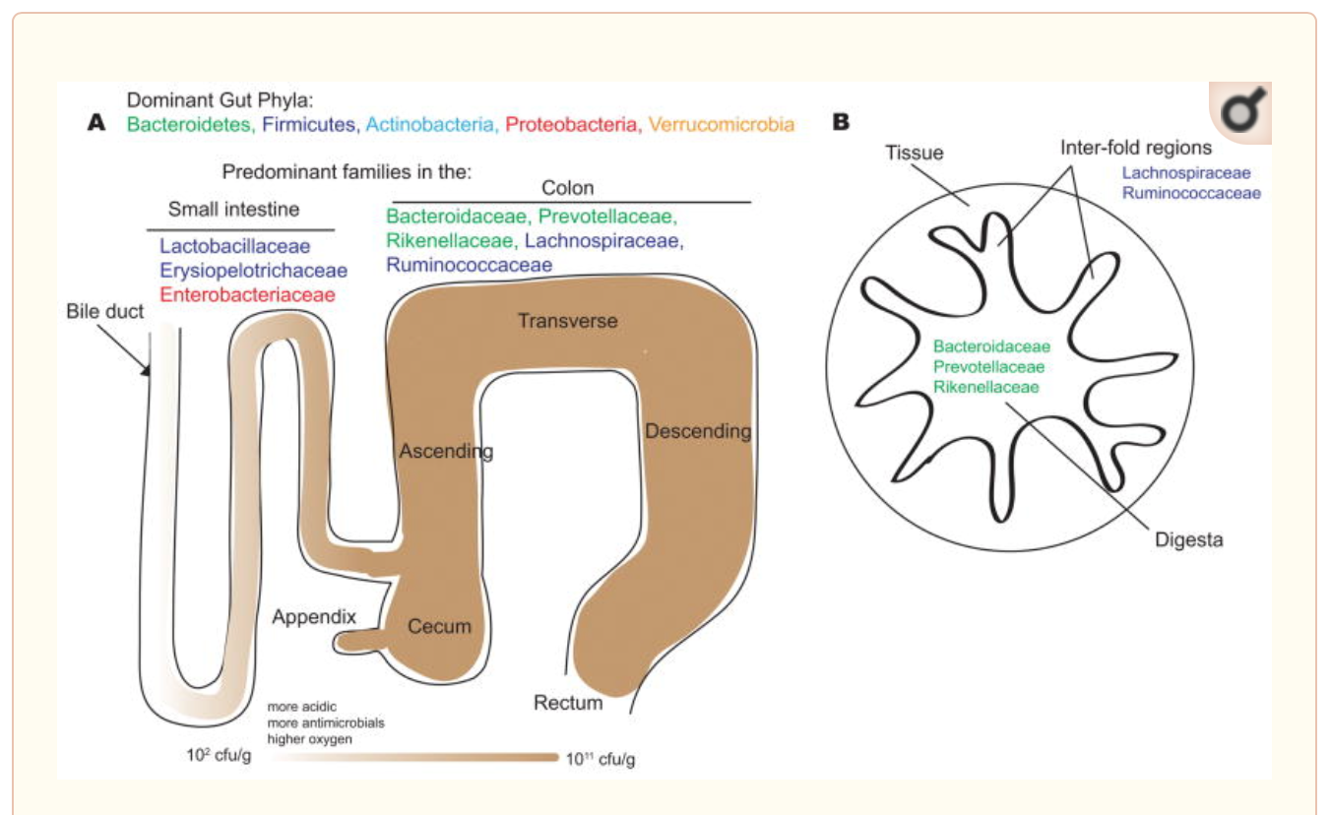
Microbial habitats in the human lower gastrointestinal tract
PP
Notes:
Figure 1
Microbial habitats in the human lower gastrointestinal tract
The dominant bacterial phyla in the gut are the Bacteroidetes, Firmicutes, Actinobacteria, Proteobacteria and Verrucomicrobia. The dominant bacterial families of the small intestine and colon reflect physiological differences along the length of the gut. For example, a gradient of oxygen, antimicrobial peptides (including bile acids, secreted by the bile duct), and pH limits the bacterial density in the small intestinal community, whereas the colon carries high bacterial loads. In the small intestine, Lactobacillaceae and Enterobacteriaceae dominate, whereas the colon is characterized by the presence of Bacteroidaceae, Prevotellaceae, Rikenellaceae, Lachnospiraceae and Ruminococcaceae. A cross-section of the colon shows the digesta – which is dominated by Bacteroidaceae, Prevotellaceae and Rikenellaceae – and the inter-fold regions of the lumen – which are dominated by Lachnospiraceae and Ruminococcaceae.
From: Donaldson et al., Nat. Rev Microbiol 2016 14(1):20-32. doi: 10.1038/nrmicro3552

Slide 35
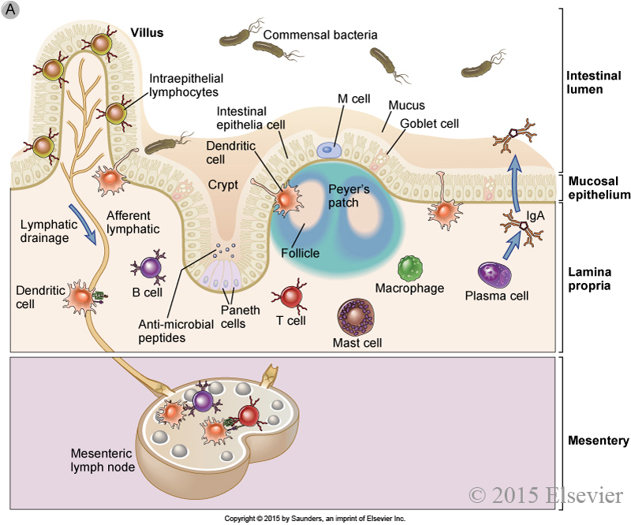
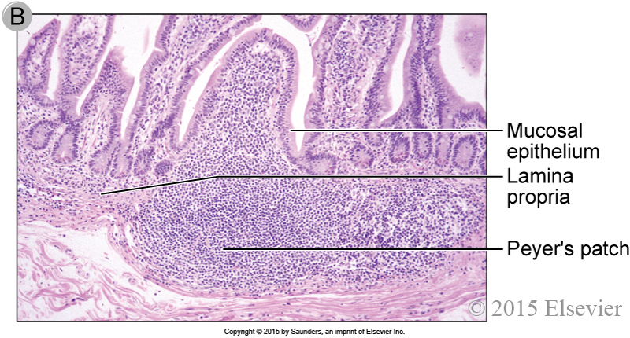
The gastrointestinal immune system (GALT)
Isolated
Lymphoid Follicles
Isolated lymphoid follicles are also located throughout the small intestinal LP.
Notes:
The gastrointestinal immune system.
A, Schematic diagram of the cellular components of the mucosal immune system in the intestine.
The main features include an epithelial barrier covered by secreted mucus, DCs and M cells that sample antigens, various innate sentinel cells and lymphocytes in the lamina propria beneath the epithelial layer, organized mucosal-associated lymphoid tissues beneath the epithelial barrier, such as Peyer’s patches, draining mesenteric lymph nodes, and plasma cells beneath the epithelium that secrete IgA, which is transported into the lumen.
Details of antigen sampling by DCs and M cells, the structure of Peyer’s patches, migration of lymphocytes between mucosa and mesenteric lymph nodes, and the secretion and transport of IgA are all described in detail in this chapter.
B, Photomicrograph of mucosal lymphoid tissue in the human intestine. Similar aggregates of lymphoid tissue are found throughout the gastrointestinal tract.

Slide 36
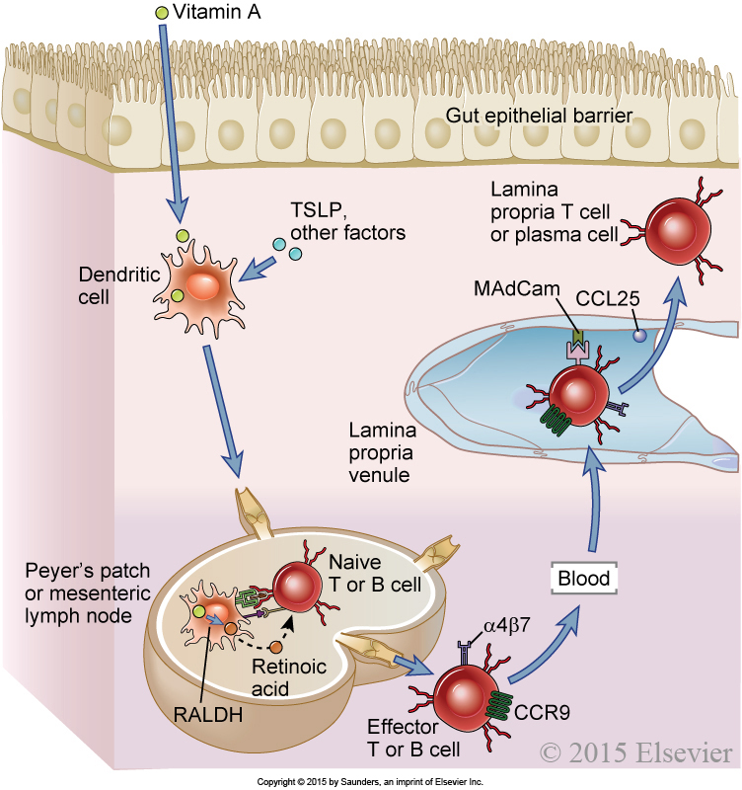
Homing properties of intestinal lymphocytes
TSLP = Thymic-stromal lymphopoietin
Made by epithelial & stromal cells
RALDH = Retinaldehyde dehydrogenase
Made by activated DCs
CCL 28, colon, mammary gland, respiratory homing
Isolated lymphoid follicle
CCR10, colon, mammary gland, respiratory homing
DC-derived retinoic acid upregulates α₄β₇ integrin and CCR9 to imprint T & B cells for homing to the small intestine
Notes:
Figure 14.3: Homing properties of intestinal lymphocytes.
The gut-homing properties of effector lymphocytes are imprinted in the lymphoid tissues, where they have undergone differentiation by naive precursors.
Dendritic cells in gut-associated lymphoid tissues, including Peyer’s patches and mesenteric lymph nodes, are induced by TSLP and other factors to express RALDH, which converts dietary vitamin A into retinoic acid.
When naive B or T cells are activated by antigen in GALT, they are exposed to retinoic acid produced by the dendritic cells, and this induces the expression of the chemokine receptor CCR9 and the integrin α4β7 on the plasma cells and effector T cells that arise from the naive lymphocytes.
The effector lymphocytes enter the circulation and home back into the gut lamina propria because the chemokine CCL25 (the ligand for CCR9) and the adhesion molecule MadCAM (the ligand for α4β7) are displayed on lamina propria venular endothelial cells.
MadCAM, mucosal addressin cell adhesion molecule; RALDH, retinaldehyde dehydrogenase; TSLP, thymic stromal lymphopoietin.

Slide 37
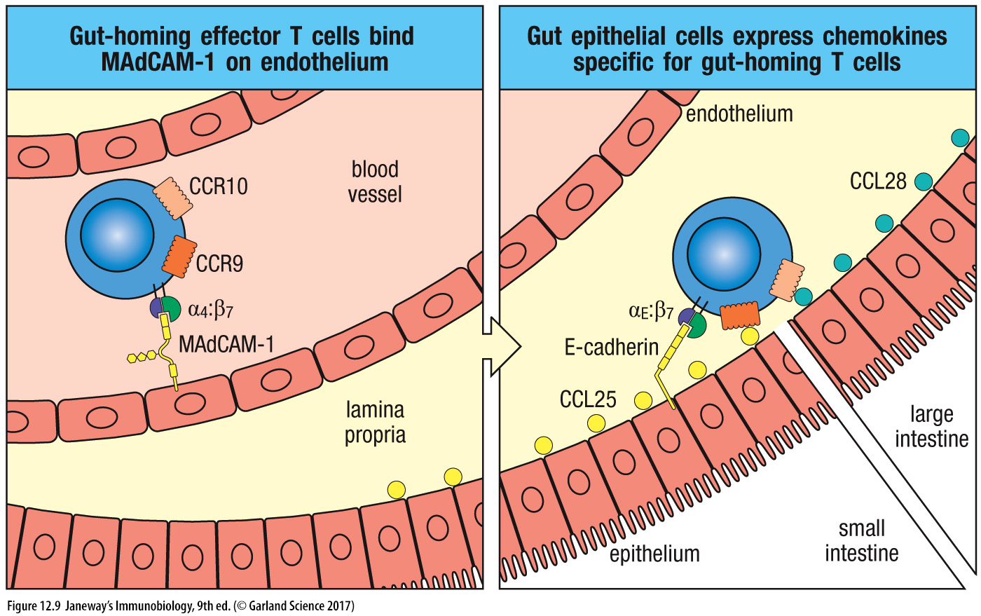
Activated T lymphocytes home to the lamina propria (mainly CD4s) and epithelium (mainly CD8s) via special selectins, adhesion molecules and chemokines
CCR10/CCL28 also in homing to other mucosa:
Lung, GU tract, lactating breast
α_{E}:β₇-cadherin interaction allows CD8s, but not CD4s or B cells, to enter the epithelial layer.
CCR10
/CCL28
CCR9/CCL25
Plasmablasts/plasma cells home to crypts in the lamina propria

Slide 38
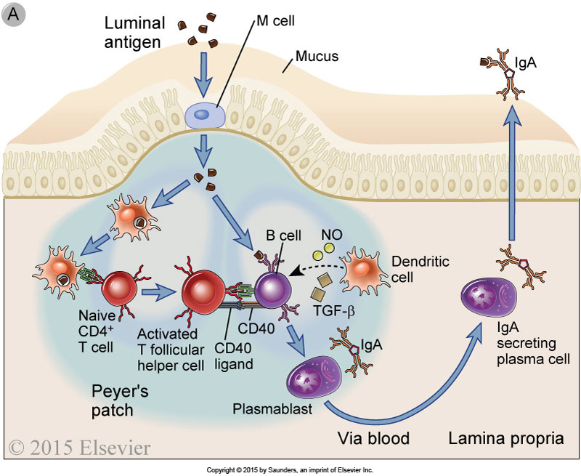
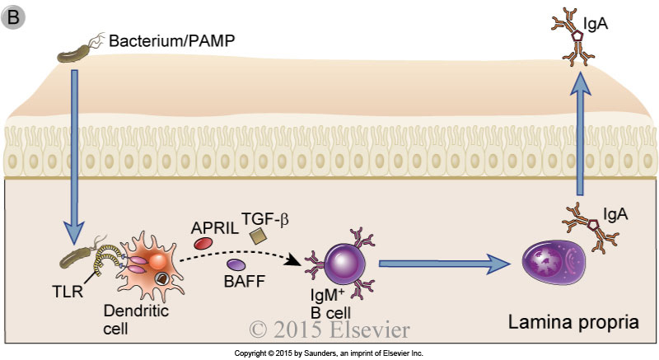
Ig A class switching in the gut
T-dependent FO B cells
T-independent ExtraFo (B1 & MZ) B cells
CCL25,28
CCR9,10
Mouse has 1 IgA class. Humans have IgA1 and A2 and Fca1R.
See: Steffen et al. Nat. Comm. 2020 https://doi.org/10.1038/s41467-019-13992-8
Notes:
IgA class switching in the gut.
IgA class switching in the gut occurs by both T-dependent and T-independent mechanisms.
A, In T-dependent IgA class switching, dendritic cells in the subepithelial dome of Peyer’s patches capture bacterial antigens delivered by M cells and migrate to the interfollicular zone, where they present antigen to naive CD4⁺ T cells.
The activated T cells differentiate into helper T cells with a T follicular helper phenotype and engage in cognate interactions with antigen-presenting IgM⁺IgD⁺ B cells that have also taken up and processed the bacterial antigen.
B cell class switching to IgA is stimulated through T cell CD40L binding to B cell CD40, together with the action of TGF-β.
This T cell–dependent pathway yields high-affinity IgA antibodies.
B, T-independent IgA class switching involves dendritic cell activation of IgM⁺ IgD⁺ B cells, including B-1 cells.
TLR ligand–activated dendritic cells secrete cytokines that induce IgA class switch, including BAFF, APRIL, and TGF-β.
This T cell–independent pathway yields relatively low-affinity IgA antibodies to intestinal bacteria.
The molecular mechanisms of class switching are described in Chapter 12.

Slide 39
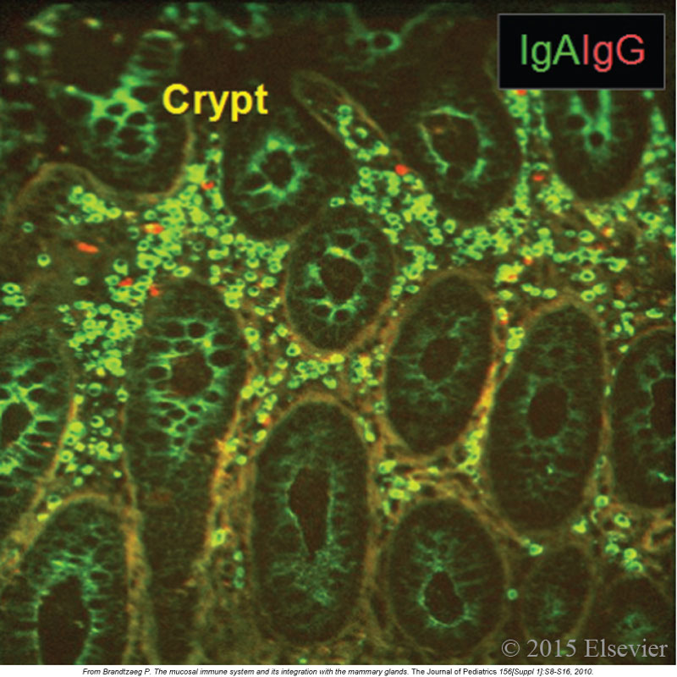
Figure 14.4: IgA-secreting plasma cells in the intestine
IgAs comprise the biggest source of protective immunity in the mucosa
Notes:
Figure 14.4: IgA-secreting plasma cells in the intestine.
The abundance of IgA-producing plasma cells (green) in colon mucosa compared with IgG-secreting cells (red) is shown by immunofluorescence staining.
IgA that is being secreted can be seen as green cytoplasm in the crypt epithelial cells.
(From Brandtzaeg P. The mucosal immune system and its integration with the mammary glands. J Pediatrics 156 [Suppl 1]:S8-S16, 2010.)

Slide 40
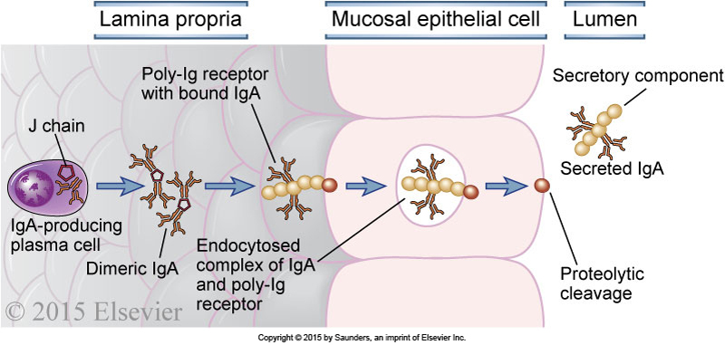
IgA (and pentameric IgM) are actively transported via their J chain
across epithelial cells and into the gut lumen
The poly-Ig receptor binds to the J chain of dimeric IgA or pentameric IgM,
eventually becoming the secretory component of those antibodies.
Notes:
Transport of IgA across epithelial cells.
IgA is produced by plasma cells in the lamina propria of mucosal tissue and binds to the poly-Ig receptor at the base of an epithelial cell.
The complex is transported across the epithelial cell, and the bound IgA is released into the lumen by proteolytic cleavage.
The process of transport across the cell, from the basolateral to the luminal surface in this case, is called transcytosis.

Slide 41
Chapter 4, Section C
Examples of immune responses

Slide 42
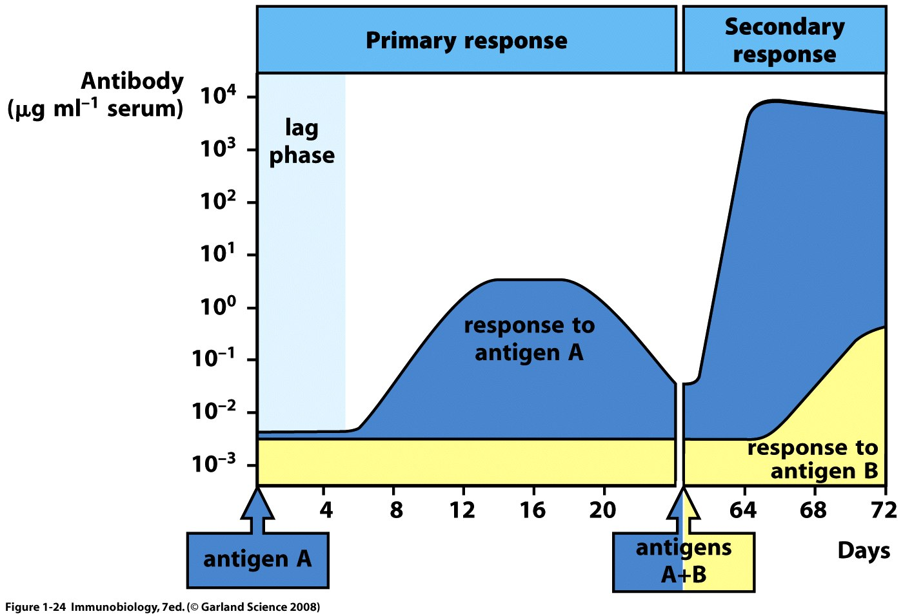
Memory B cells, produced after “primary” (first) vaccination,
will respond faster and more strongly to a “secondary” (booster) vaccination.
Antigen-specific

Slide 43
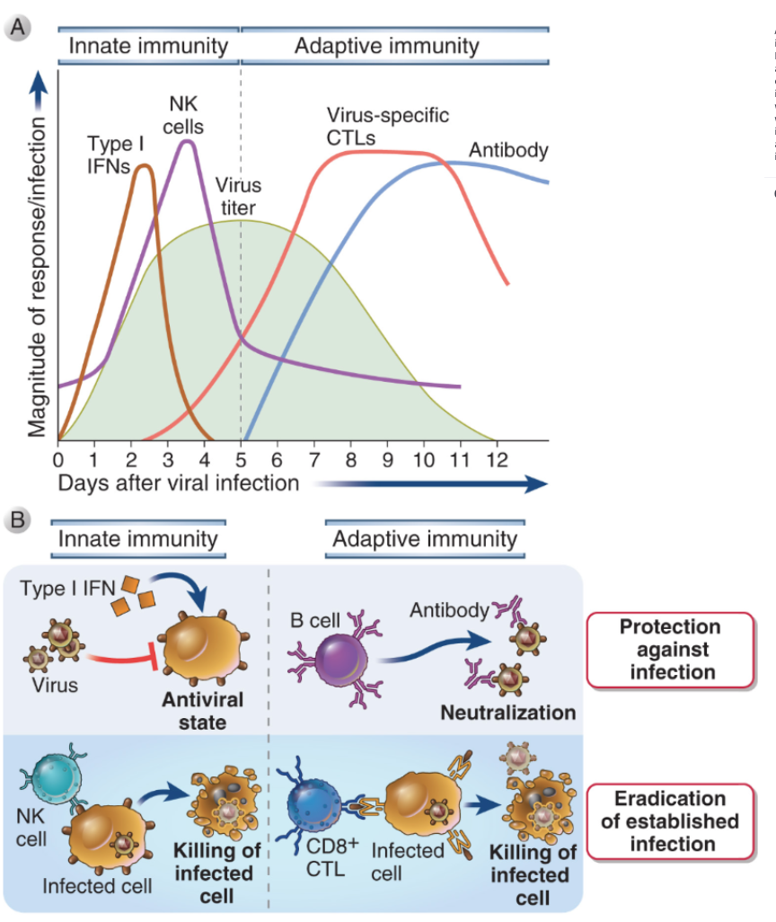
Innate and adaptive phases of immunity to viral infection
Including antibody-dependent cell killing by NK cells (ADCC)
Most antiviral vaccines protect by eliciting neutralizing antibodies (as well as CMI)
Notes:
Figure 16.8: Innate and adaptive immune responses against viruses.
A, Kinetics of innate and adaptive immune responses to a virus infection. B, Mechanisms by which innate and adaptive immunity prevent and eradicate virus infections. Innate immunity is mediated by type I IFN, which prevent infection, and NK cells, which eliminate infected cells. Adaptive immunity is mediated by antibodies and CTLs, which block infection and kill infected cells, respectively.

Slide 44
Immunity to viral infections
Innate immune receptors on DCs and macrophages are intracellular
Type I interferon response
NK cells
Adaptive immunity involves
Neutralizing antibodies blocking infection
CD8 CTLs killing infected cells
NK cells & ADCC killing infected cells
Viral persistence can lead to B- and T-cell exhaustion
e.g., PD-1 inhibitory receptor upregulation
Immune evasion mechanisms
Many target Class I MHC

Slide 45
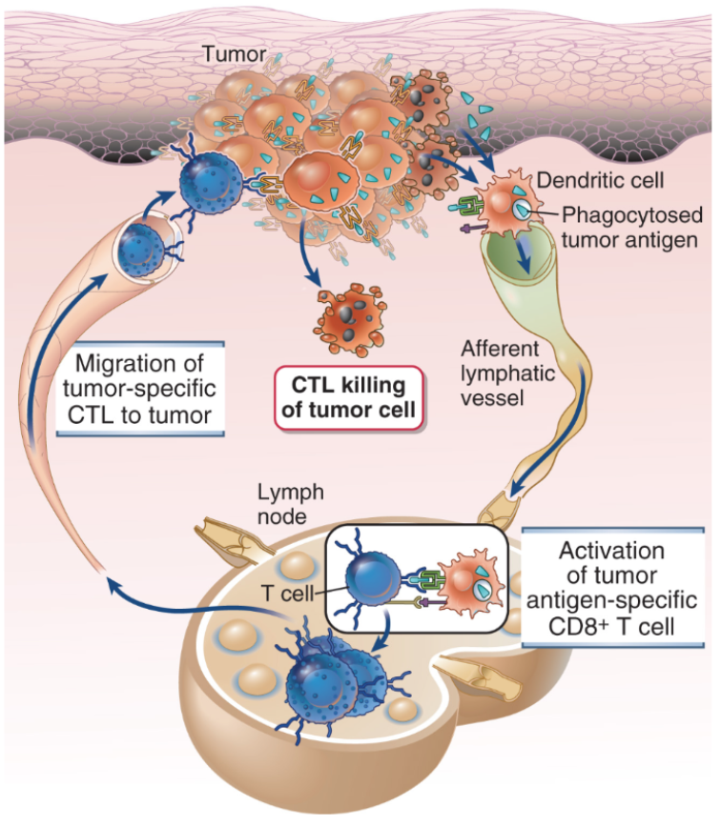
Tumor antigens can be presented by DCs in secondary lymphoid tissues, activating T-cell development into CD4 TH cells and CTLs
DCs present antigen on MHC II
& cross-present antigen on MHC I
DCs can be in periphery
Or in the lymphoid tissues draining the tumor site (metastatic tumor cells are often observed in draining lymph nodes, and are a sign of metastasis)
Notes:
Figure 18.4: Cytotoxic T lymphocyte (CTL) response against tumors.
Tumor antigens are picked up by host dendritic cells, and responses are initiated in peripheral (secondary) lymphoid organs.
Tumor-specific CTLs migrate back to the tumor and kill tumor cells.
Other mechanisms of tumor immunity are not shown.

Slide 46
Figure 6.13: Pathways of antigen processing and presentation
All cell types
APCs only:
DCs
B cells
MΘs
Notes:
Figure 6.13: Pathways of antigen processing and presentation.
In the class I MHC pathway (top panel), protein antigens in the cytosol are processed by proteasomes, and peptides are transported into the endoplasmic reticulum (ER), where they bind to class I MHC molecules.
In the class II MHC pathway (bottom panel), protein antigens that are degraded in lysosomes bind to class II MHC molecules.
Details of these processing pathways are shown in Figs. 6.14 and 6.15. ER, endoplasmic reticulum; TAP, transporter associated with antigen processing.

Slide 47
Cross-presentation of extracellular antigens on class-I MHC to CD8⁺ T cells
NOTE: Only APCs (DCs, B cells and macrophages) can cross present antigen!
Notes:
Figure 6.17: Cross-presentation of antigens to CD8⁺ T cells.
Cells infected with intracellular microbes, such as viruses, are ingested by dendritic cells, and the antigens of the infectious microbes are transported into the cytosol and processed and presented in association with class I MHC molecules to CD8⁺ T cells (see also Fig. 6-16).
Thus, dendritic cells are able to present endocytosed vesicular antigens by the class I pathway.
Note that the same cross-presenting APCs may display class II MHC–associated antigens from the microbe for recognition by CD4⁺ helper T cells.

Slide 48
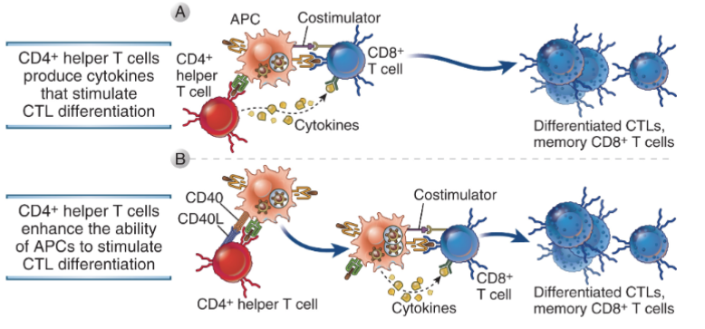
Activated CD4 (Th1) T cells provide direct cytokine stimulation to CD8 T cells (Signal 3), and activate DCs to stimulate CTL differentiation
Notes:
Figure 11.2: Role of helper T cells in the differentiation of CD8+ T lymphocytes.
CD4+ helper T cells promote the development of CD8+ CTLs and memory cells by secreting cytokines that act directly on the CD8+ cells (A)
or by activating APCs to become more effective at stimulating the differentiation of the CD8+ T cells, e.g., by increasing the expression of co-stimulators on the APCs (B).

Slide 49
Tumor immunotherapies
Checkpoint blockade (therapeutic antibodies, and engineered Fcs)
Vaccination with tumor antigens
Neoantigens
Tumor associated antigens
Adoptive therapy with anti-tumor T cells
CAR-T cells
Autologous T cells transformed with anti-tumor TcRs
Autologous, activated DCs bearing tumor antigens (DC vaccine)
Passive immunotherapy with antibodies
Antibodies against tumor-associated antigens
NK cells & ADCC, antibody & complement-mediated phagocytosis by macrophages
Immunotoxin-antibody conjugates

Slide 50
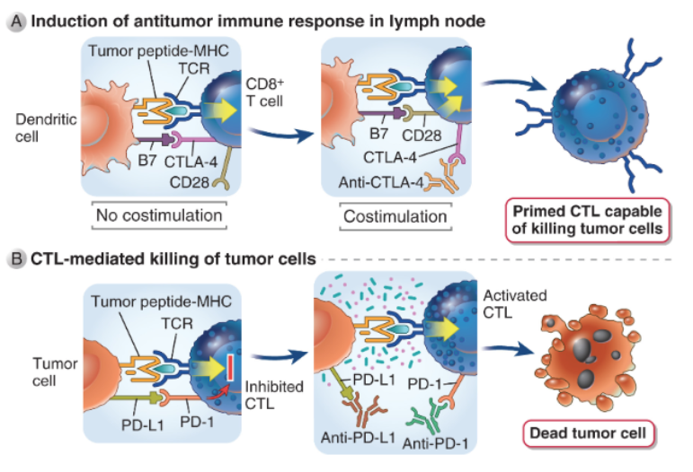
Rx antibody-mediated blockade of immunosuppressive signaling (immunosuppressive checkpoint blockade)
Notes:
Figure 18.8: Checkpoint blockade.
Tumor patients often mount ineffective T cell responses to their tumors because of the upregulation of inhibitory receptors such as CTLA-4 and PD-1 on the tumor-specific T cells, and expression of the ligand PD-L1 on the tumor cells.
Blocking anti-CTLA4 antibodies (A)
or anti-PD-1 or anti-PD-L1antibodies (B)
are highly effective in treating several types of advanced tumors, by releasing the inhibition of tumor-specific T cells by these molecules.
Anti-CTLA-4 may work by blocking CTLA-4 on effector T cells (shown) or on Treg.

Slide 51
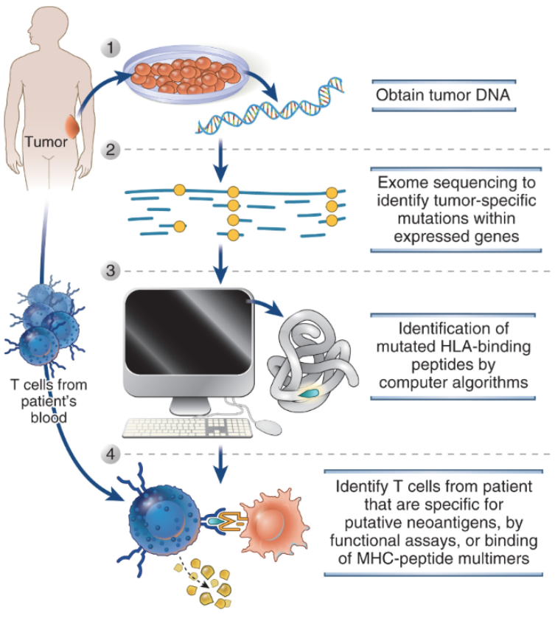
”Personalized” identification of neoantigens
Class-I MHC only
ID peptides that activate patient’s CD8 T cells displayed on his/her B cells’MHC.
Clone TcRs from exhausted CTLs, transform ”young” CD8 cells with them, expand and infuse.
OR made a vaccine with reactive peptides and immunize to expand endogenous CD8 T cells.
Notes:
Figure 18.9: Detecting tumor neoantigens that elicit T cell responses.
Tumor DNA can be purified (1),
and exome sequencing can detect random mutations in the genome of cancer cells (2).
Computer algorithm can then be used to determine which mutations occur in amino acid sequences that encode peptides that would bind to the MHC alleles in that patient (3).
The validity of the putative neoantigenic peptides can be tested by assays of patient T cell response to these peptides in vitro or by testing if MHC-peptide multimeric complexes can bind to the T cells (4).
This approach is being used to create personalized tumor vaccines.

Slide 52
DC-based cancer vaccines
Treat blood monocytes with GM-CSF to develop DCs
and conditioned with adjuvants.
Or transfected with expression cassettes encoding GM-CSF and tumor antigen -> MHC-I pathway
These could be CTLs or central memory CD8 T cells. Or possibly naïve CD8 T cells.
CTLs must home to the tumor
Notes:
Figure 18.10: Dendritic cell vaccines.
Dendritic cells, generated in vitro from blood monocytes taken from a tumor patient, can be pulsed with defined tumor antigens and infused back into the patient, where they will present the antigen to T cells specific for that antigen and boost a tumor-specific immune response.
In other approaches, the dendritic cells are transfected with a gene encoding the tumor antigen, and sometimes also a cytokine that promotes immune responses, and these cells are used as vaccines.

Slide 53
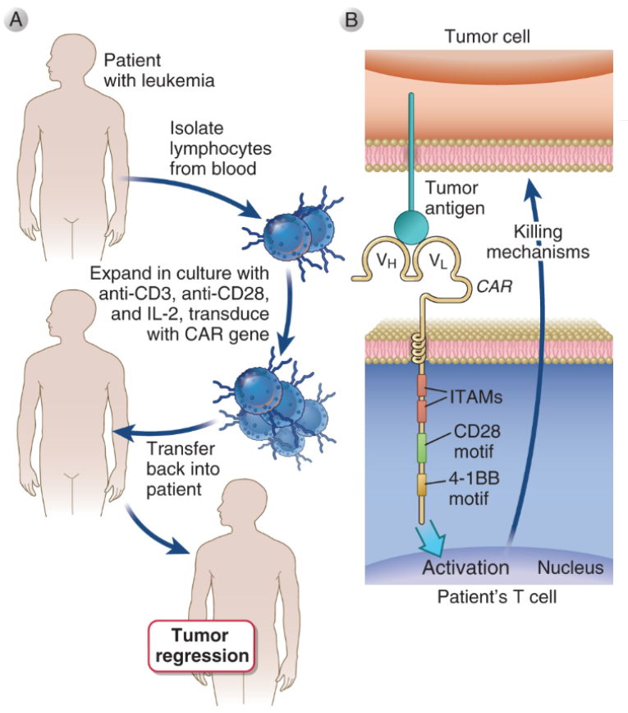
Adoptive cell therapy with autologous T cells expressing chimeric-antigen receptor: “CAR-T cells”
Single-chain antibody (scFv) against a tumor-associated antigen
NOT a neoantigen!!
So, all the problems of “self” for that scFv!
RISKs of going after the same antigen expressed at low levels in normal tissues!
What kind of immune reaction would such a response be similar to?
Notes:
Figure 18.11: Chimeric antigen receptor T cell therapy.
A, T cells isolated from the blood of a patient are expanded by culture in IL-2, anti-CD3, and anti-CD28, genetically modified to express recombinant chimeric antigen receptors (CARs), and transferred back into the patient.
B, CARs are composed of an extracellular Ig single chain variable fragment specific for a tumor antigen, and cytoplasmic signaling domains that activate T cells, such as TCR complex ζ chain ITAMs and motifs in the cytoplasmic domain of the costimulatory receptors such as CD28 and 4-1BB, which promote robust T-cell activation.
CAR-T cell therapy has been successful to treat certain leukemias and lymphomas.

Slide 54
Chapter 5: Big Immunological Data
Importance of “big immunological data” to our understanding of immune responses, and to development of specific and personalized therapies.
1. AIRR-sequencing (AIRR-seq) data
2. Systems immunology
Immunological/biological context is necessary to draw relevant/correct conclusions from AIRR-seq data.

Slide 55
Thanks for attending this webinar!
Feel free to contact me with questions/comments.
Attend one of our meeetings!
The next AIRR Community meeting will be 9-11 Dec 2021
Stay tuned on The Antibody Society website: https://www.antibodysociety.org/

