Slide 1
AIRR Community Webinar Fundamentals of the Immune System Chapter 1: Overview of the immune system
Jamie K. Scott, MD, PhD
Professor Emerita
Simon Fraser University
Thursday, 03 June 2021

Slide 2
Chapter 1: Overview of the immune system
Overview
A. Humoral and cellular immunity
B. Innate and adaptive immune responses and their receptors
1. Innate immunity’s “molecular pattern” recognition receptors (PAMPs & DAMPs)
2. Adaptive immunity’s B-cell and T-cell receptors (BcRs & TcRs)
C. Basic structure of the immune system
1. Cells, tissues and compartments
a. Secondary lymphoid tissues, where antigen is concentrated
b. How antigen is presented to naïve and memory B and T cells
2. Circulatory and lymphatic systems: “Superhighway” of the immune system
D. General timing and dynamics of immune responses
1. Innate immune responses recruit & orchestrate adaptive immune responses
2. The interaction/linkage between innate and adaptive immune responses
NOTE: Where figures are unlabeled, see the Notes section of each slide, showing either:
Abbas et al., Cellular and Molecular Immunology, 9th Ed. 2018, Elsevier.
Murphy et al., Janeway’s Immunobiology, 9th Ed. 2017, Garland Press.

Slide 3
Chapter 1 Section A
Humoral and cellular immunity

Slide 4
Humoral immunity is mediated by soluble proteins,
whereas cell-mediated immunity is mediated by cells
Notes:
Figure 1-2: Types of adaptive immunity.
In humoral immunity, B lymphocytes secrete antibodies that prevent infections and eliminate extracellular microbes. In cell-mediated immunity, helper T lymphocytes activate macrophages to kill phagocytosed microbes, or cytotoxic T lymphocytes directly destroy infected cells.
From: Abbas et al., Cellular and Molecular Immunology, 9th Ed. 2018, Elsevier.

Slide 5
Chapter 1 Section B
Innate and adaptive immune responses and their receptors

Slide 6
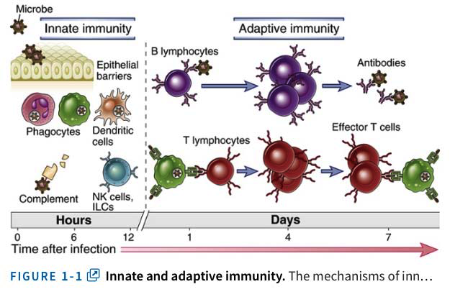
Innate immune responses precede and shape adaptive immune responses
“Natural”
antibodies
& cytokines
Cytokines
Notes:
Innate and adaptive immunity.
The mechanisms of innate immunity provide the initial defense against infections. Adaptive immune responses develop later and require the activation of lymphocytes. The kinetics of the innate and adaptive immune responses are approximations and may vary in different infections. ILC, innate lymphoid cell; NK, natural killer.
From: Abbas et al., Cellular and Molecular Immunology, 9th Ed. 2018, Elsevier.

Slide 7
Comparing the “sensors” involved in innate and adaptive immunity
Memory / Weak/None / Strong
Notes:
Table 4.1. Specificity of Innate and Adaptive Immunity
From: Abbas et al., Cellular and Molecular Immunology, 9th Ed. 2018, Elsevier.

Slide 8
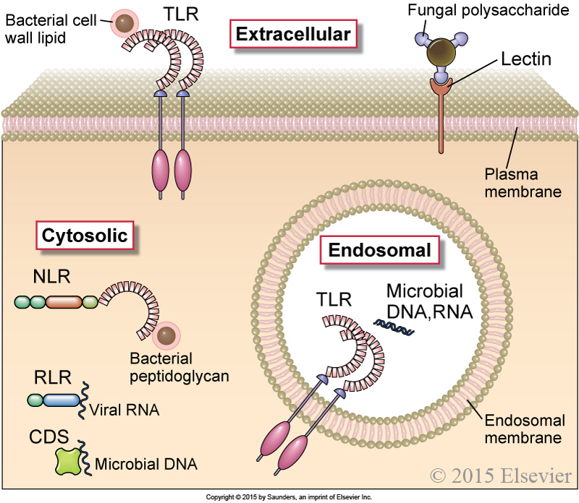
Cellular locations of pattern recognition receptors (PRRs)
of the innate immune system
PRRs of innate immunity are located in multiple cellular compartments
Notes:
Cellular locations of pattern recognition receptors (PRRs) of the innate immune system.
Some pattern recognition molecules, including members of the TLR family (see Fig. 4-2) and lectin receptors, are expressed on the cell surface, where they may bind extracellular pathogen-associated molecular patterns. Other TLRs are expressed on endosomal membranes and recognize nucleic acids of microbes that have been phagocytosed by cells. Cells also contain cytosolic sensors of microbial infection, including the NOD-like receptor (NLR) family of receptors, RIG-like receptors (RLRs), and cytosolic DNA sensors (CDS). Only selected examples of microbial PAMPs recognized by these receptors are shown. Cytosolic receptors that recognize products of damaged cells (DAMPs) as well as some microbes are shown in Figure 4-4.
From: Abbas et al., Cellular and Molecular Immunology, 9th Ed. 2018, Elsevier.

Slide 9
Pattern recognition molecules can be cell-surface receptors,
or soluble proteins that bind to PAMPs/DAMPs
PAMP: Pathogen-associated molecular pattern
DAMP: Damage-associated molecular pattern
Notes:
Pattern Recognition Molecules of the Innate Immune System
From: Abbas et al., Cellular and Molecular Immunology, 9th Ed. 2018, Elsevier.

Slide 10
Cells of the innate immune system
Epithelial barriers
Defensins – constitutive and induced
Cathelicidins - induced synthesis and activation
Phagocytes
Macrophages (MΘs) derived from blood monocytes
Neutrophils
DCs (classical & plasmacytoid)
Classical DCs are mostly the initial antigen-presenting cell (APC) for T cells;
Plasmacytoid DCs detect viruses and secrete large amounts of type I (α,β) interferons
Bridge between innate and adaptive immunity; they pick up antigen peripherally, travel to lymph
Natural killer (NK) cells
Killer activity
Activating receptors bearing ITAMs (KIRs, C-type lectin receptors some with class Ib MHC binding: NKGD2 + MIC-A & MIC-B)
Antibody-dependent cellular cytotoxicity (ADCC) via CD 16 (FcγRIIIA receptor that binds IgG1 and 3 isotypes)
Inhibitory receptors bearing ITIMs recruit SHIP and SHP to dampen NK response (PD-1, NKG2A, LILRB
Cytokine production (γ-interferon)
Innate lymphoid cells (ILCs): Group 1, 2 & 3 ILCs
(categorized based on Th1, Th2 & Th17 cytokine profiles, respectively)
Group 1: Th1 cytokines (esp. γ-interferon) includes cytotoxic and non-cytotoxic NK-cell subsets
Group 2: Th2 cytokines including IL5, IL13
Group 3: TH17 inflammatory cytokines including IL17, IL22;
Lymphoid inducer (LTi) cells also secrete tumor necrosis factor (TNF) and bear α-lymphotoxin (α−LT)
Lymphocytes with limited TcR or BcR diversity
T cells: Intra-epthelial α/β and γ/δ T cells, iNKT cells all bear TcRs of limited diversity
B cells: B1 (a and b), and marginal zone B cells bear BcRs of limited diversity (not nearly as limited)
Mast Cells & Basophils: Activated by IgE clustering: secrete short and long-acting vasoactive mediators
Eosinophils: Driven by Th2 responses, they control parasites by secreting toxic proteins
Granulocytes = Neutrophils, basophils, eosinophils (loaded with vasoactive and toxic granules)

Slide 11
Notes:
From: Abbas et al., Cellular and Molecular Immunology, 9th Ed. 2018, Elsevier.

Slide 12
The cells of adaptive immunity:
B cells, CD4⁺ helper T cells, & CD8⁺ cytotoxic T cells
B-cell/Ig receptors comprise antibodies containing a C-terminal transmembrane domain and short cytoplasmic tail.
Plasma cells do not translate those domains, allowing antibody secretion.
CD4 and CD8 are cell-surface markers involved in T-cell receptor signaling.
They ensure T cells recognize the correct class of MHC molecule (I vs II).
CD4
CD8
Plasma cell
Notes:
Figure 1-2: Types of adaptive immunity.
In humoral immunity, B lymphocytes are activated to become antibody-secreting plasma cells; antibodies can directly block infections and signal the elimination of extracellular microbes.
In cell-mediated immunity,CD4+ helper T lymphocytes activate macrophages to kill phagocytosed microbes, or CD8+ cytotoxic T lymphocytes directly destroy infected cells.
From: Abbas et al., Cellular and Molecular Immunology, 9th Ed. 2018, Elsevier.

Slide 13
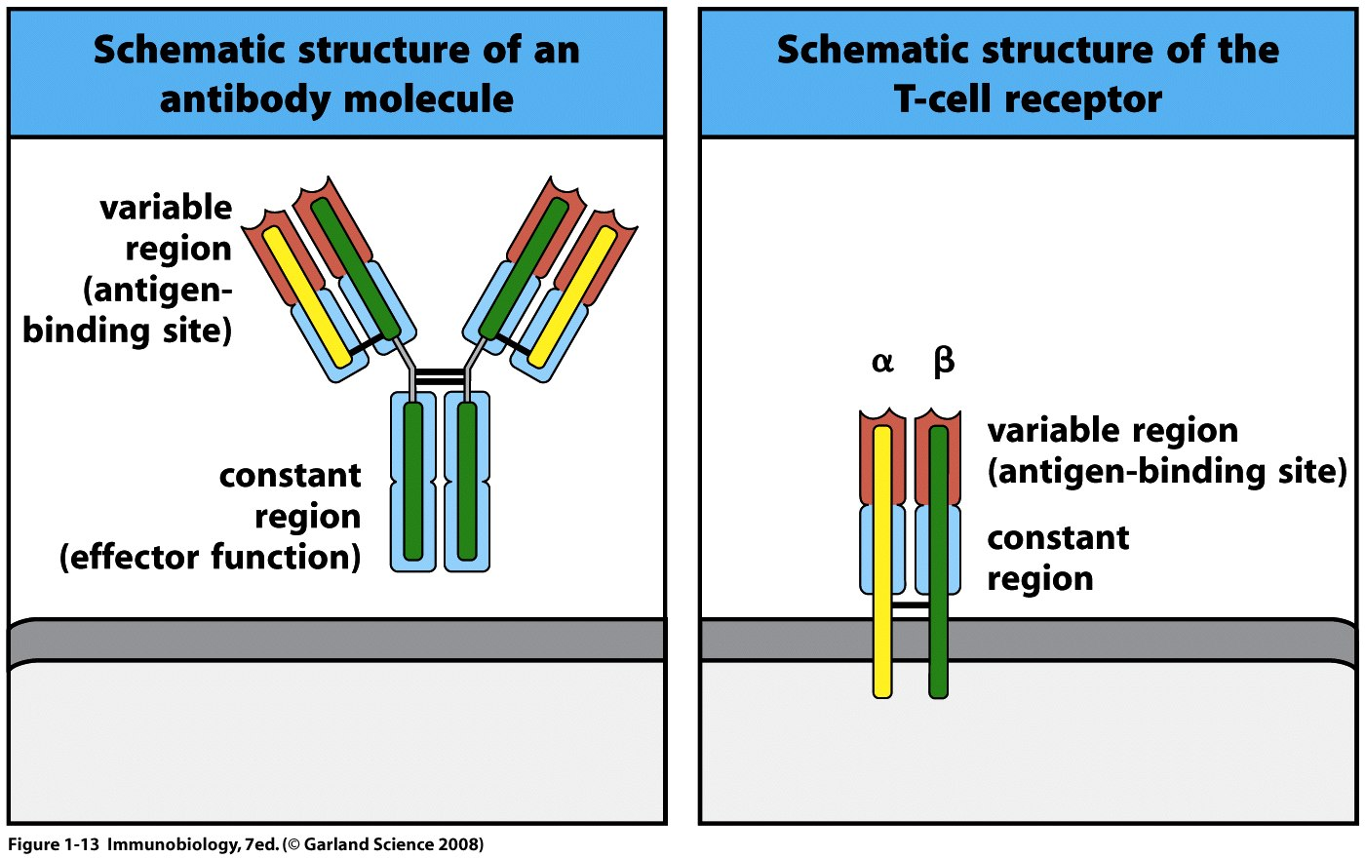
The diversity of B-cell receptors (secreted as antibodies) and T-cell receptors
is responsible for antigen specificity in adaptive immune responses
Or γ δ
Notes:
From: Murphy et al., Janeway’s Immunobiology, 9th Ed. 2017, Garland Press.
The structure of the antigen-binding domains and constant regions of antibodies/BcRs and TcRs are homologous, based on the ”immunoglobulin fold”

Slide 14
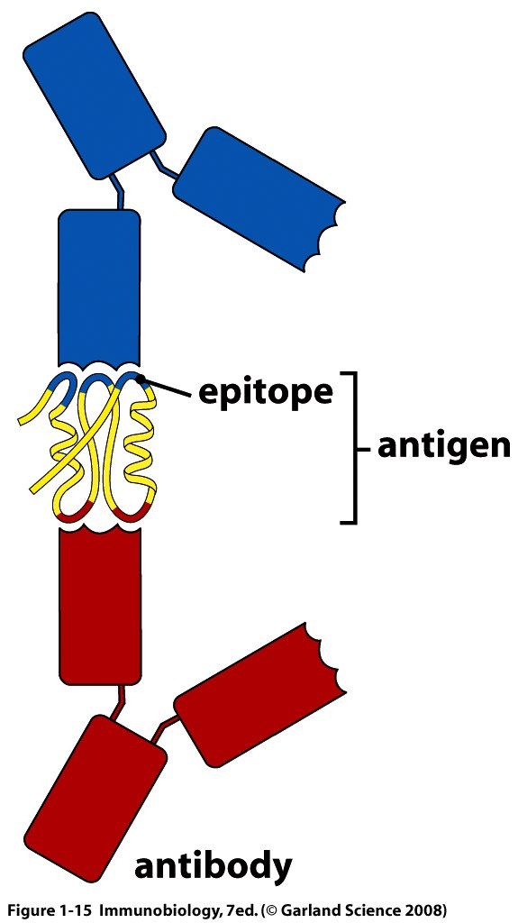
Diversity of antigen recognition in adaptive immunity
is a consequence of structural and chemical diversity
Diversity is concentrated in the antigen-binding site (= paratope) of antibodies and T-cell receptors.
The antibody’s paratope comprises the surface contact region with that of the antigen: the epitope.
This allows B cells and T cells to bind and respond to a huge diversity of antigens.
paratope
Notes:
From: Murphy et al., Janeway’s Immunobiology, 9th Ed. 2017, Garland Press.

Slide 15
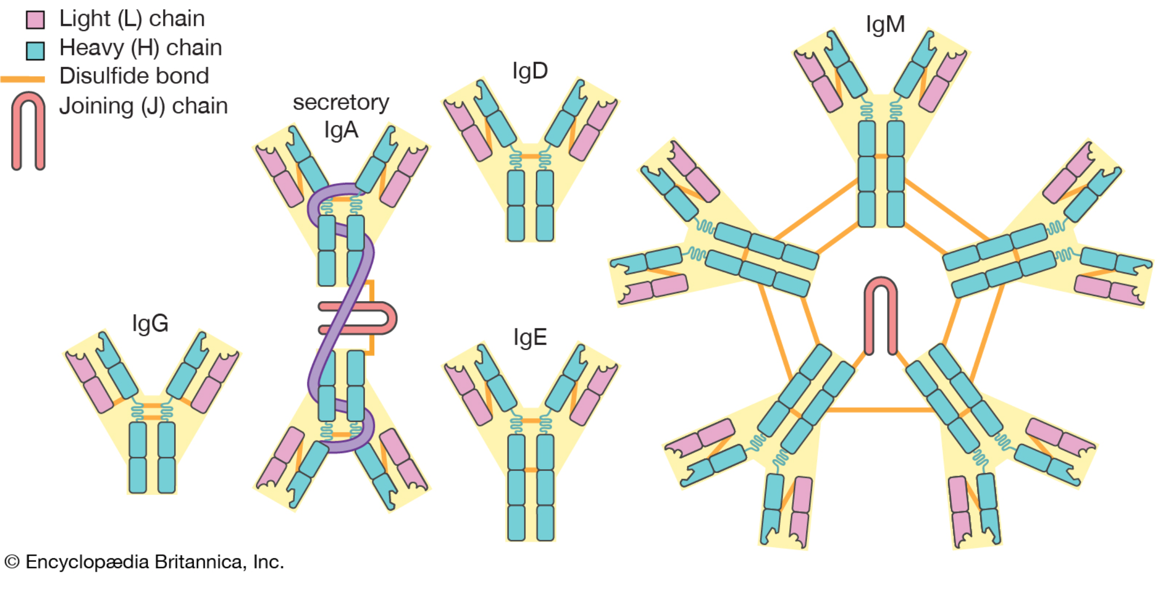
Structures of the immunoglobulin classes
Notes:
In humans, there are 2 sub-classes of IgA (A1 and A2) and 4 sub-classes of IgG (G1-G4)
Antibody responses typically begin with IgM and then switch over to the other classes/subclasses of antibody
IgGs (mainly G1 and G2) are in the highest concentration in the circulation due to their being retained by FcRn molecules on endothelial cells lining the vasculature.

Slide 16
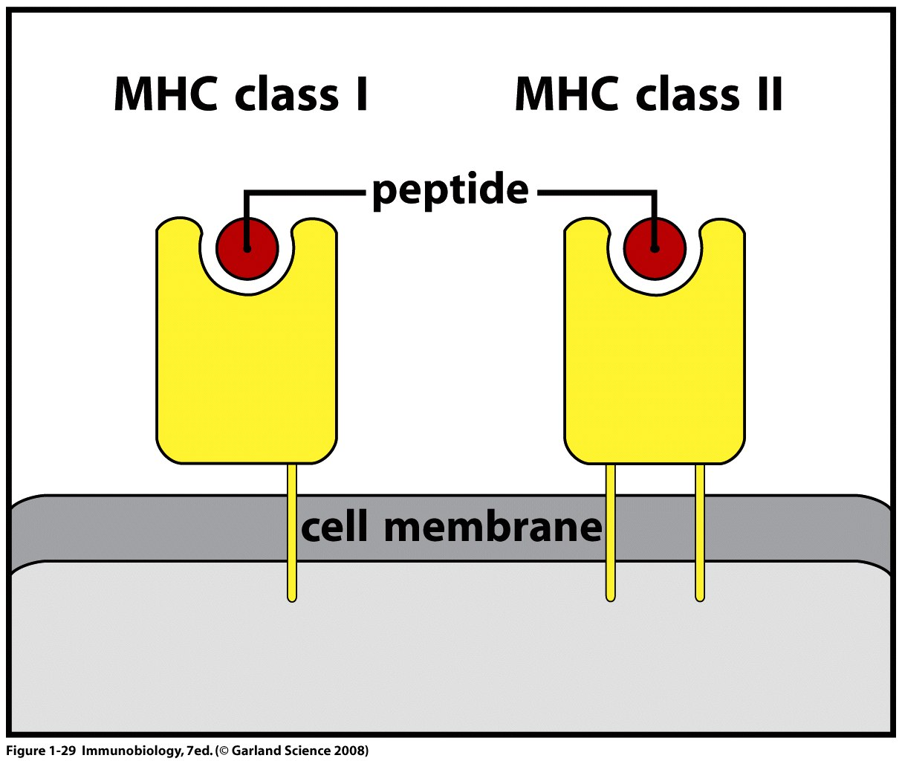
T cells recognize peptide fragments of protein antigens bound by MHC molecules
Allowing antigen presentation on a cell surface “in the context” of a MHC molecule
The peptide antigen is often, incorrectly, referred to as the “T-cell epitope”
Notes:
From: Murphy et al., Janeway’s Immunobiology, 9th Ed. 2017, Garland Press.

Slide 17
Class I MHC is on the surface of almost all cell types and mediates cell killing.
Foreign proteins are processed by the infected cell
and presented as peptide-class I MHC complexes to CD8⁺ cytotoxic T cells.
Their TcRs recognize both the antigen and the MHC molecule while CD8 ensures that the MHC molecule is Class I.
Notes:
From: Murphy et al., Janeway’s Immunobiology, 9th Ed. 2017, Garland Press.

Slide 18
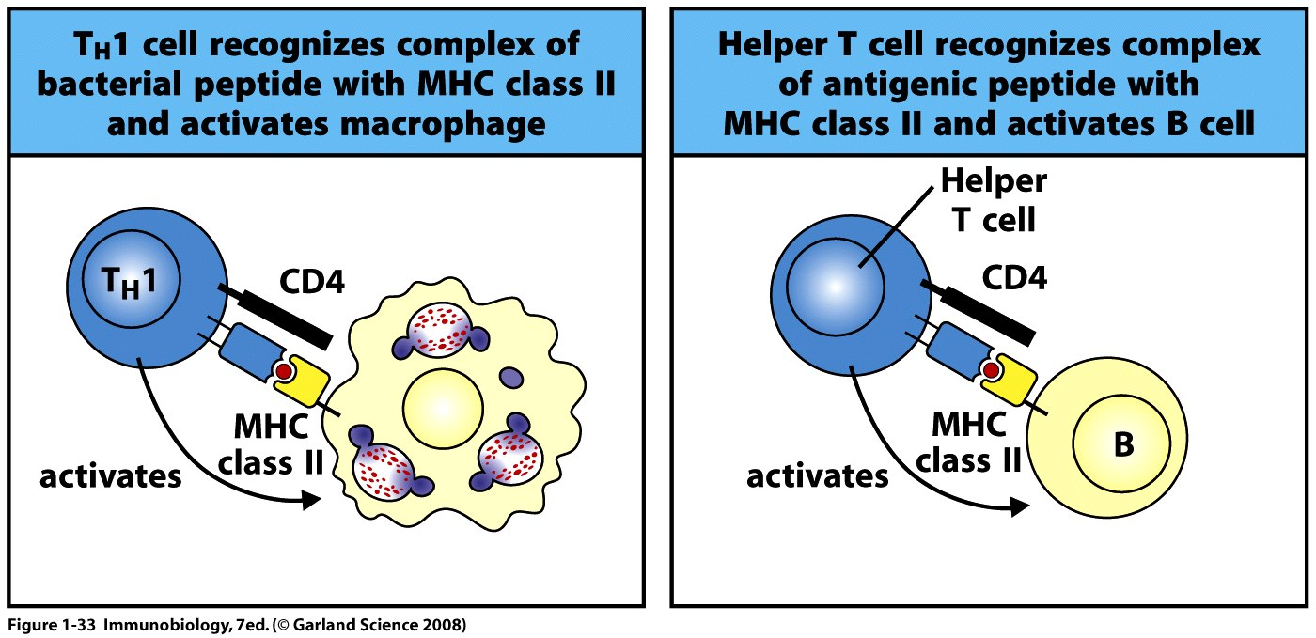
Class II MHC is produced by antigen-presenting cells
(APCs: dendritic cells, macrophages, and B cells),
DCs initiate both CD4 and CD8 T cell responses
CD4 T cells activate macrophages, and support of B-cell responses.
Infected macrophages process foreign antigen and present peptides on class II MHC to CD4+ T cells
B-cell receptors bind & internalize antigen, then process and present it to CD4+ T cells
Notes:
From: Murphy et al., Janeway’s Immunobiology, 9th Ed. 2017, Garland Press.

Slide 19
Chapter 1 Section C
Basic structure of the immune system

Slide 20
Hematopoiesis produces the effector cells of the immune system
Innate ”predecessors” of many cell types are produced during fetal development, arising in the yolk sac, or fetal liver and migrating to the tissues to become resident cells.
Examples are the macrophage-lineage Kupffer cells of the liver, the osteoclasts of the bone marrow, and oligodendrocytes of the brain, which are implanted in tissues during fetal development, and self-renew in situ.
In contrast, bone-marrow-derived monocytes are recruited to tissues to become macrophages, usually during inflammatory responses.
Begins in the bone marrow, driven by cell-cell interactions and cytokines.
Notes:
Figure 2.11. Hematopoiesis.
The development of the major lineages of blood cells is depicted in this hematopoietic tree.
The principal cytokines that drive the maturation of different lineages are described in Table 2-4.
The development of lymphocytes is described later in this chapter and in Figure 8-2.
Most dendritic cells are also derived from the same common myeloid precursor that monocytes are derived from (not shown).
Mast cells, NK cells, and other innate lymphoid cells (not shown) are also derived from committed progenitors in the bone marrow.
From: Abbas et al., Cellular and Molecular Immunology, 9th Ed. 2018, Elsevier.
From: Abbas et al., Cellular and Molecular Immunology, 9th Ed. 2018, Elsevier.

Slide 21
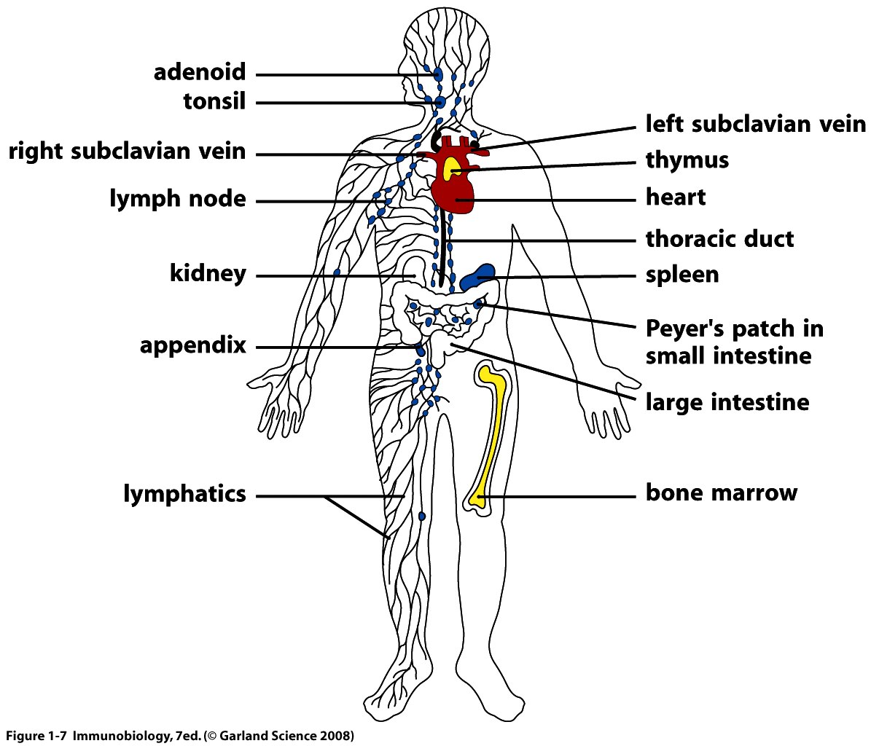
Lymphocytes develop in the bone marrow and thymus (primary lymphoid tissues).
They circulate in the cardiovascular and lymphatic systems, and migrate to
the spleen, lymph nodes, etc. (secondary LTs) in search of antigen.
Notes:
From: Murphy et al., Janeway’s Immunobiology, 9th Ed. 2017, Garland Press.

Slide 22
The lymphatic system is an integral part of the cardiovascular system
The thoracic duct drains the trunk and left side of the body above the diaphragm.
The right lymphatic duct drains the right side of the body above the diaphragm.
The cysterna chyli drains the trunk and connects into the thoracic duct.
The right ventricle of the heart “pulls” lymph from the thoracic duct into the right atrium.
Blood moves from the right ventricle to the lungs, then back to the left atrium of the heart. The left ventricle pushes blood out to the aorta and the arteries of the body.
Arteries become arterioles and finally capillaries (1 endothelial cell thick + basement membrane), gasses are exchanged here, and plasma containing nutrients leaks into the tissues.
Lymphatic vessels pick up tissue fluids, becoming lymph, which returns to the right heart via the thoracic duct.
Thus completing the cycle!
The inside of the entire cardiovascular system is lined with endothelial cells
Notes:
Figure 2.13. The lymphatic system.
The major lymphatic vessels, which drain into the inferior vena cava (and superior vena cava, not shown), and collections of lymph nodes are illustrated. Antigens are captured from a site of infection and the draining lymph node to which these antigens are transported and where the immune response is initiated.
The inside of the cardiovascular and lymphatic systems are lined with endothelial cells.
The right heart “pulls” lymph into the blood circulation via the thoracic duct (and lymphatic ducts) which drain into the inferior vena cava and/or subclavian veins.
These are the closest veins to the right atrium of the heart.
Blood is circulated from the right ventricle to the pulmonary artery, where it passes through the lungs, and becomes oxygenated at the capillaries of the alveoli.
Oxygenated blood then returns to the left atrium of the heart through the pulmonary vein; finally, the oxygenated blood is pumped to the periphery via the aorta, the main artery of the body.
Arterial blood flows from the aorta, to arteries to arterioles (all of which are enveloped in smooth muscle).
Blood then flows to the capillaries; at this stage there is one cell (the endothelial cell) and a basement membrane separating the blood from the underlying tissue.
Wherever there is tissue, there are capillaries within 50 microns! And fluid is constantly leaking out of the capillaries into the tissues (the interstitia).
The main job of the lymphatics is to take up that fluid and bring it back to the blood circulation.
On its way back to the heart, the “lymphatic fluids” percolate through lymph nodes, where large antigens (large particulate complexes & microbes) can be picked up by subcapsular macrophages; smaller soluble antigens and cytokines enter the FRC conduits and can be picked up by dendritic cells in the lymph node paracortex. Thus, antigens and cytokines, as well as lymphocytes returning to the blood, pass through the lymph nodes.
From: Abbas et al., Cellular and Molecular Immunology, 9th Ed. 2018, Elsevier.

Slide 23
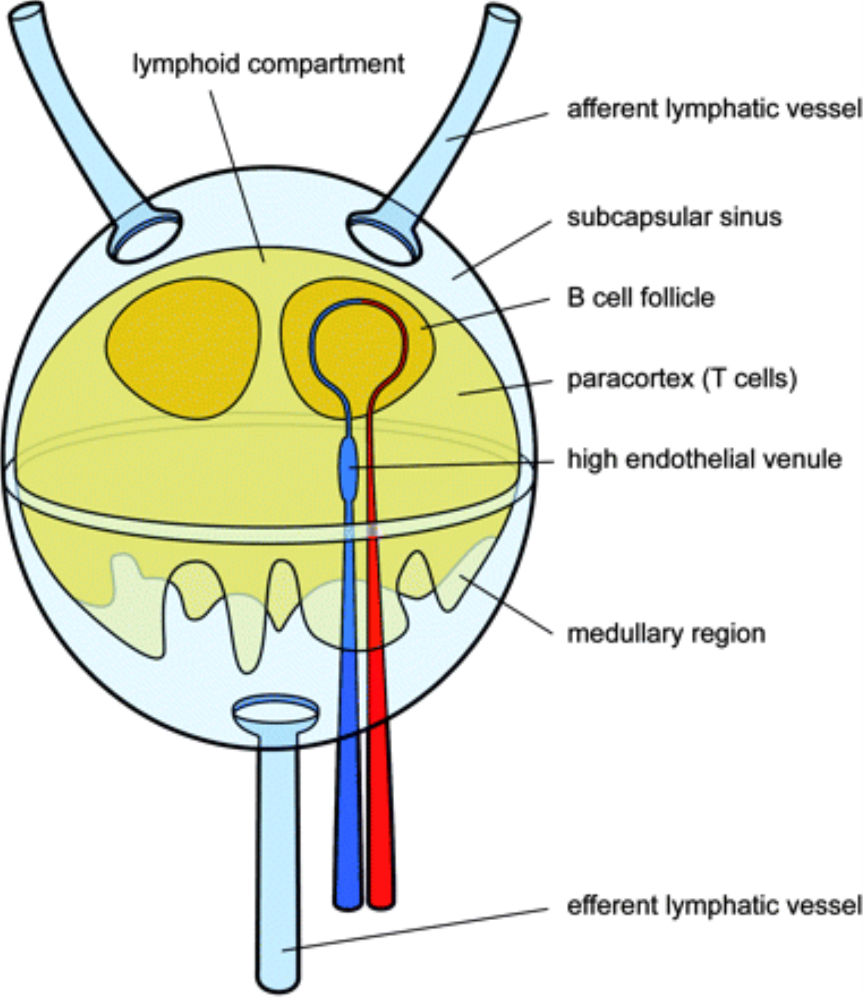
Secondary LT: Schematic view of a lymph node
Antigen, cytokines & DCs from the tissues enter with lymph
B & T cells enter the lymph node paracortex from the circulation via HEVs, and migrate to their respective areas
B & T cells exit with the lymph and enter the circulation via the thoracic duct
From: The conduit system of the lymph node
Int Immunol. 2008;20(12):1483-1487. doi:10.1093/intimm/dxn110
Int Immunol | © The Japanese Society for Immunology. 2008. All rights reserved. For permissions, please e-mail: journals.permissions@oxfordjournals.org
Notes:
Fig. 1. A highly schematic view of the lymph node structure. Incoming afferent lymphatic vessels distribute the lymph (plus dendritic cells, macrophages and some lymphocytes) into the subcapsular sinus. Most of the fluid passes around much of the lymphoid compartment to leave through the efferent lymphatic vessels. During this passage, it is filtered by macrophages that line the outer borders of the lymphoid compartment. Part of the lymph fluid enters the conduit system inside the lymphoid compartment and leaves the lymph via the blood circulation at high endothelial venules, which are also the main site of entry of lymphocytes to the lymph node.
23

Slide 24
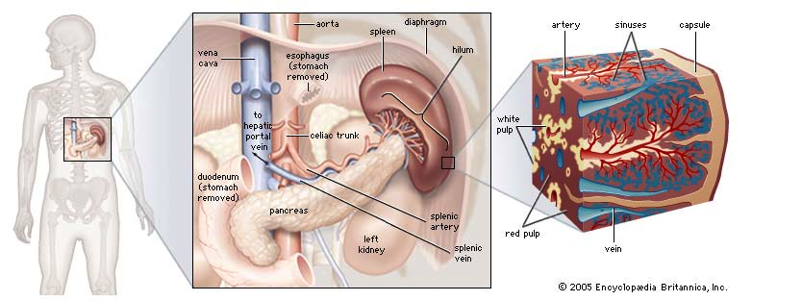
Secondary LT: The Spleen
Splenic arteries -> arterioles terminate in sinus cords -> sinusoids -> Splenic veins -> Hepatic Portal Vein
Thus arterial blood entering the splenic red pulp enters a low pressure system
The blood crosses over into the venous sinuses by crossing an endothelial barrier
White pulp = secondary lymphoid tissue, with segregated B- and T-cell zones
Red pulp = sinuses where RBCs are “cleaned” by MΘ and/or removed
NOTE: the spleen and thymus have only efferent lymphatics (leaving the tissue), not afferents (entering it)!

Slide 25
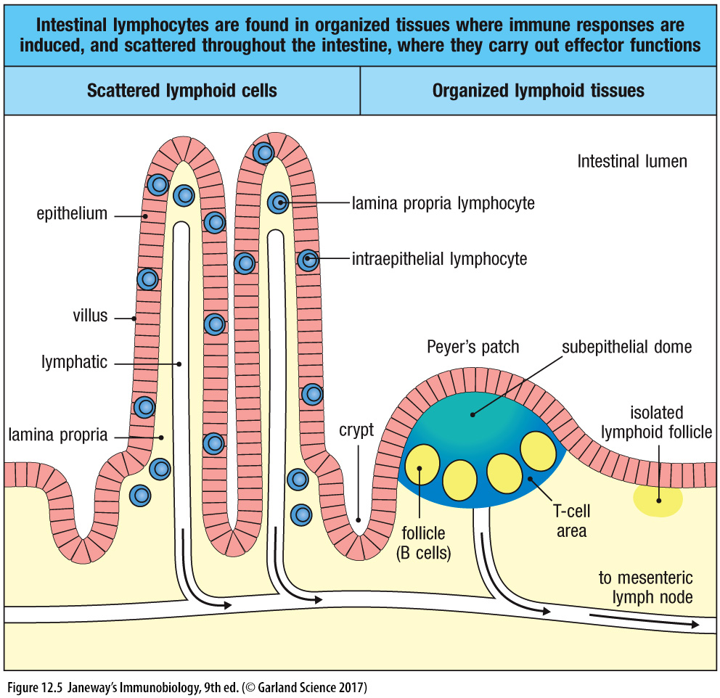
Secondary LTs: Mucosal lymphoid tissues include Peyer’s patches, isolated follicles & scattered lymphocytes in lamina propria & epithelium
IgA-secreting
plasma cells
Lymph, containing antigen, activated cells, etc. from all these sites, drains to the mesenteric LNs
Notes:
From: Murphy et al., Janeway’s Immunobiology, 9th Ed. 2017, Garland Press.

Slide 26
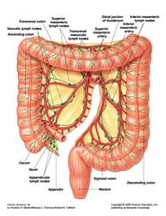
Mesenteric lymph nodes draining the large intestine
Mesenteric lymph nodes also drain the small intestine

Slide 27
Chapter 1 Section D
General timing and dynamics of immune responses

Slide 28
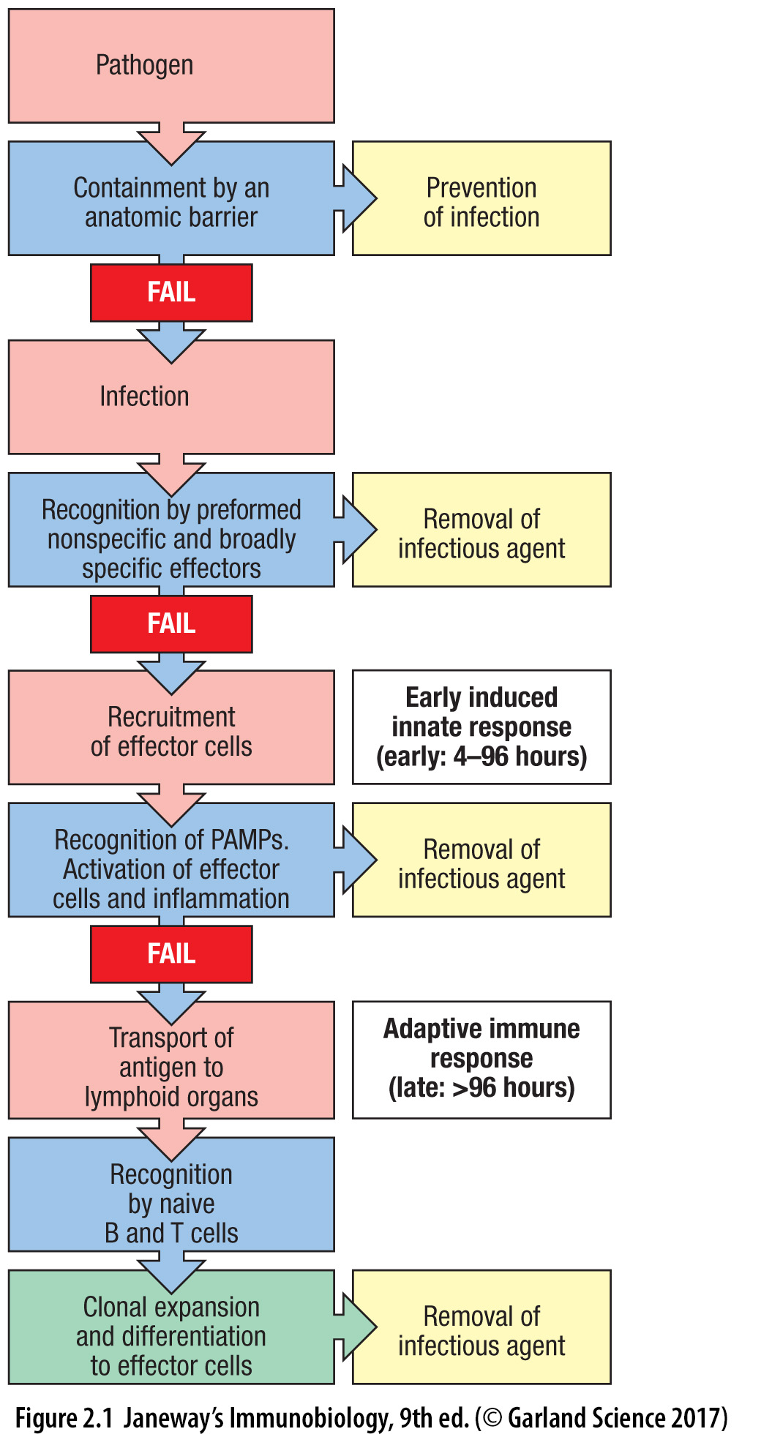
The phases of the immune response are driven by antigen persistence
Immunological memory:
A stronger, faster immune response on subsequent contact with an antigen.
Clonal expansion of memory lymphocytes.
(Antibody production by long-lived plasma cells.)
Should the infection return, there will be pre-existing memory cells and antibodies, plus the cells and molecules of the innate immune system, to clear it.
Chronic immune responses are against pathogens that can’t be cleared, self antigens, or from less specific inflammatory processes (e.g., metabolic syndrome).
Pre-existing
innate immunity
Antigen = Generator of antibodies (original meaning)
Antigen can be infectious agent (virus, bacteria, parasite), autoantigen (self), allergen or a vaccine
Notes:
From: Murphy et al., Janeway’s Immunobiology, 9th Ed. 2017, Garland Press.

Slide 29
Innate immune responses precede and shape adaptive immune responses
Cytokines
Natural
antibodies
Dendritic cells provide the bridge between innate and adaptive phases of an immune response
Notes:
Figure 1-1: Innate and adaptive immunity.
The mechanisms of innate immunity provide the initial defense against infections. Adaptive immune responses develop later and require the activation of lymphocytes. The kinetics of the innate and adaptive immune responses are approximations and may vary in different infections. ILC, innate lymphoid cell; NK, natural killer. From: Abbas et al., Cellular and Molecular Immunology, 9th Ed. 2018, Elsevier.

Slide 30
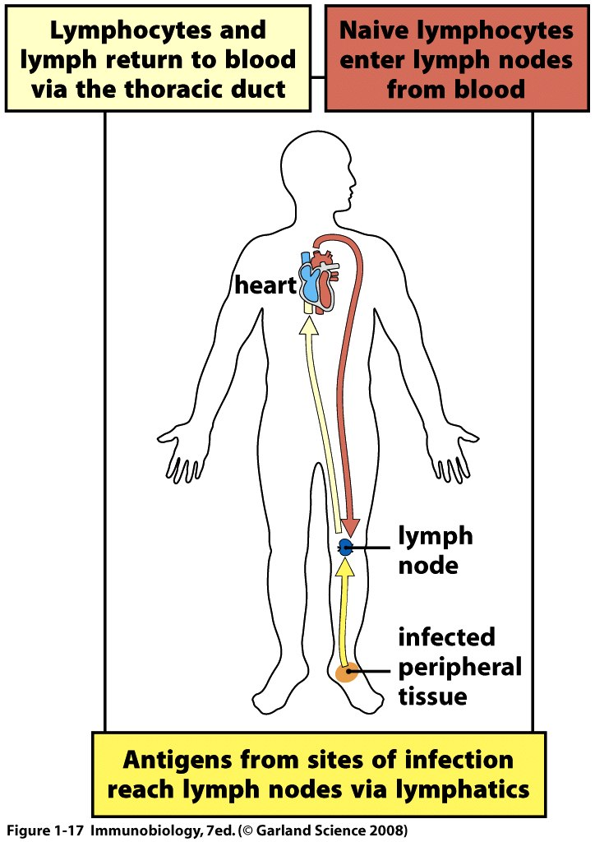
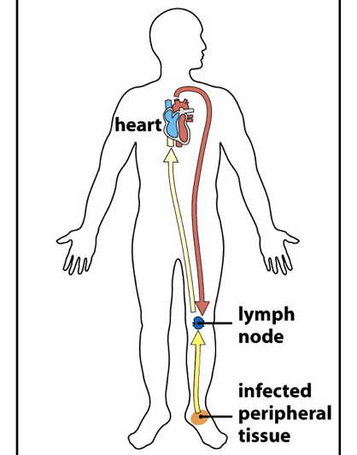
Initiation & deployment of adaptive immune responses
Activated lymphocytes leave the lymph node and enter the circulation via the thoracic duct. They home to the site of infection, where they enter to clear antigen.
X
Lymphocytes circulate through the secondary LTs, where antigens from the periphery are collected and concentrated. Activated lymphocytes are recruited to sites of infection.
Notes:
Antigens move, via the lymphatics, from the periphery to the secondary lymphoid tissues, where they are concentrated and presented to B and T lymphocytes, along with stimulation from innate immune responses.
B and T lymphocytes enter the secondary lymphoid tissues via the circulatory system, and return to the circulatory system via the lymphatics.
On binding to antigen through their surface antibody/B-cell or T-cell receptors, antigen-specific B and T lymphocytes in the secondary lymphoid tissues divide and differentiate into memory and effector cells.
Via the lymphatics, effector B and T lymphocytes re-enter the circulation and home to the sites where they perform their effector functions, along with other recruited cells (e.g., macrophages, neutrophils, NK cells, etc.).
The immune response is initiated by antigen, and ends after antigen clearance, leaving behind a pool of memory lymphocytes ready for the next encounter with antigen.
From: Murphy et al., Janeway’s Immunobiology, 9th Ed. 2017, Garland Press.

Slide 31
The Life of a Lymphocyte in a Lymphocyte Repertoire
Naïve (antigen inexperienced) repertoires of B and T cells are generated in the bone marrow and thymus, respectively, through recombination of gene segments.
Mature, naïve cells (able to respond to antigen) circulate through the secondary lymphoid tissues where, in T-cell rich areas, T cells sample “activated” antigen-presenting cells (APCs) for antigen, and where, in B-cell rich areas, B cells sample follicular dendritic cells (FDCs) for antigen.
B and T cells whose Ab or TcR binds antigen, and that receive the “right” co-stimulation, become activated (antigen selection)
Activated B and T cells divide (clonal expansion/amplification) and differentiate into effector cells and memory cells
B cells become plasma cells; their BcRs are lost and they secrete Ab, and “memory B cells” that can respond to antigen quickly and strongly. With help from follicular helper T (Tfh) cells, follicular B cells switch their Ig class, and undergo somatic mutation, and affinity maturation
CD8⁺ T cells become cytotoxic effectors and “central” memory T cells.
CD4⁺ helper T cells become activated to secrete cytokines, to activate APCs [MΘs (Th1 cells) and B cells (Tfh cells)], or to suppress immune responses (regulatory T cells, Tregs). All these cell types produce “memory T cells”.
Differentiated effector cells migrate to the tissues or secondary LTs where they will act.

Slide 32
AIRR Community Webinar Fundamentals of the Immune System Chapter 2: Lymphocyte Development
Jamie K. Scott, MD, PhD
Professor Emerita
Simon Fraser University
Thursday, 03 June 2021

Slide 33
Chapter 2
Lymphocyte development
A. Genetic basis of B-cell and T-cell receptor diversification
B. Positive and negative selection
C. B- and T-cell subsets
D. Adaptive-immune receptor repertoires (AIRRs)
1. What AIRRs are
2. How AIRRs are currently assessed via high-throughput
sequencing.

Slide 34
Clonal selection by antigen is to immunity as natural selection by the fittest is to evolution
Positive & Negative selection by self-antigens
Leaves weakly self-reactive clones that form the B- & T-cell repertoires.
Selection by foreign antigen
Lymphocytes differentiate into memory and effector cells that are “amplified” by cell division.
Notes:
Figure 1-3: The clonal selection hypothesis.
Each antigen (X) selects a preexisting clone of specific lymphocytes and stimulates the proliferation and differentiation of that clone.
The diagram shows only B lymphocytes giving rise to antibody-secreting effector cells, but the same principle applies to T lymphocytes.

Slide 35
Clonal Selection by Antigen Was Postulated in the 1950s and 1960s!!
SELECTION BY FOREIGN ANTIGEN
NEGATIVE
SELECTION
*Lymphocytes bearing receptors that weakly bind to self antigen are stimulated to survive and contribute to the ”naïve repertoire” POSITIVE SELECTION

Slide 36
Chapter 2, Section A
Genetic basis of B-cell and T-cell receptor diversification

Slide 37
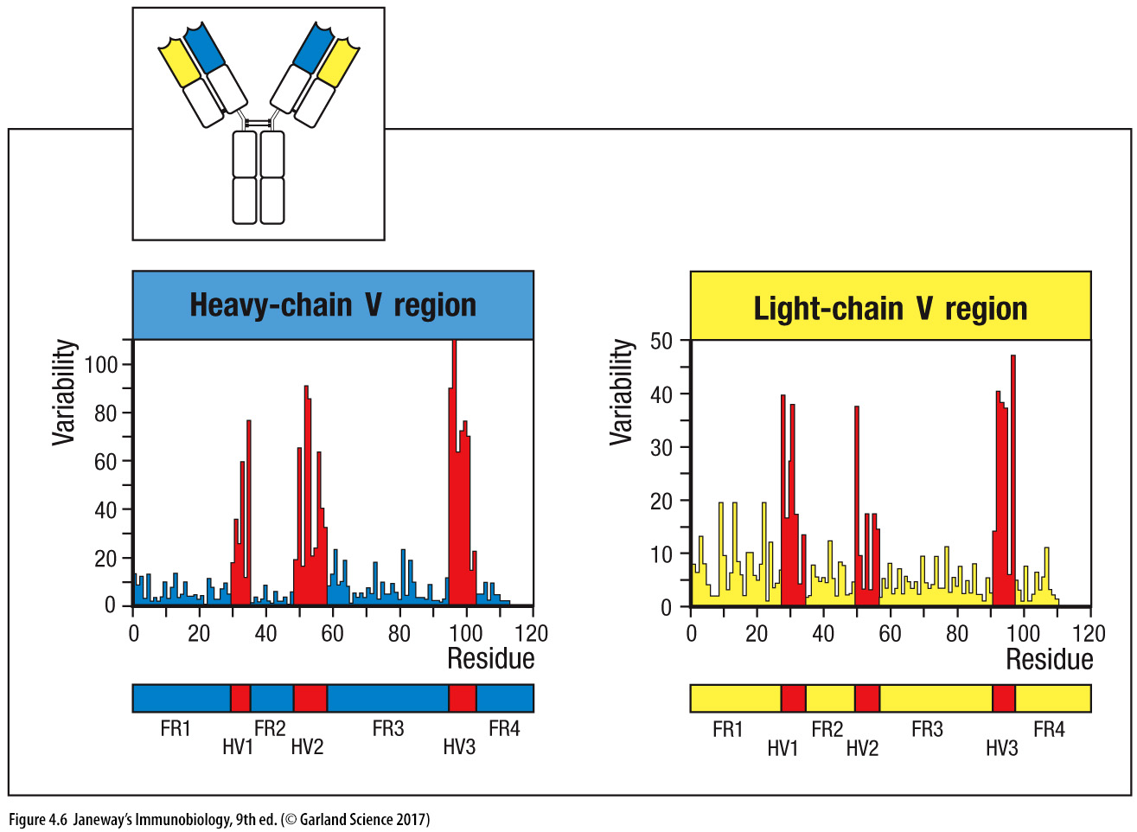
Sequence diversity in antibody V domains is concentrated
in 3 complementarity-determining regions (CDRs)
Encoded by germline: V gene |D| J gene V gene | J gene
Each VH and VL domain is encoded by germline V (D) and J gene segments
that have recombined to form a “productively rearranged” or “functional” V gene

Slide 38
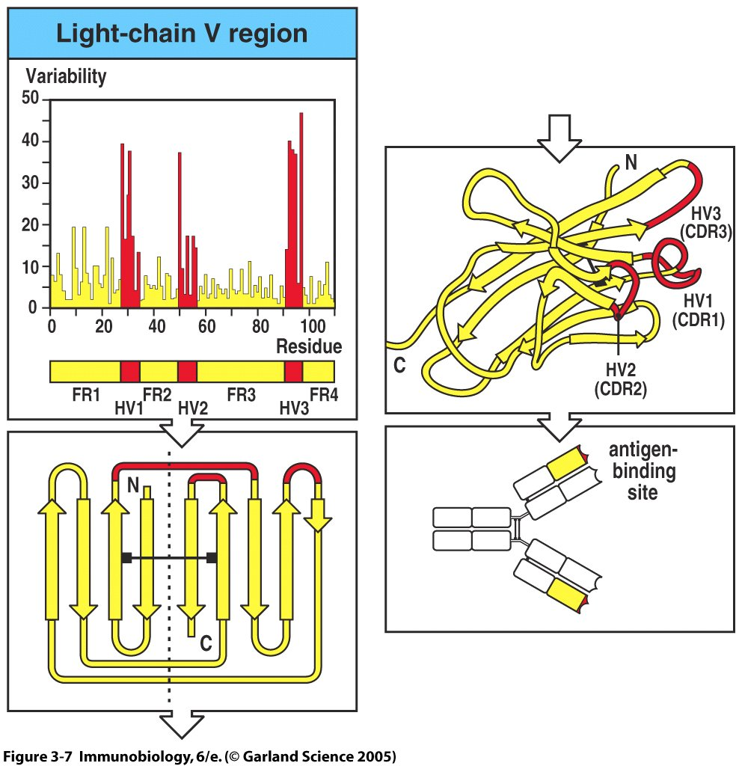
CDRs are located at turns at one end of the beta-pleated sheet sandwich that forms a V domain.
CDR1
CDR2
CDR3
The CDRs of VH and VL domains together form the antibody-combining site
(the antigen-binding site or paratope of an antibody is defined by its contacts with antigen, i.e., the epitope)

Slide 39
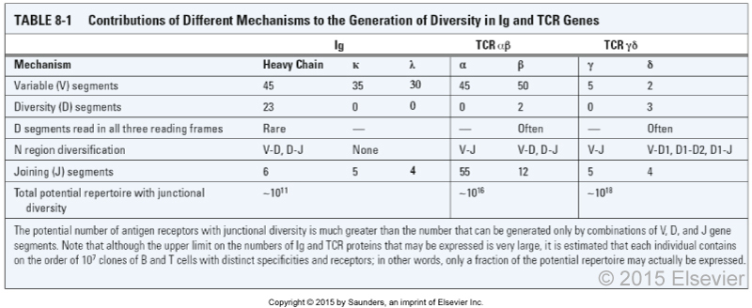
There are 3 IG loci and 4 TcR loci; they all have the same general layout:
Multiple V (D) and J gene segments, single/a few constant-region gene segments, which are fused together by an intra-chromosomal recombination mechanism, forming a single, functional gene that expresses one of the two chains of a BcR or TcR
Notes:
Table 08-01. Contributions of Different Mechanisms to the Generation of Diversity in Ig and TCR Genes
Abbas et al., Cellular and Molecular Immunology, 9th Ed. 2018, Elsevier.

Slide 40
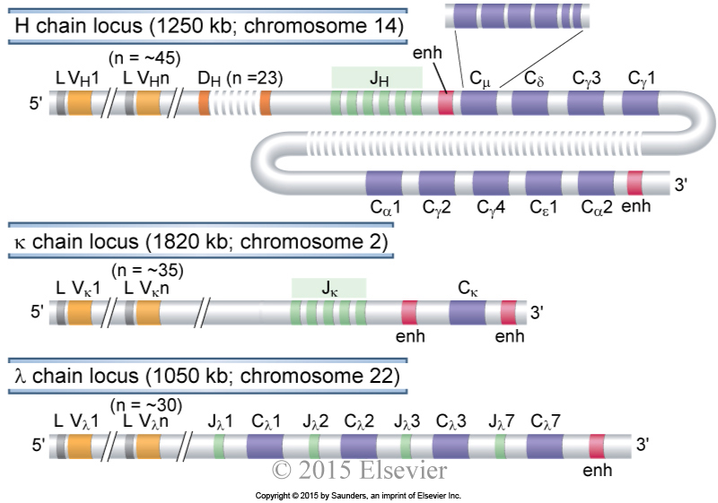
Germline organization of human Ig loci
All leader exons (L) in the Igh, Igκ and Igλ loci have 5’ promoters (P).
The P has only been added to the first chromosomal example here, but it applies to all L exons.
This principle also holds for the TcR loci.
P
P
The IgH locus rearranges first, with 2 chances to produce a functional H chain and a ~55% success rate (1/3 + (2/3 x 1/3)). Light chain loci (κ & λ) rearrange later with multiple chances to produce a functional L chain, including chances to escape deletion caused by self-reactive BCRs (receptor editing)
Notes:
Germline organization of human Ig loci.
The human heavy chain, κ light chain, and λ light chain loci are shown.
Only functional genes are shown; pseudogenes have been omitted for simplicity.
Exons and introns are not drawn to scale.
Each C_{H} gene is shown as a single box but is composed of several exons, as illustrated for C_{µ}.
Gene segments are indicated as follows: L, leader (often called signal sequence); V, variable; D, diversity; J, joining; C, constant; enh, enhancer.
In this and in subsequent figures the tubular structures depict double stranded segments of chromosomes with the 5’ and 3’ ends referring to the coding strands.
Abbas et al., Cellular and Molecular Immunology, 9th Ed. 2018, Elsevier.

Slide 41
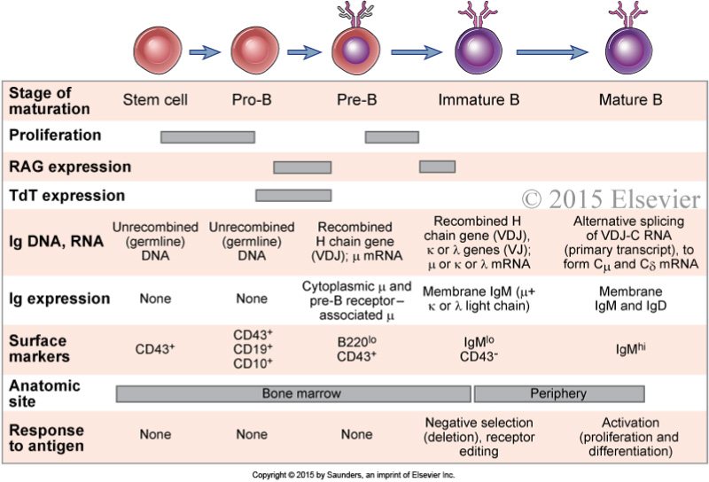
Stages of B cell development
CLP->Pre-pro
CLP= common lymphoid
precursor
PrePro= precursor of
progenitors
Pro = progenitor
Pre = precursor
IgD
Notes:
Figure 8.12: Stages of B cell maturation.
Events corresponding to each stage of B cell maturation from a bone marrow stem cell to a mature B lymphocyte are illustrated.
Several surface markers in addition to those shown have been used to define distinct stages of B cell maturation.
Abbas et al., Cellular and Molecular Immunology, 9th Ed. 2018, Elsevier.

Slide 42
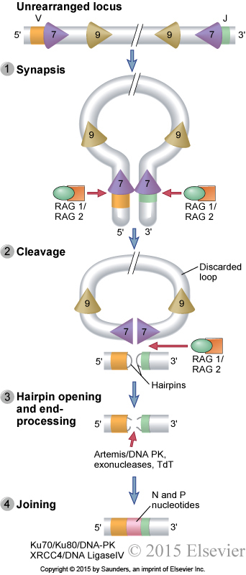
Sequential events during V(D)J recombination
Non-coding recombination signal sequences are located at the 3’ end of V gene segments, on either side of D gene segments, and at the 5’ end of J gene segments.
They are used to align gene segments during recombination.
KRECs – κ locus recombination circles in B cells and
TRECs – α locus recombination circles in T cells
Persist but do not divide when the cell divides; their frequency reflects the number of cell divisions post-recombination.
Cleaved ends ligate to form hairpins***
“Imprecise joining” starts with an imprecise site of cleavage by Artemis
“N” and “P” nucleotides can be added at the junctions.
Notes:
Sequential events during V(D)J recombination.
Synapsis and cleavage of DNA at the heptamer/coding segment boundary are mediated by Rag-1 and Rag-2.
The coding end hairpin is opened by the Artemis endonuclease, and broken ends are repaired by the non-homologous end joining machinery present in all cells.
Note that the two strands of DNA are shown in the hairpins but not in other schematic illustrations of genes.
Abbas et al., Cellular and Molecular Immunology, 9th Ed. 2018, Elsevier.

Slide 43
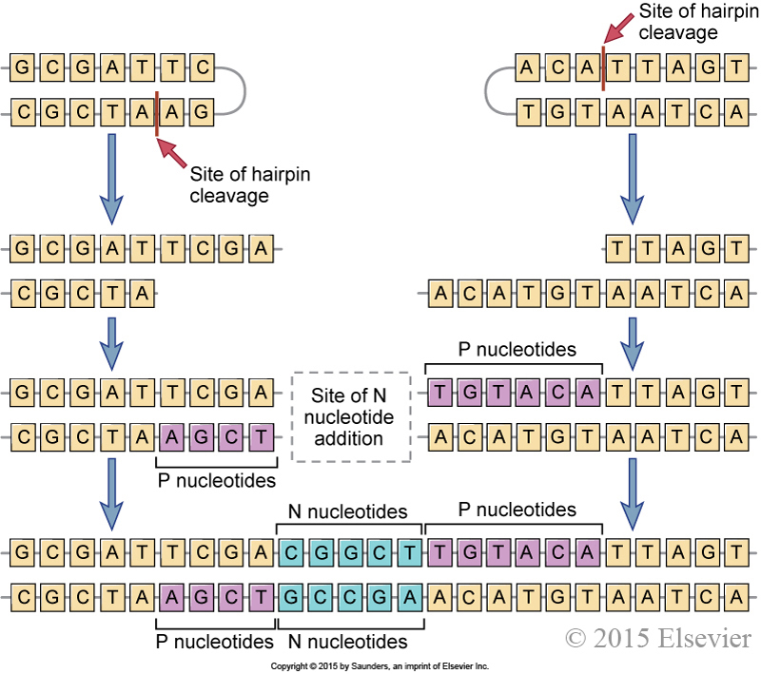
Diversification at V(D)J junctions
by Artemis
3’ end of a V or D
gene segment
5’ end of a D or J gene segment
Exonuclease can also
“chew back” the 3’ ends to delete the 3’ end of the germline V gene segment.
“Palindromic” (P) nucleotides are added to fill in free single strands. They are templated by the complementary strand.
”Non-templated” (N) nucleotides are added to free ends by terminal deoxynucleotidyl transferase (TdT)
Repair mechanisms ligate the ends back together.
by Artemis
Palindromic (P) nucleotides can be deduced from knowing the sequence of the 3’ end of the germline V gene segment.
Non-templated (N) nucleotides can be deduced from the lack of alignment with a germline V gene segment.
Notes:
Junctional diversity.
During the joining of different gene segments, addition or removal of nucleotides may lead to the generation of novel nucleotide and amino acid sequences at the junction. Nucleotides (P sequences) may be added to asymmetrically cleaved hairpins in a templated manner.
Other nucleotides (N regions) may be added to the sites of V-D, V-J, or D-J junctions in a non-templated manner by the action of the enzyme TdT.
These additions generate new sequences that are not present in the germline.
Abbas et al., Cellular and Molecular Immunology, 9th Ed. 2018, Elsevier.

Slide 44
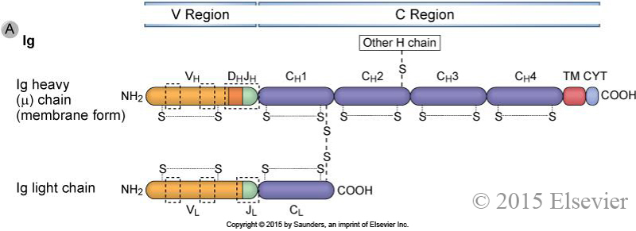
Domains of Ig and TCR proteins
(NOT REGIONS)
V Domain
C Domains/Domain
The secreted forms of Ig heavy chains have at the C-terminus, a secretory domain instead of TM and CYT domains.
TcRs are secreted! never
Notes:
Domains of Ig and TCR proteins.
The domains of Ig heavy and light chains are shown in A, and the domains of TCR α and β chains are shown in B.
The relationships between the Ig and TCR gene segments and the domain structure of the antigen receptor polypeptide chains are indicated.
The V and C regions of each polypeptide are encoded by different gene segments.
The locations of intrachain and interchain disulfide bonds (S-S) are approximate.
Areas in the dashed boxes are the hypervariable (complementarity-determining) regions (CDRs).
The CDR3 sequence is the most variable and typically contributes the most to antigen contact and binding affinity.
In the Ig heavy chains and the TCR alpha. Βετα, γαμμα and δελτα chains, transmembrane (TM) and cytoplasmic (CYT) domains are encoded by separate exons.
Abbas et al., Cellular and Molecular Immunology, 9th Ed. 2018, Elsevier.

Slide 45
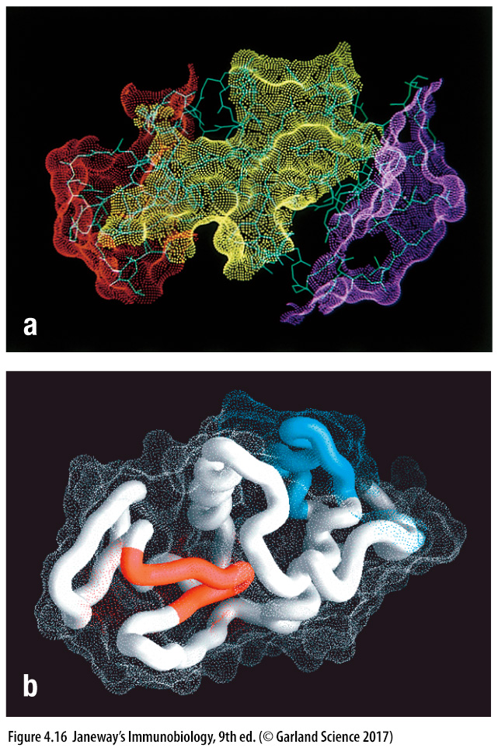
Antibody and T-cell epitopes on hen eggwhite lyzozyme (HEL)
Epitopes for 3 anti-HEL monoclonal antibodies (MAbs) are exclusively on the surface of HEL
T-cell epitopes inside (red) and on the surface (blue) of the folded
HEL structure.

Slide 46
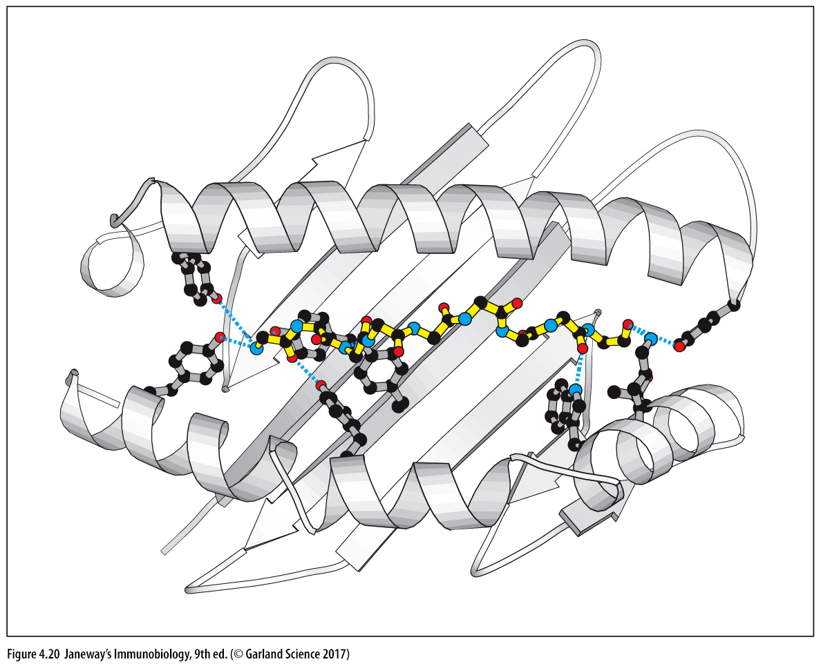
Epitope-peptides for T cells bind to class I MHC
via anchor residues and N- and C-termini

Slide 47
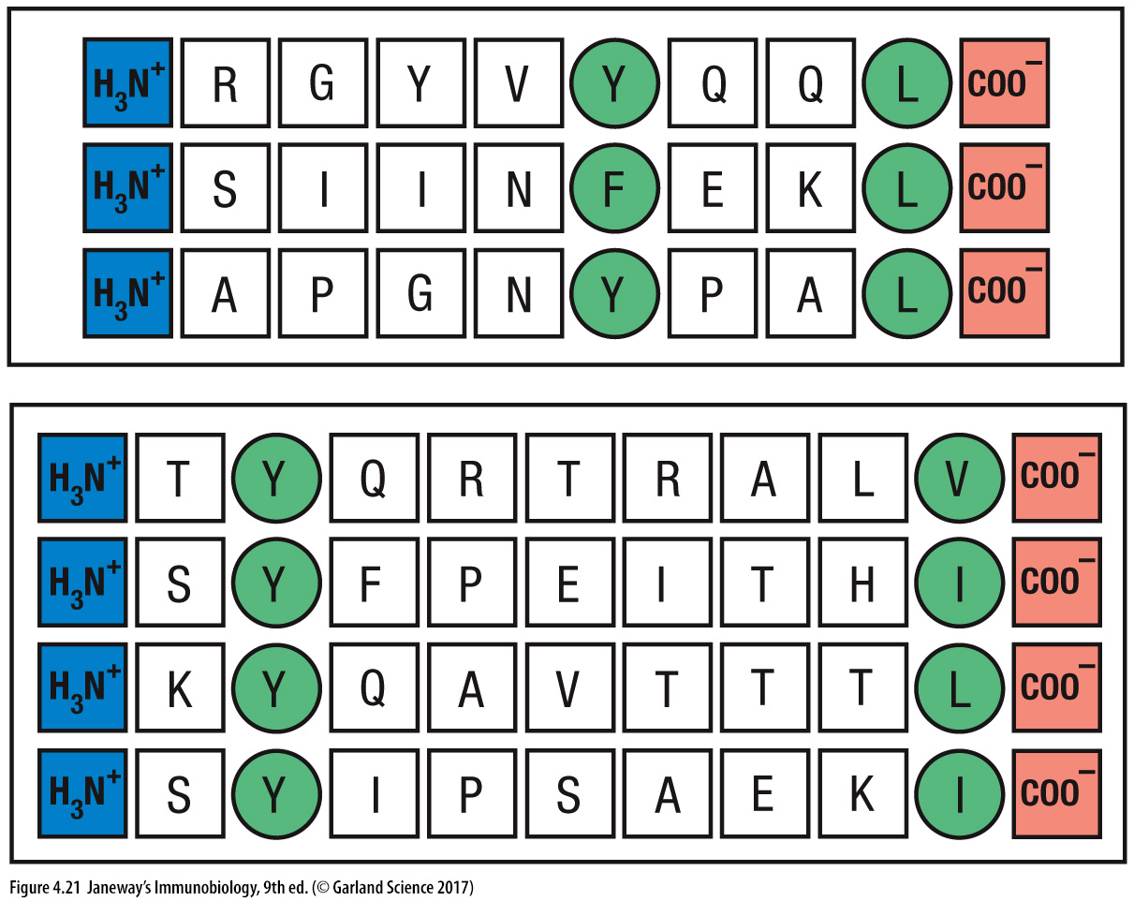
Anchor residues differ for two different class I MHC molecules

Slide 48
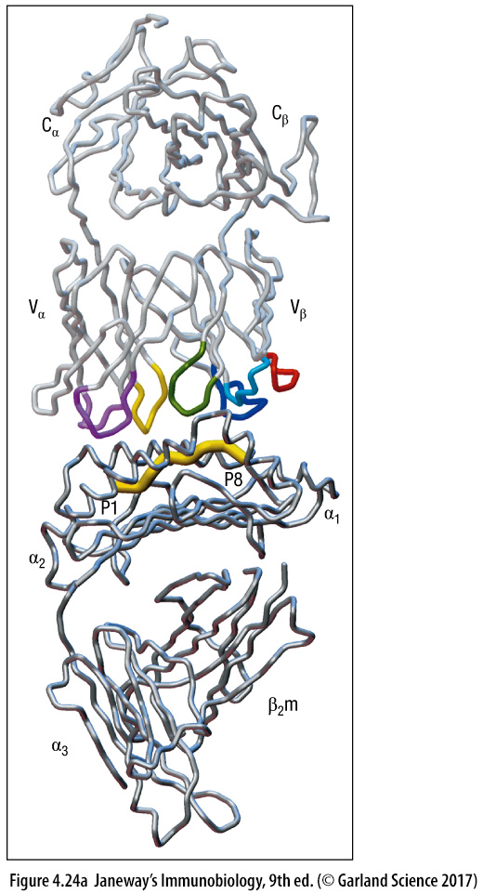
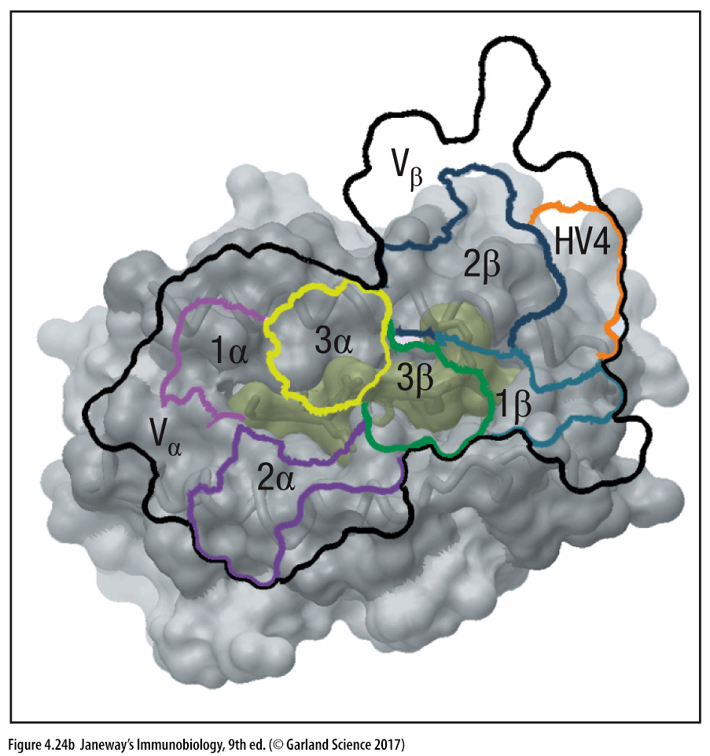
T-cell receptor CDRs contact most of the surface of class I MHC-peptide complexes

Slide 49
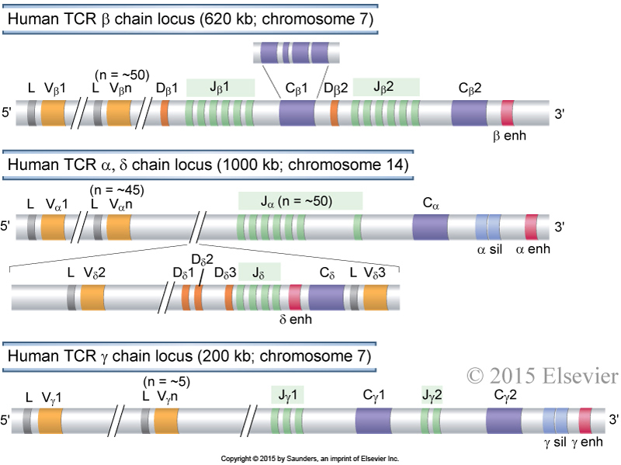
Germline organization of human TCR loci: TCR α, TCR β(δ) and TCR γ
P
P
All TcRβ, Tcrα, TcRγ and TcRδ loci have promoters (P) 5’ to each leader (L) exon
P has only been added before the leader exon (L) in the top chromosomal example, but it applies to all examples of L exons here.
P
P
P
P
P
P
Notes:
Germline organization of human TCR loci.
The human TCR β, α, γ, and δ chain loci are shown, as indicated.
Exons and introns are not drawn to scale, and nonfunctional pseudogenes are not shown.
Each C gene is shown as a single box but is composed of several exons, as illustrated for C_{β}1.
Gene segments are indicated as follows: L, leader (usually called signal sequence); V, variable; D,diversity; J, joining; C, constant; enh, enhancer; sil, silencer (sequences that regulate TCR gene transcription).
Abbas et al., Cellular and Molecular Immunology, 9th Ed. 2018, Elsevier.

Slide 50
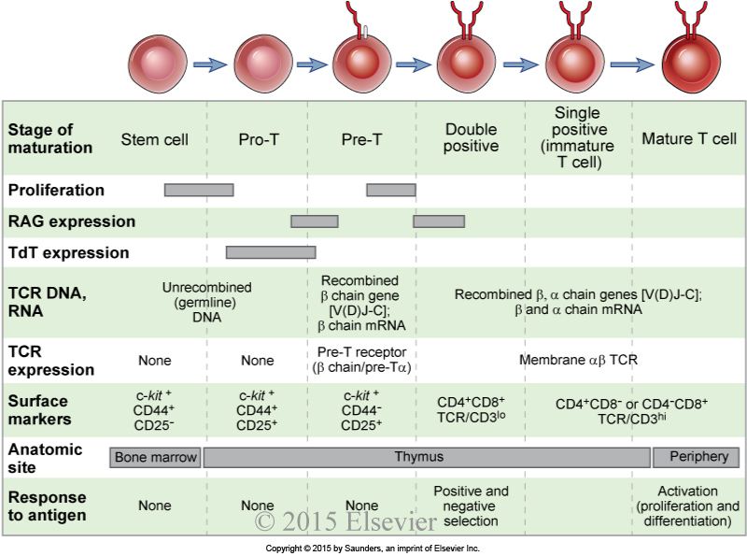
Stages of T-cell maturation are analogous to those of B cells
*
*
*
*
*Pro-T = progenitor T cell; Pre-T = precursor T cell
*
Double positive = expresses both CD4 and CD8; Single positive = expresses CD4 OR CD8
Notes:
Stages of T cell maturation.
Events corresponding to each stage of T cell maturation from a bone marrow stem cell to a mature T lymphocyte are illustrated.
Several surface markers in addition to those shown have been used to define distinct stages of T cell maturation.
Abbas et al., Cellular and Molecular Immunology, 9th Ed. 2018, Elsevier.

Slide 51
Chapter 2, Section B
Positive and negative selection

Slide 52
Central and peripheral tolerance to self antigens.
Positive selection = strong or weak binding to self antigen leads to clonal survival
Negative selection = strong binding to self antigen leads to clonal death
Negative selection creates tolerance (of self) by deleting or anergizing strong-binding self-reactive clones.
In the periphery, positive selection keeps clones alive by weak signaling through the BcR or TcR, while negative selection deletes strongly self-reactive clones.
Notes:
Figure 15.1: Central and peripheral tolerance to self antigens.
Abbas et al., Cellular and Molecular Immunology, 9th Ed. 2018, Elsevier.

Slide 53
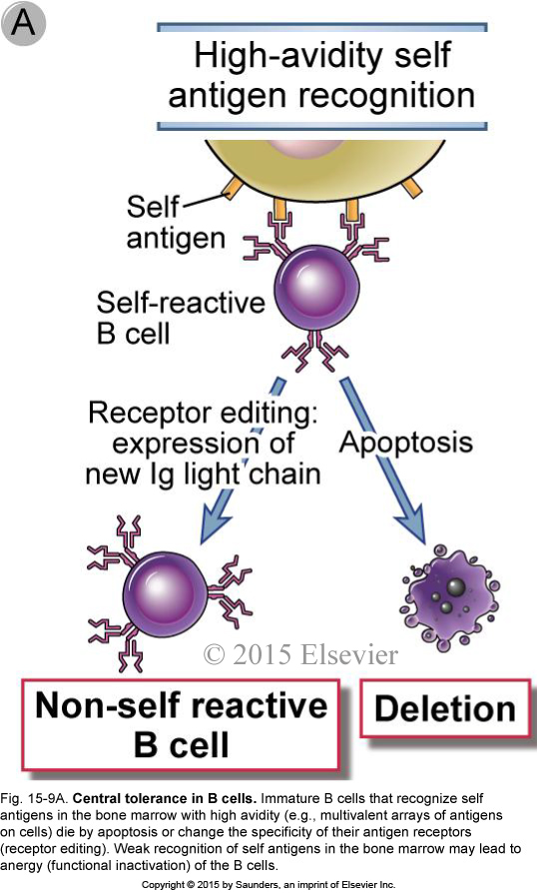
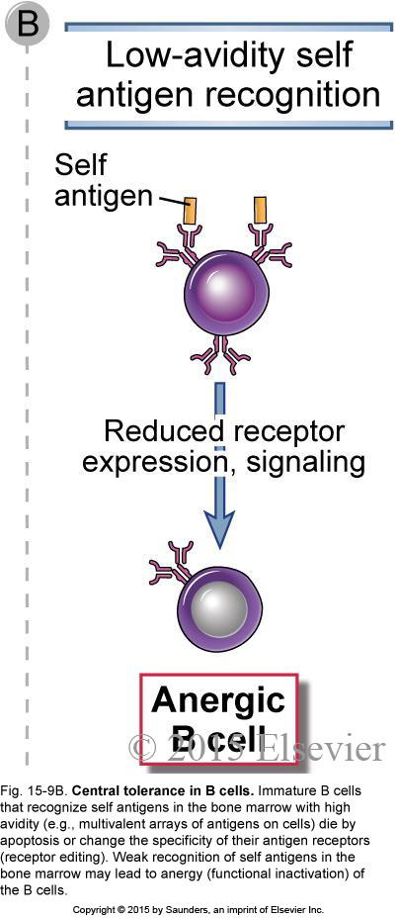
Negative selection on B cells in the bone marrow
Notes:
Central tolerance in B cells
Immature B cells that recognize self antigens in the bone marrow with high avidity (e.g., multivalent arrays of antigens on cells) die by apoptosis or change the specificity of their antigen receptors (receptor editing).
Weak recognition of self antigens in the bone marrow may lead to anergy (functional inactivation) of the B cells.
Abbas et al., Cellular and Molecular Immunology, 9th Ed. 2018, Elsevier.

Slide 54
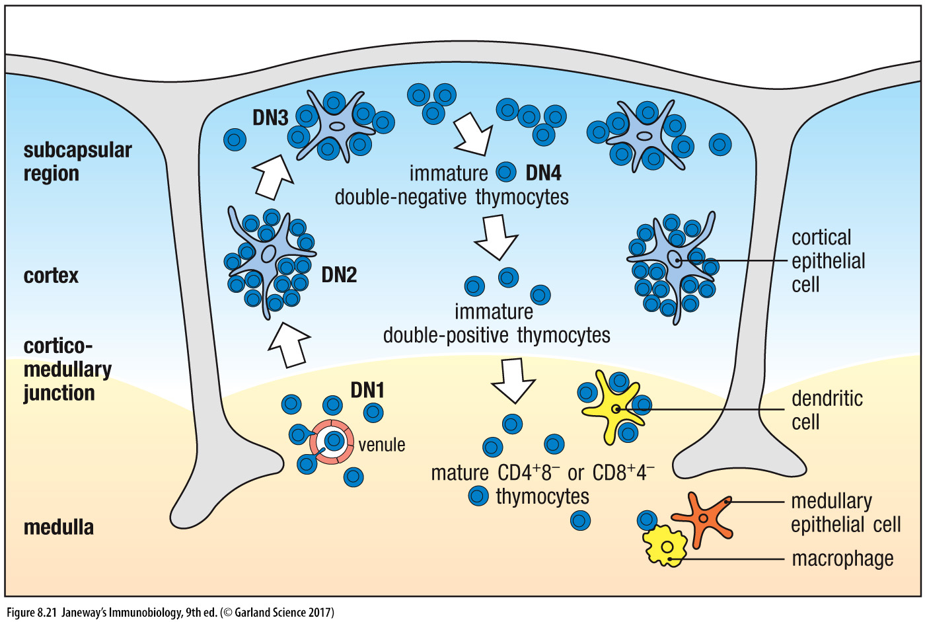
T-cell differentiation follows a pathway through the thymus
DP cells undergo positive selection on class I and II MHC on thymic cortical epithelial cells.
Then, negative selection on medullary epithelial cells, DCs and macrophages.

Slide 55
Chapter 2, Section C
B-cell and T-cell subsets

Slide 56
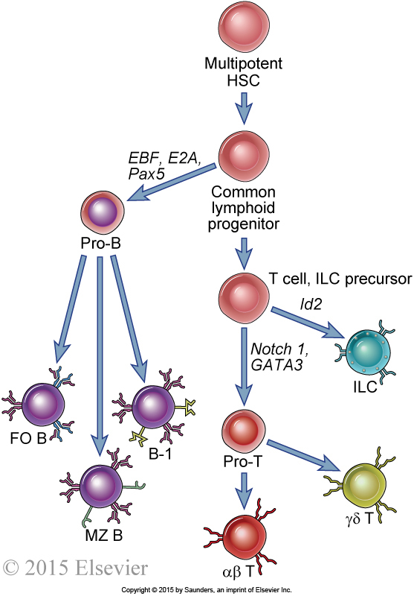
Pluripotent stem cells give rise to distinct B- and T-cell lineages
some NK cells plus NK-T cells
Th1
Th2
Th17
Tfh
Tfr
Treg
CD8 cytotoxic T cells
(bind class I MHC)
CD4 helper T cells
(bind class II MHC)
Notes:
Pluripotent stem cells give rise to distinct B and T lineages.
Hematopoietic stem cells (HSCs) give rise to distinct progenitors for various types of blood cells.
One of these progenitor populations (shown here) is called a common lymphoid progenitor (CLP).
CLPs give rise mainly to B and T cells but may also contribute to NK cells and some dendritic cells (not depicted here).
Pro-B cells can eventually differentiate into follicular (FO) B cells, marginal zone (MZ) B cells, and “innate-like” B-1 cells (which are from a separate lineage and also arise in fetal life).
Pro-T cells in the thymus may commit to either the αβ lineage or the “innate-like” γδ T cell lineage (which also arises in fetal life).
The αβ lineage comprises conventional CD4 and CD8 T cells.
Commitment to different lineages is driven by various transcription factors, indicated in italics. ILC, innate lymphoid cells
Abbas et al., Cellular and Molecular Immunology, 9th Ed. 2018, Elsevier.

Slide 57
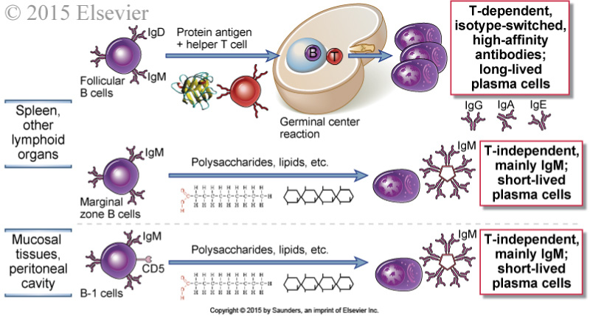
Distinct B-cell subsets mediate different types of antibody responses
Follicular (B2) B cells are attracted to the networks of follicular dendritic cells that define follicles. They produce high affinity antibodies and can have lasting memory.
MZ B cells (AKA extrafollicular B cells) are located on the outer zones surrounding follicles. They produce antibodies with intermediate affinity, and have weak memory
B1 B cells produce “natural” antibodies induced by microbial PAMPs.
T-independent antibody responses tend to involve short-lived plasma cells,
IgM (little class switching), low somatic hypermutation and little/no memory
Notes:
Distinct B cell subsets mediate different types of antibody responses.
Follicular B cells respond to protein antigens and thus initiate T-dependent antibody responses. T-independent responses to multivalent antigens are mediated mainly by marginal zone B cells in the spleen and B-1 cells in mucosal sites.
These functional distinctions between subsets are not absolute.
Abbas et al., Cellular and Molecular Immunology, 9th Ed. 2018, Elsevier.

Slide 58
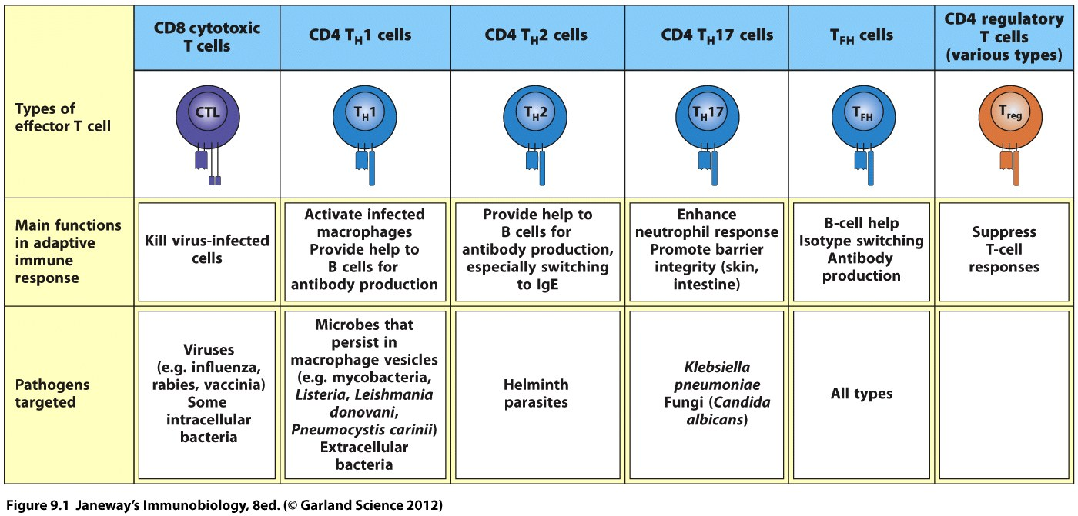
CD8 T cells and CD4 T-cell subsets and their functions

Slide 59
2.10: Change in proportion of naïve and memory T cells with age.
The immune system of people living under heavy nutritional, emotional and infectious stress can age early!
Notes:
Figure 2.10: Change in proportions of naive and memory T cells with age.
The proportions of naïve and memory T cells are based on data from multiple healthy individuals.
The estimate of thymic output is an approximation.
(Courtesy of Dr. Donna L. Farber, Columbia University College of Physicians and Surgeons, New York.)
Abbas et al., Cellular and Molecular Immunology, 9th Ed. 2018, Elsevier.

Slide 60
Chapter 2, Section D
Adaptive-immune receptor repertoires (AIRRs)

Slide 61
What is an adaptive immune receptor repertoire (AIRR)?
The collection of B-cell receptors (BcR) and/or T-cell receptors (TcR) in a population of lymphocytes.
Because each BcR heavy chain or TcR β chain has a unique combination of V gene, J gene and CDR3 sequence, it can be used to define B- and T-cell clones. More recently heavy-light or α/β or γ/δ pairings can be identified, defining B- or T-cell clones even more clearly
Thus, the behavior of clones in a population can be followed.
Some clones in a population may expand (through antigen recognition)
Some clones may develop into another cell type (e.g., a B cell becoming an antibody-secreting plasma cell), which can be detected by cell surface markers
Some clones may disseminate to other lymphoid tissues, or migrate to other peripheral tissues, and can be found by sampling multiple tissues
High-throughput, massive parallel cDNA sequencing (RNA-seq) and single-cell RNA sequencing (scRNA-seq) technologies have allowed the assessment of tens of thousands to millions of B or T cell clones simultaneously.

Slide 62
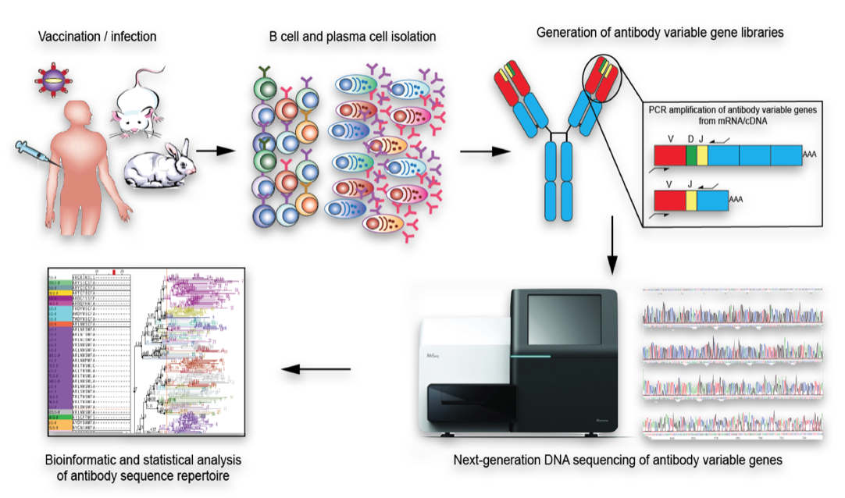
Antibody/BcR and TcR repertoires can be characterized by high throughput sequencing
from mRNA -> cDNA

Slide 63
AIRR Community Webinar Fundamentals of the Immune System Chapter 3: Clonal responses of B and T cells
Jamie K. Scott, MD, PhD
Professor Emerita
Simon Fraser University
Thursday, 03 June 2021

Slide 64
Chapter 3: Clonal Responses of T cells and B cells
Clonal responses of T-cells and B-cells
(in the context of lymphoid compartments where antigen is concentrated and presented to naïve and memory cells)
A. Signaling, activation, proliferation and differentiation of T-cells
1. CD8 cytotoxic T cells
2. CD4 helper and regulatory T cells
B. Signaling, activation, proliferation and differentiation of B-cells
1. B1, MZ/extrafollicular B cells
2. Follicular B cells
C. Role of co-stimulation in determining the type of immune
response generated (including anergy/tolerance)

Slide 65
Chapter 3, Section A
Signaling, activation, proliferation and differentiation of T-cells

Slide 66
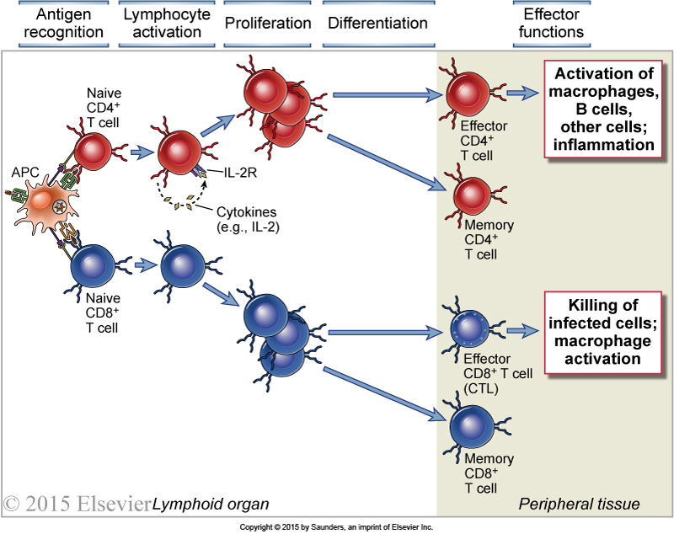
Phases of T-cell responses
Including
Tregs
Notes:
Phases of T cell responses.
Antigen recognition by T cells induces cytokine (e.g., IL-2) secretion, particularly in CD4⁺ T cells, clonal expansion as a result of cell proliferation, and differentiation of the T cells into effector cells or memory cells.
In the effector phase of the response, the effector CD4⁺T cells respond to antigen by producing cytokines that have several actions, such as the recruitment and activation of leukocytes and activation of B lymphocytes, while CD8⁺ CTLs respond by killing other cells.
Abbas et al., Cellular and Molecular Immunology, 9th Ed. 2018, Elsevier.

Slide 67
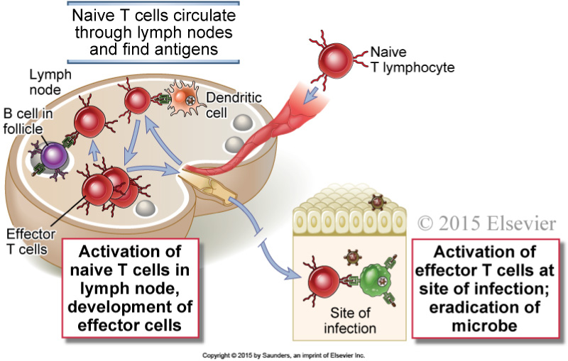
Activation of naive and effector T cells by antigen
Notes:
Activation of naive and effector T cells by antigen.
Antigens that are transported by dendritic cells to lymph nodes are recognized by naive T lymphocytes that recirculate through these lymph nodes.
The T cells are activated to differentiate into effector cells, which may remain in the lymphoid organs to help B lymphocytes or migrate to sites of infection, where the effector cells are again activated by antigens and perform their various functions, such as macrophage activation.
Abbas et al., Cellular and Molecular Immunology, 9th Ed. 2018, Elsevier.

Slide 68
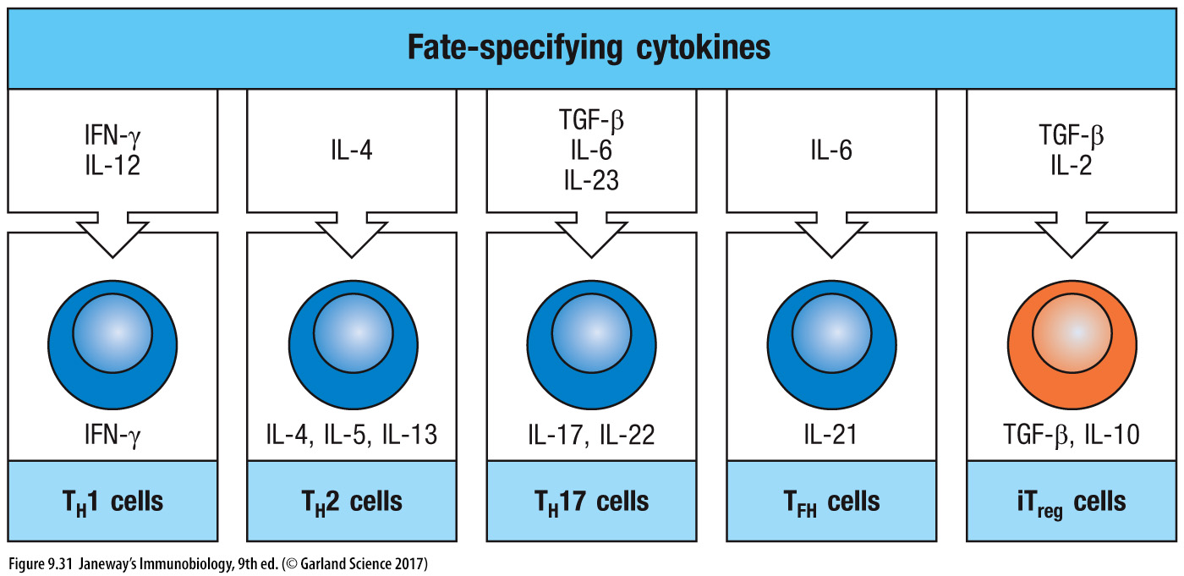
DCs & other cells deliver cytokine signals
that induce the differentiation naïve CD4 T cells into T-cell subsets
NKs
DCs
Eos
Basos
MCs
No IL12
No IL4
DC
Endoth
T & B cells
MΘ
DC
Endoth
T & B cells
MΘ

Slide 69
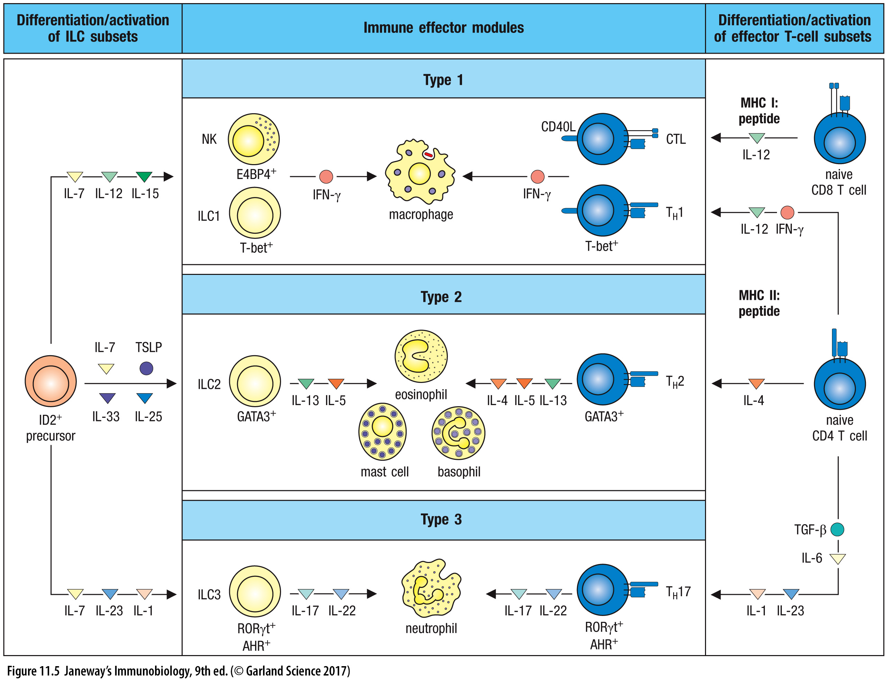
ILCs 1, 2 & 3 work with TH1, 2, 17 cells as an “immune module”, orchestrating the response to specific types of pathogens
M1 MΘ
(M1 MΘ)
mucosal
epithelia
+ M2 MΘ
(eos & basos produce IL4)
Mucosal
“barrier”
tissue
ILC1s are similar to TH1 cells; NK cells are similar to CTLs; ILC2s are similar to TH2 cells;
ILC3s are similar to TH17 cells in their function & master regulators, and in the cytokines they secrete

Slide 70
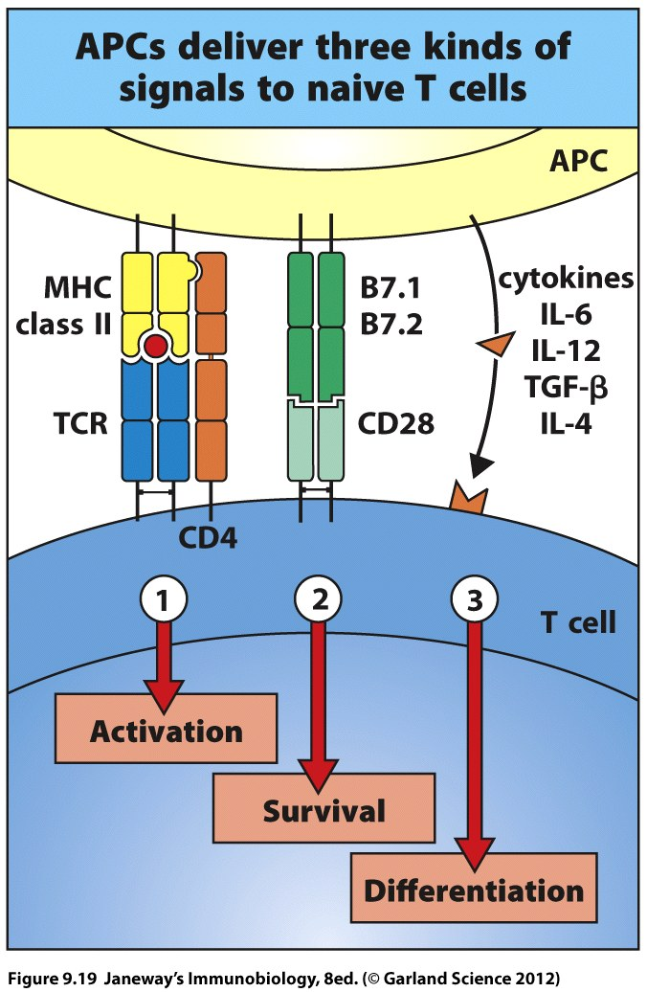
Naïve T cells respond to 3 kinds of signal types
The T cell will upregulate its CD40 ligand to further activate the APC via its CD40 receptor

Slide 71
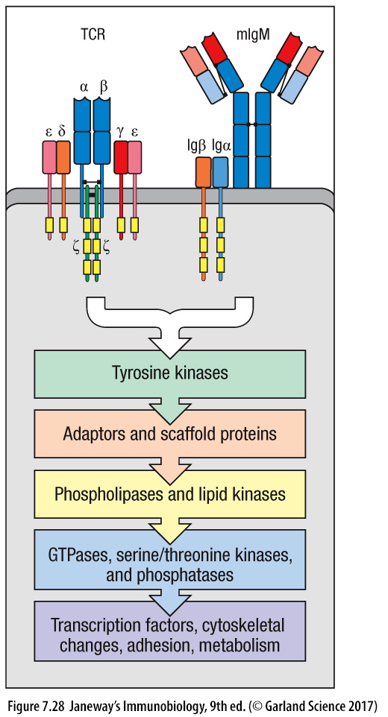
Overview of TcR and BcR signaling
CD28
CD4/8
CD19, CD21, CD81
Src-family tyrosine kinase Lck (Fyn)
Src-family tyrosine kinases Fyn, Blk, Lyn
Tyrosine kinase Zap 70-SH2
Tyrosine kinase Syk-SH2
Scaffolds LAT & SLP-76; Adaptor Gads
Scaffold SLP-65
PI3 Kinase, PLC-γ
PI3 Kinase, PLC-γ
Map kinases, PKC-q, calcineurin
Map kinases, PKC-θ, calcineurin
NFκB, AP-1 (Fos & c-Jun), NFAT
NFκB, AP-1 (Fos & c-Jun), NFAT

Slide 72
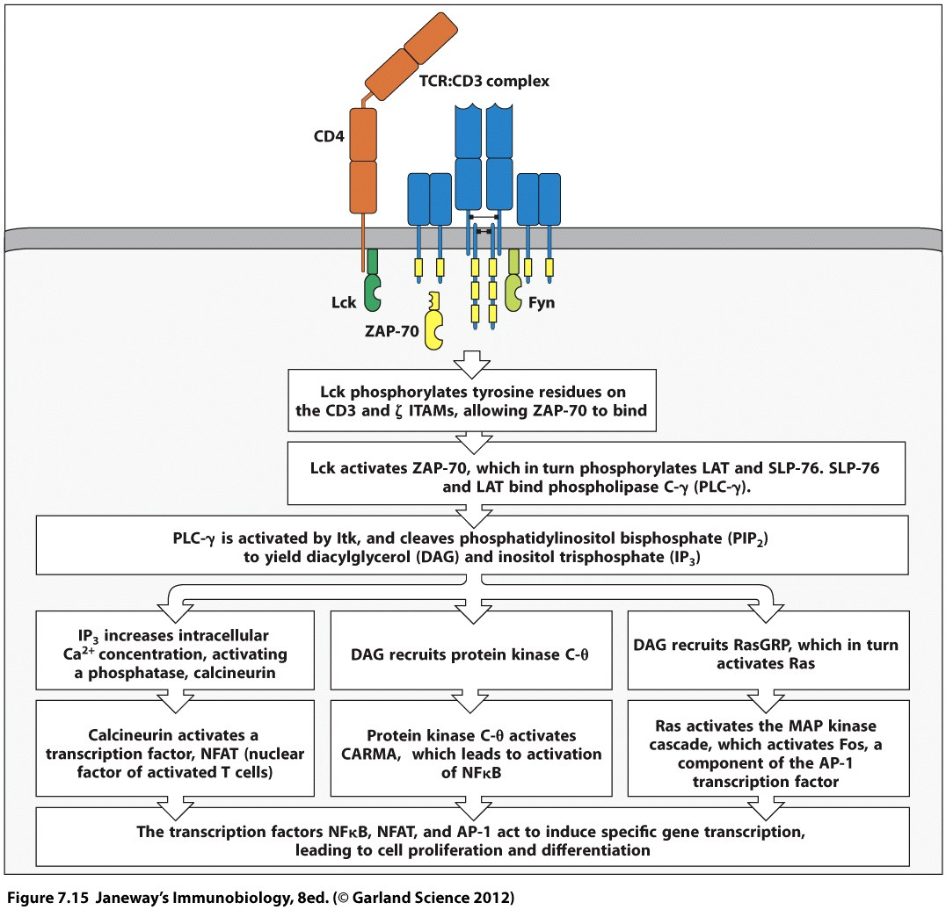
T-cell receptor signaling and co-stimulation work together
B7.1 & B7.2 on APC
1st signal:
TcR -ITAMs & CD4/8
2nd signal:
CD28, ICOS
CTLA-4-ITIMs
inhibition
CD28
Co-stimulation
(Fig 9-9, p. 203)
Lck PO4s Tyr
On CD28’s tail
PI3 Kinase binds
PIP2 -> PIP3
Recruits Itk & Akt
Lck PO4 activates
X
The 3rd signal, cytokine signaling, induces T-cell differentiation into an effector phenotype
Notes:
ITAM: Immunoreceptor tyrosine-based ACTIVATING motif (Tyrs are phosphorylated allowing ZAP-70 to bind and starts signaling)
ITIM: Immunoreceptor tyrosine-based INHIBITORY motif (Tyrs are phosphorylated allowing SHP or SHIP to dephosphorylate signaling molecules)

Slide 73
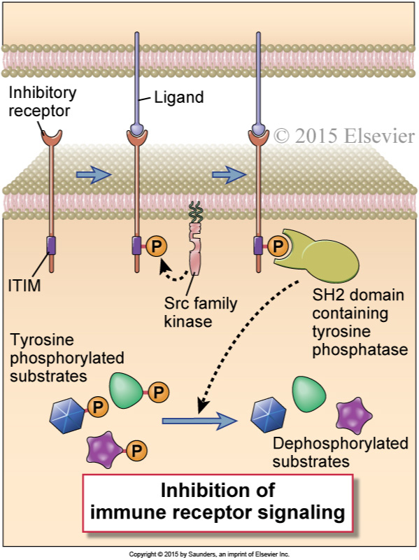
Inhibitory signaling involves dephosphorylating enzymes
that degrade the signaling pathways
CD45 is not involved in this pathway
Notes:
Inhibitory signaling in lymphocytes.
A schematic depiction is provided of an inhibitory receptor with an extracellular ligand-binding domain and a cytosolic ITIM motif. Ligand binding results in phosphorylation of the ITIM tyrosine by a Src family kinase, followed by recruitment of an SH2 domain–containing tyrosine phosphatase that can attenuate immune receptor signaling.
Abbas et al., Cellular and Molecular Immunology, 9th Ed. 2018, Elsevier.

Slide 74
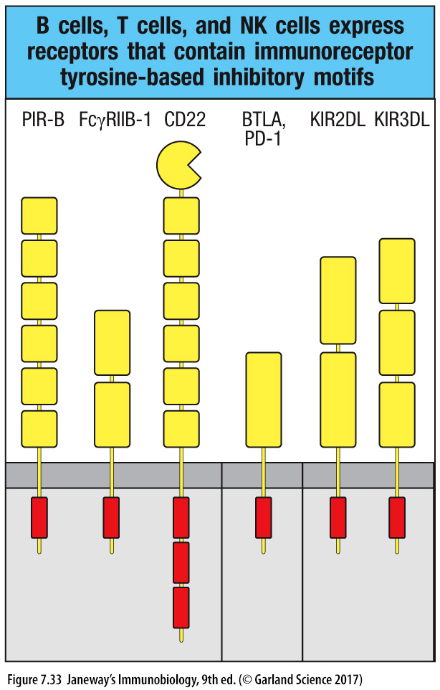
TcR signaling is inhibited via T-cell PD-1 binding by PD ligands 1 & 2
SHP - Phospho-Tyr phosphatase
SHIP - Inositol (PIP₃) phosphatase
Both bind phosphorylated ITIMs
(and ITSMs).
*
*
ITIMS are bound by Src Homology (SH) domains
on phosphatases, recruiting them into the signaling complex.
PD-L1 is expressed on MQ & DCs, PD-L2 is on DCs
Antagonistic therapeutic antibodies that block PD1 can break T-cell suppression

Slide 75
Chapter 3, Section B
Signaling, activation, proliferation and differentiation of B-cells

Slide 76
Phases of the humoral immune response
Most isotype switching,
affinity maturation
(& somatic hypermutation),
memory & production of long-lived plasma cells (& their homing to the bone marrow)
involve follicular B cells that have been driven by T_{FH} cells in germinal center reactions
Notes:
Phases of the humoral immune response.
The activation of B cells is initiated by specific recognition of antigens by the surface Ig receptors of the cells.
Antigen and other stimuli, including helper T cells, stimulate the proliferation and differentiation of the specific B cell clone.
Progeny of the clone may differentiate into plasma cells that produce IgM or other Ig isotypes (e.g., IgG), may undergo affinity maturation, or may persist as memory cells (that have also typically undergone class switching and affinity maturation).
Abbas et al., Cellular and Molecular Immunology, 9th Ed. 2018, Elsevier.

Slide 77
Pathways of antigen delivery to follicular B cells
Notes:
Pathways of antigen delivery to follicular B cells.
Small antigens are delivered to B cells in follicles through afferent lymphatics and via conduits, and larger antigens by subcapsular sinus macrophages or by dendritic cells in the medulla.
Abbas et al., Cellular and Molecular Immunology, 9th Ed. 2018, Elsevier.

Slide 78
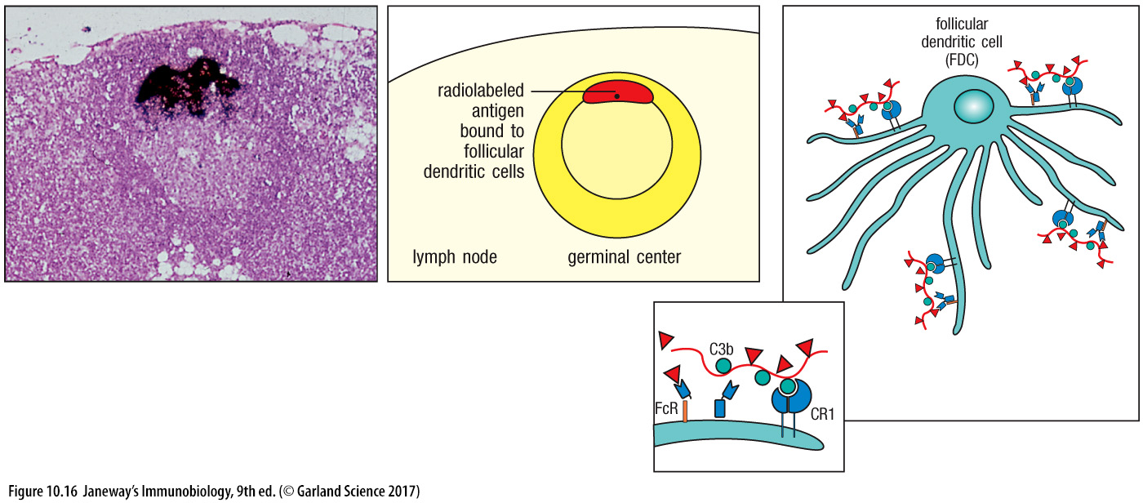
FDCs retain antigen in the form of immune complexes
FcγR activates FDCs to produce survival signals (APRIL & BAFF)
Immune complexes comprise antigen, antigen-specific IgG antibody, and complement

Slide 79
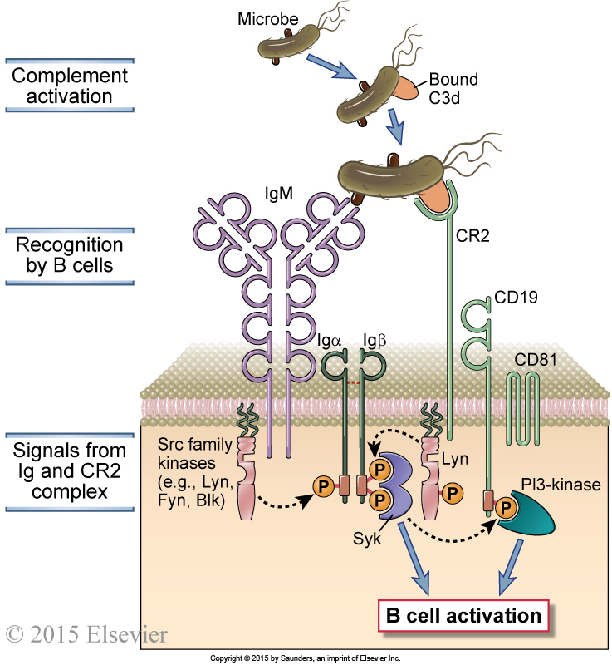
Complement helps activate B-cell signaling through the CD19 complex
Notes:
Role of complement in B cell activation.
B cells express a complex of the CR2 complement receptor, CD19, and CD81. Microbial antigens that have bound the complement fragment C3d can simultaneously engage both the CR2 molecule and the membrane Ig on the surface of a B cell. This leads to the initiation of signaling cascades from both the BCR complex and the CR2 complex, because of which the response to C3d-antigen complexes is greatly enhanced compared with the response to antigen alone.
Abbas et al., Cellular and Molecular Immunology, 9th Ed. 2018, Elsevier.

Slide 80
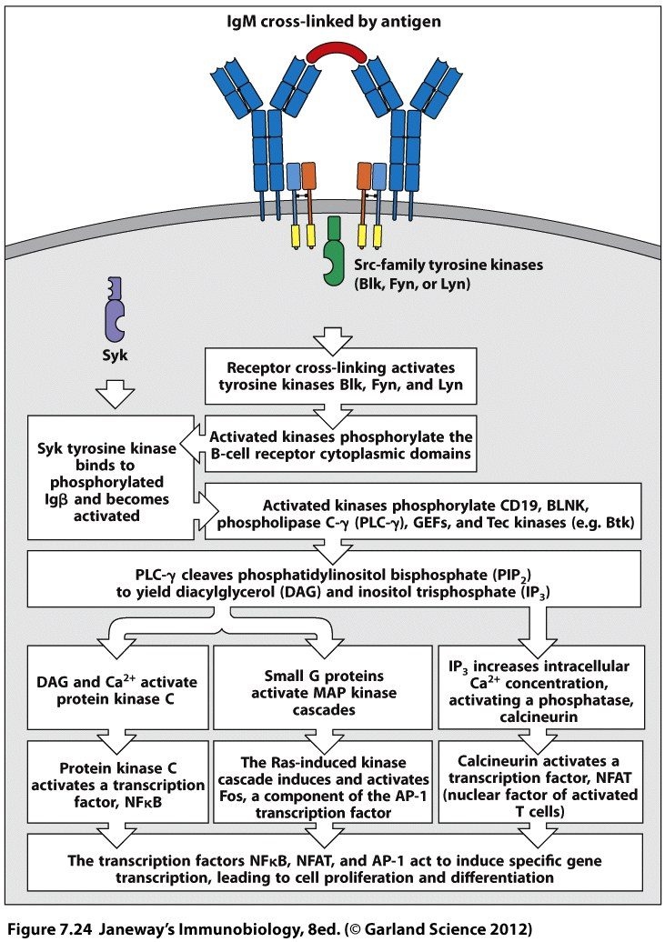
BcR signaling works with complement signaling and CD 40 signaling
FcRIIb-ITIMs: Bind IgGs
to inhibit signaling
C3 fragments
CD40L Th cells
CD19, 81, 21
CD40
1st signal: BcR
2nd signal: CD40, CD19/21/81
Lyn
PI3K
PI3K
“nonclassical”
NFkB pathway
Notes:
FcRIIb is an Fc receptor that specifically binds the Fc region of IgGs.

Slide 81
Sequence of events in humoral immune responses
to T cell–dependent protein antigens
Notes:
Sequence of events in humoral immune responses to T cell–dependent protein antigens.
A, Immune responses are initiated by the recognition of antigens by B cells and CD4+ T cells. The activated lymphocytes migrate toward one another and interact at the interface of T and B cell zones.
B, The initial T-dependent B cell proliferation and differentiation results in the formation of an extrafollicular focus, in which B cells proliferate, can undergo isotype switching, and differentiate into plasma cells (mostly short-lived). Some of the T cells that are activated in the extracellular focus develop into follicular helper T cells and migrate back into the follicles, together with some activated B cells, to form a germinal center.
The late events in B cell responses occur in germinal centers and include somatic mutation and the selection of high-affinity cells (affinity maturation), additional isotype switching, memory B cell generation, and the generation of long-lived plasma cells, described in later figures.
Abbas et al., Cellular and Molecular Immunology, 9th Ed. 2018, Elsevier.

Slide 82
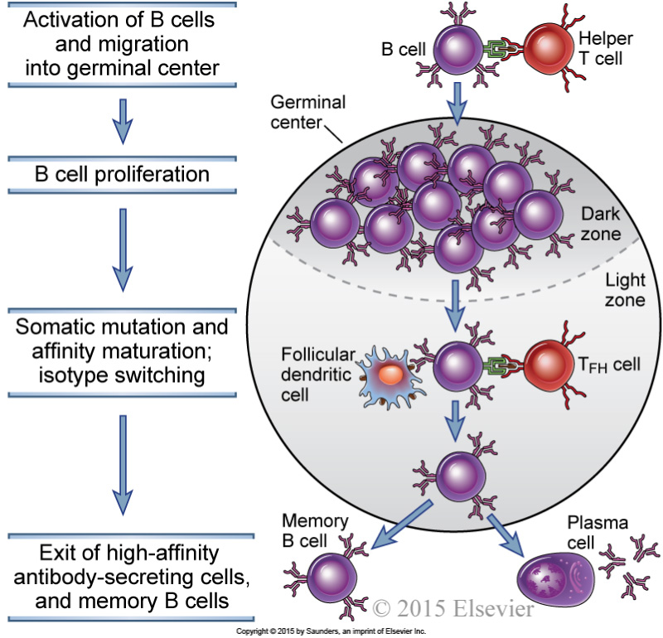
The germinal center reaction in a lymph node
Notes:
The germinal center reaction in a lymph node.
Activated B cells migrate into the follicle and proliferate, forming the dark zone of the germinal center.
These B cells undergo extensive isotype switching and somatic hypermutation of Ig V genes, and migrate into the light zone, where they encounter follicular dendritic cells displaying antigen and T_{FH} cells.
B cells with the highest affinity Ig receptors are selected to survive, and they differentiate into antibody-secreting cells and memory B cells.
The antibody-secreting cells leave and reside in the bone marrow as long-lived plasma cells, and the memory B cells enter the recirculating lymphocyte pool.

Slide 83
Germinal center reactions produce “central” memory B cells and antibody-secreting plasmablasts (destined to become plasma cells)
The BcR becomes a secreted antibody
Notes:
Production of membrane and secreted µ chains in B lymphocytes.
Alternative processing of a primary RNA transcript results in the formation of mRNA for the membrane or secreted form of the µ heavy chain.
B cell differentiation results in an increasing fraction of the µ protein produced as the secreted form.
TP, TM, and CY refer to tail piece, transmembrane, and cytoplasmic segments, respectively.
Cµ1, Cµ2, Cµ3, and Cµ4 are four exons of the Cµ constant gene region.
Abbas et al., Cellular and Molecular Immunology, 9th Ed. 2018, Elsevier.

Slide 84
Class switching requires CD40L & is mediated by LPS and cytokines
Mice: IgG1, 2a, 2b (2c) and 3. Humans: IgG 1-4

Slide 85
Affinity maturation
When antigen is limiting, B cells bearing high-affinity antibodies are selected over their lower-affinity counterparts in the light zones.
Thus B cells bearing lower affinity antibodies die off, and “drop out” of the antibody response.
Somatic mutations are produced by activation-induced cytosine deaminase, the same enzyme that mediates class switching!
Notes:
An overview of affinity maturation.
Early in the immune response, low-affinity antibodies are produced.
During the germinal center reaction, somatic mutation of Ig V genes and selection of B cells with high-affinity antigen receptors result in the production of antibodies with high affinity for antigen.
Abbas et al., Cellular and Molecular Immunology, 9th Ed. 2018, Elsevier.

Slide 86
Progression of clonal lineages based upon somatic mutations
accumulating in unmutated, recombined Ig V genes
Lineages of B cells can be traced by analyzing their SHM patterns compared to their germline V, D and J gene segments, and building phylogenetic trees of their lineages.
This example used a hapten for cloning hapten-specific MAbs from immunized mice. That is why it is not a “poly-clonal” response but instead is dominated by a single VH gene.
Normally, there would be an initial polyclonal IgM response against multiple determinants on an antigen, with the lower-affinity clones dropping out as the GC reaction progresses, multiple somatically mutated lineages would arise over time.
AIRR-sequencing allows assessment of multiple clonal lineages;
but depends on knowing the germline V, D and J genes of the individual!
Notes:
Somatic mutations in Ig V genes.
Hybridomas were produced from spleen cells of mice immunized 7 or 14 days previously with a hapten, oxazolone, coupled to a protein and from spleen cells obtained after secondary and tertiary immunizations with the same antigen.
Hybridomas producing oxazolone-specific monoclonal antibodies were produced, and the nucleotide sequences of the V genes encoding the Ig heavy and light chains were determined.
Mutations in V genes increase with time after immunization and with repeated immunizations and are clustered in the complementarity-determining regions (CDRs).
The location of CDR3 in the heavy chains is approximate.
The affinities of the antibodies produced also tend to increase with more mutations, as indicated by the lower dissociation constants (Kd) for hapten binding.
(Modified from Berek C, Milstein C: Mutation drift and repertoire shift in maturation of the immune response, Immunological Reviews 96:23-41, 1987, Blackwell Publishing.)
Abbas et al., Cellular and Molecular Immunology, 9th Ed. 2018, Elsevier.

Slide 87
AID-mediated recombination of gene fragments
into the heavy chain V region
Pepper & Cockburn 2017 Immunol & Cell Biol 95:862-863

Slide 88
Chapter 3, Section C
Role of co-stimulation in determining the type immune response generated
(including anergy/tolerance)

Slide 89
Mechanisms of helper T-cell-mediated B-cell activation
T cell is also activated by B cell’s B7 (binding to CD28) and ICOS ligand (binding to ICOS)
The local mix of cytokines drives class switching by B cells.
Notes:
Mechanisms of helper T cell–mediated B cell activation.
Helper T cells that are activated by recognizing antigens presented by B cells express CD40L, which binds to CD40 on B cells and stimulates B cell proliferation and differentiation.
Cytokines produced by the helper T cells also contribute to B cell responses.
Abbas et al., Cellular and Molecular Immunology, 9th Ed. 2018, Elsevier.

Slide 90
CD28 co-stimulation, via binding to an APC’s B7, helps activate T-cells
Notes:
Functions of costimulators in T cell activation.
A, The resting APC (typically dendritic cells presenting self antigens) expresses few or no costimulators and fails to activate naive T cells.
(Antigen recognition without costimulation may make T cells unresponsive [tolerant]; we will discuss this phenomenon in Chapter 15.)
B, Microbes and cytokines produced during innate immune responses activate APCs to express costimulators, such as B7 molecules.
The APCs (usually presenting microbial antigens) then become capable of activating naive T cells. Activated APCs also produce cytokines such as IL-12, which stimulate the differentiation of naive T cells into effector cells.

Slide 91
CD28 signaling through B7 is inhibited by CTLA-4

Slide 92
Therapeutic co-stimulatory blockade by a CTLA4-IgFc fusion
Notes:
The mechanism of therapeutic co-stimulatory blockade.
A, The normal T cell response induced by antigen recognition and costimulation mediated by B7-CD28.
B, A fusion protein consisting of the extracellular portion of CTLA-4 and the Fc tail of an IgG molecule is used to bind to and block B7 molecules, thus preventing their interaction with the activating receptor CD28 and inhibiting T cell activation.
Abbas et al., Cellular and Molecular Immunology, 9th Ed. 2018, Elsevier.

Slide 93
Clonal expansion and contraction of T-cell populations
Notes:
Clonal expansion of T cells.
The numbers of CD4⁺ and CD8⁺ T cells specific for microbial antigens and the expansion and decline of the cells during immune responses are illustrated.
The numbers are approximations based on studies of model microbial and other antigens in inbred mice
Abbas et al., Cellular and Molecular Immunology, 9th Ed. 2018, Elsevier.

