Slide 1
Biological Resources Working Group
AIRR-C meeting
December 8th 2020
Maggie Bostick, Takara Bio
Encarnita Mariotti-Ferrandiz, Sorbonne Université

Slide 2
Outline
Working Group history & organization
2019-2020 achievements
Future directions proposed as a motion
Leadership plan as a motion

Slide 3
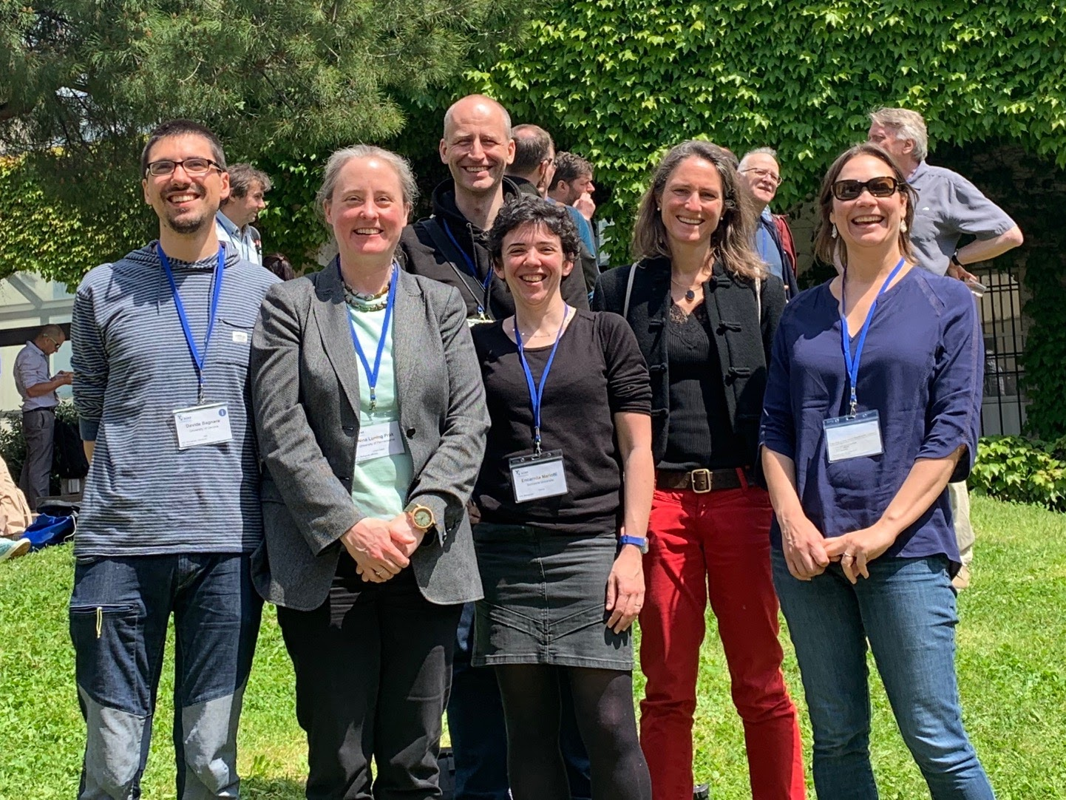
Working Group history & organization
Created in 2017 @ 3rd AIRR-C meeting, NIH Fishers Lane Conference Center, Rockville, MD
Founded on the needs to better control AIRR-seq data
Co-chairs (since 2017):
  Maggie Bostick - Takara Bio USA
  Encarnita Mariotti-Ferrandiz - Sorbonne Université
  19 members, of which 8 joined after AIRR-C#4
  Biweekly online meetings; minutes associated
  Yearly reporting to the AIRR-C
A sample of the members @4th AIRR-C meeting, Genoa, 2019

Slide 4
Details about members
First Name | Last Name | Member since | Affiliation | City, Country | Research topic
Davide | Bagnara | 06/12/2017 | University of Genoa | Genoa, Italy | B cell repertoire; oncoimmunology
Maggie | Bostick | 06/12/2017 | Takara Bio | Mountain View (CA), USA | Molecular biology R&D; immune repertoire kit and tool development
Christian | Busse | 06/12/2017 | DKFZ | Heidelberg, Germany | B cell repertoire; single cell; bioinformatics
Nina | Luning Prak | 06/12/2017 | University of Pennsylvania Perelman School of Medicine | Philadelphia (PA), USA | B cell repertoire; autoimmune disease; human
Encarnita | Mariotti-Ferrandiz | 06/12/2017 | Sorbonne University, Medical school | Paris, France | T cell repertoire; single cell; autoimmune disease; human
Jacob | Sherkow | 06/12/2017 | New York Law School | New York (NY), USA | Regulatory and IP issues on biotechnologies
Cinque | Soto | 06/12/2017 | Vanderbilt University | Nashville (TN), USA | B cell repertoire; vaccine design
Johannes | Trueck | 06/12/2017 | University of Zurich | Zurich, Switzerland | B cell repertoire; immunodeficiency; immune reconstitution; standards; vaccine design; bioinformatics
Anne | Eugster | 07/12/2017 | University of Dresden | Dresden, Germany | T cell repertoire; single cell; autoimmune disease; human
Lindsay | Cowell | 20/02/2019 | UT Southwestern | Dallas (TX), USA | B cell repertoire modelling
Marie-Paule | Lefranc | 20/02/2019 | IMGT | Montpellier, France | IMGT
Chris | Tipton | 20/02/2019 | Emory University Department of Medicine | Atlanta (GA), USA | B-cell repertoire; autoimmune diseases
Aimee | Payne | 03/04/2019 | University of Pennsylvania Perelman School of Medicine | Philadelphia (PA), USA | Human autoimmunity, B cell repertoire, cellular immunotherapy
Pierre | Barennes | 17/04/2019 | Sorbonne University, Medical school | Paris, France | T cell repertoire; autoimmune disease; human
Francisco | Arcila | 01/07/2019 | DKFZ | Heidelberg, Germany | B cell repertoire; single cell; bioinformatics
Ginger | DeBelli | 01/08/2019 | Vanderbilt Vaccine Center, Crowe Lab | Nashville (TN), USA | B-cell repertoire, vaccine
Elaine | Chen | 01/12/2019 | Vanderbilt Vaccine Center, Crowe Lab | Nashville (TN), USA | B-cell repertoire, vaccine
Xiao | Liu | 20/02/2020 | BGI China, China National GeneBank | Shenzhen, China | TCR repertoire, Autoimmune diseases
Houda | Alachkar | 01/10/2020 | University of Southern California | Los Angeles (CA), USA | Immuno-oncology

Slide 5
Goal
To provide the AIRR Community with biological calibrators and reagents for standardization and harmonization of AIRR-seq experiments.

Slide 6
Initial aims & tasks
Create a questionnaire to survey scientists regarding their needs for standards and calibrators in AIRR-seq experiments
-> Write a manuscript reviewing biological standards and other analytical controls using the questionnaire results
Establish a collection of such standards for inter-lab comparisons and ultimately for communal sale
->Write a second manuscript about one or more specific assay standards

Slide 7
2019-2020 achievements
AIRR Biological Resources Survey analysis
WG seminars on biological standards developed by WG members
Manuscript reviewing biological standards and other analytical controls using the questionnaire results
Introduction of the WG to the Euroclonality NGS group
Minisymposium on biological standards

Slide 8
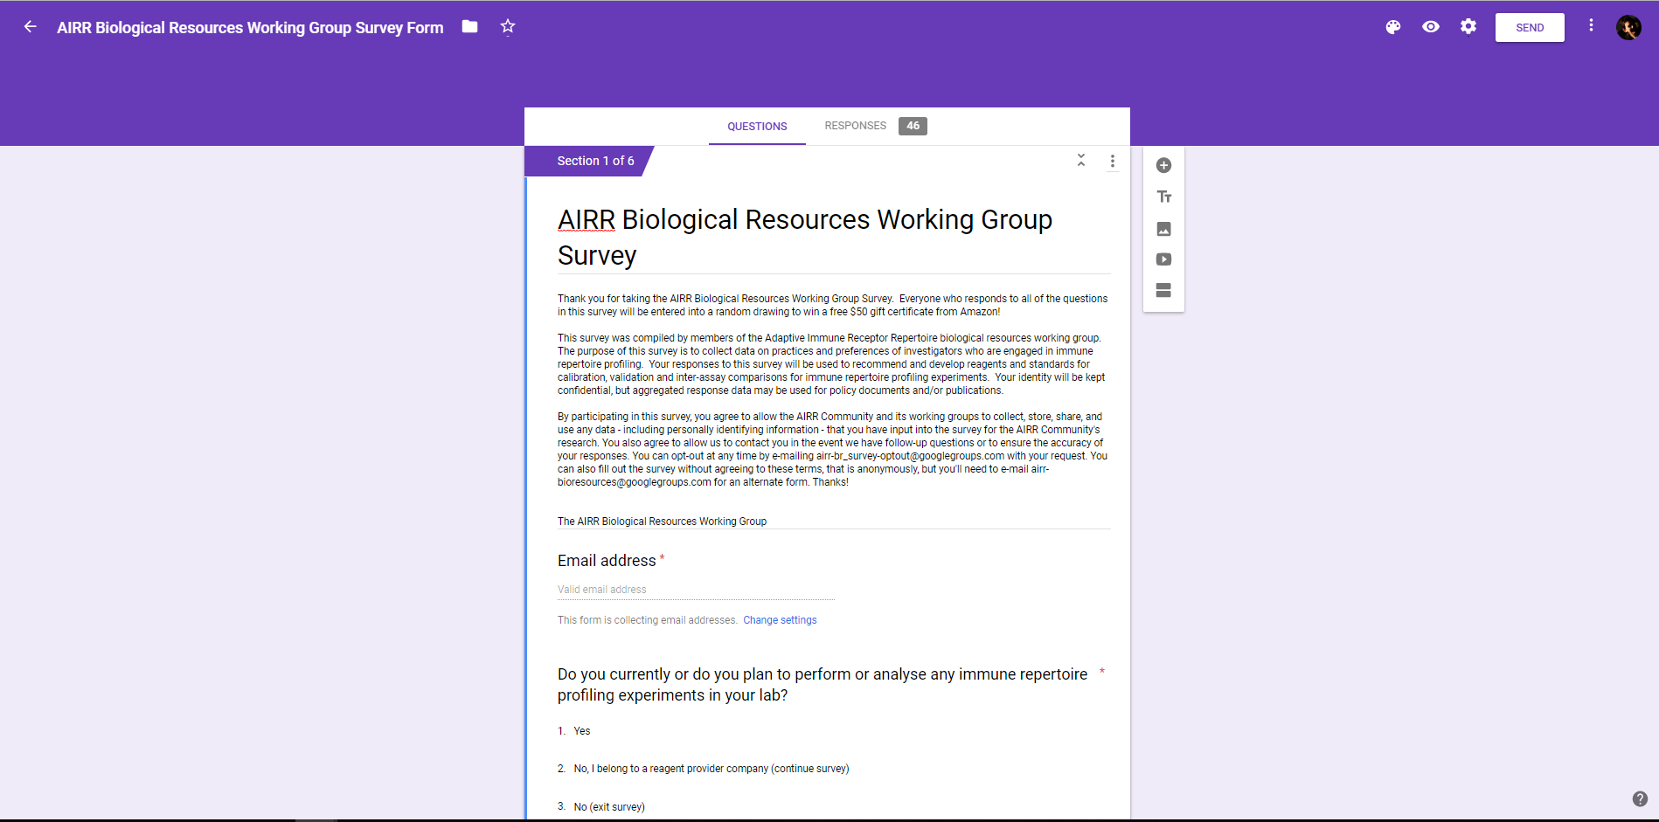
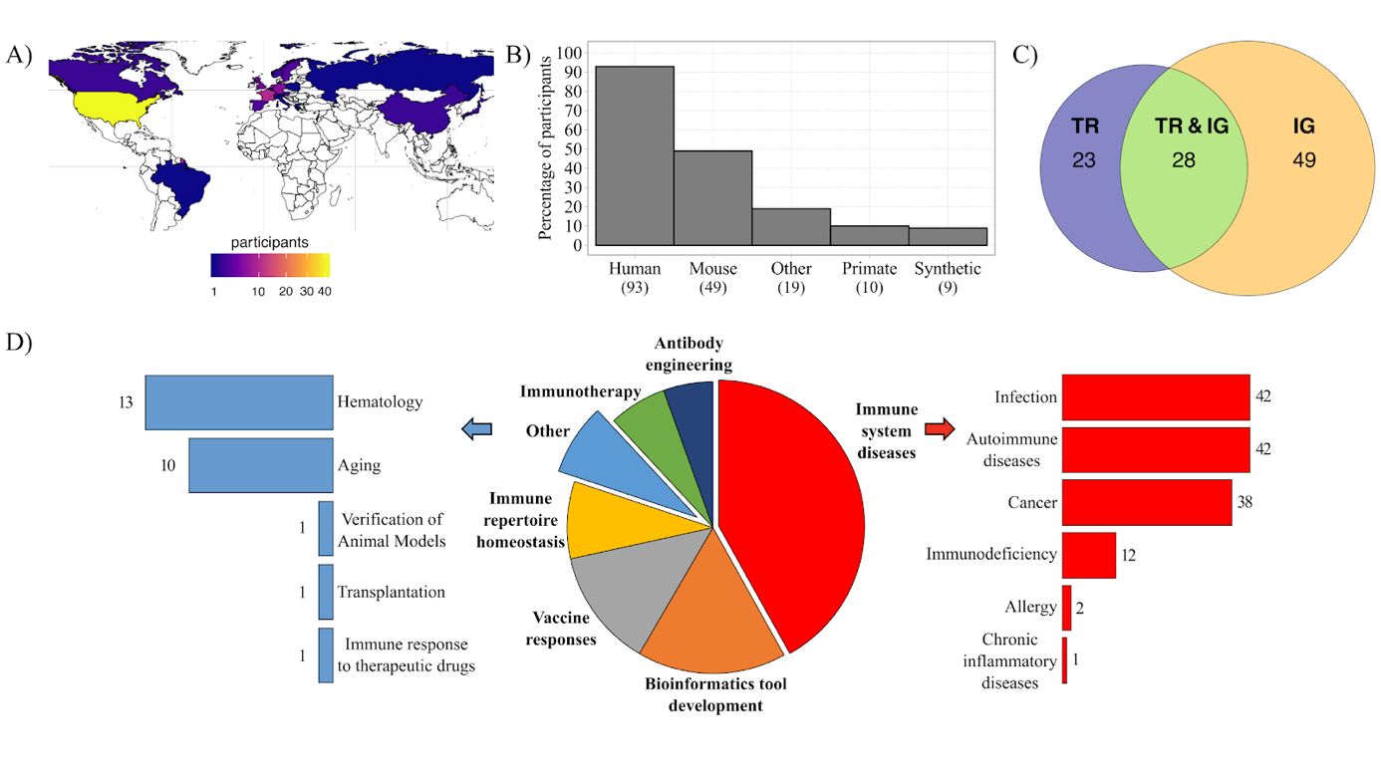
AIRR Biological Resources Survey
26 questions’ online survey, subdivided into 4 sections:
A. General questions about investigators and their research programme
B. Questions about your samples
C. Questions about amplification and library preparation
D. Questions about controls and calibrators
101 participants

Slide 9
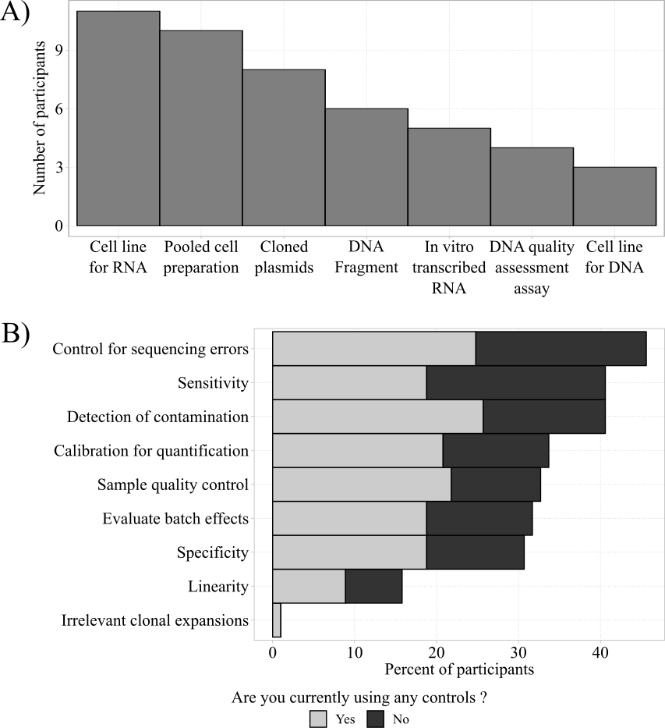
AIRR Biological Resources Survey results
Results of the survey clearly show that the researchers involved in AIRR studies are:
interested by using controls,
but no gold standard control used
controlled parameters depend on experiments and questions

Slide 10
Scientific session on standards current use and development
Three researchers introduced their current development:
Sai Reddy (Friedensohn et al, Frontiers in Immunol)
Johannes Trueck (member of the WG)
Chris Tipton (member of the WG)
Shared conclusions
⇒ synthetic fragments
⇒ only IG controls
⇒ mainly for multiplex PCR controls (JT also for RACE)
⇒ more work to be done within the group
🡪 No gold standard identified

Slide 11
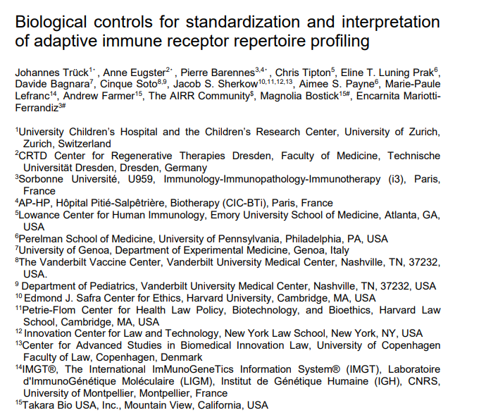
Review on biological standards and needs
The manuscript is divided into four sections:
1. An introduction describing the applications of the variety of AIRR-seq techniques and the survey participants’ demographics.
2. A presentation of the needs and requirements for control reagents for their applications.
3. A summary of currently available controls and standards.
4. A proposal for areas of prioritization for current use and future development of controls.
Approved by the AIRR-C
Submitted for publication as a review to eLife (awaiting feedback)

Slide 12
Euroclonality-NGS discussion
Euroclonality NGS organised an AIRR/Euroclonality-NGS discussion meeting
→ Christian (representing the AIRR-C, Min. Stand., Repo & Software WG)
→ Encarnita (representing the BioResource WG)
BioResources WG has been introduced (aims, activities, future directions)
Discussed possible collaboration/team-up between the groups
Conclusions
Some common objectives have been identified
Euroclonality NGS will introduce their work in our minisymposium (see after)
Further meetings with other members of the WG will be organised

Slide 13
Mini-symposium on standards current use and development
6 researchers will introduce their current development, highlighting the pros & cons
December 7th 2020, prior to the 5th AIRR-C meeting
Frederic Davi/Anton Langerak (Euroclonality; mPCR; IG/TR; MRD/CLL/ALL)
Brandon DeKosky (Kansas University; Single-cell/B-cell)
Nina Luning Prak (member of the WG; UPenn; MRD; control sample)
Chris Tipton (member of the WG; Emory)
Johannes Trueck (member of the WG; Synthetic IgG)
Encarnita Mariotti-Ferrandiz (member of the WG; T cell repertoire/autoimmune disease)
Had a successful meeting, with ~20 attendees and a discussion following presentations.
Gave the group several ideas of what direction to go into next.

Slide 14
Future Directions
→ Apply for funding
→ Initiate a comparative study for B-cell AIRR-Seq methods
→ to work-out existing differences between approaches
→ define what calibrators need to be developed.
→ Identify and collect suitable DNA/RNA calibrators/controls and cell mixes for AIRR-seq
→ Identify members of the community able to define statistical measurement for AIRR-Seq experiment validation (in collaboration with other WGs)
→ Perform inter-lab comparison
→ Perform outreach to academic, government, and commercial partners to disseminate the identified and validated controls
→ Define legal requirements for distribution

Slide 15

Leadership
→ Maggie & Encarnita will leave the leadership roles
→ Anne Eugster & Johannes Trueck/Cinque Soto will take the lead from 2021
Membership
→ currently 19 members → Opt-out survey to be send to confirm current membership?
→ new ones very welcome → just contact us at bioresources@airrc.antibodysociety.org

Slide 16
Thank you!

