Slide 1
Welcome to the AIRR Community Meeting V: Zooming into the AIRR Community!
December 8-10, 2020

Slide 2
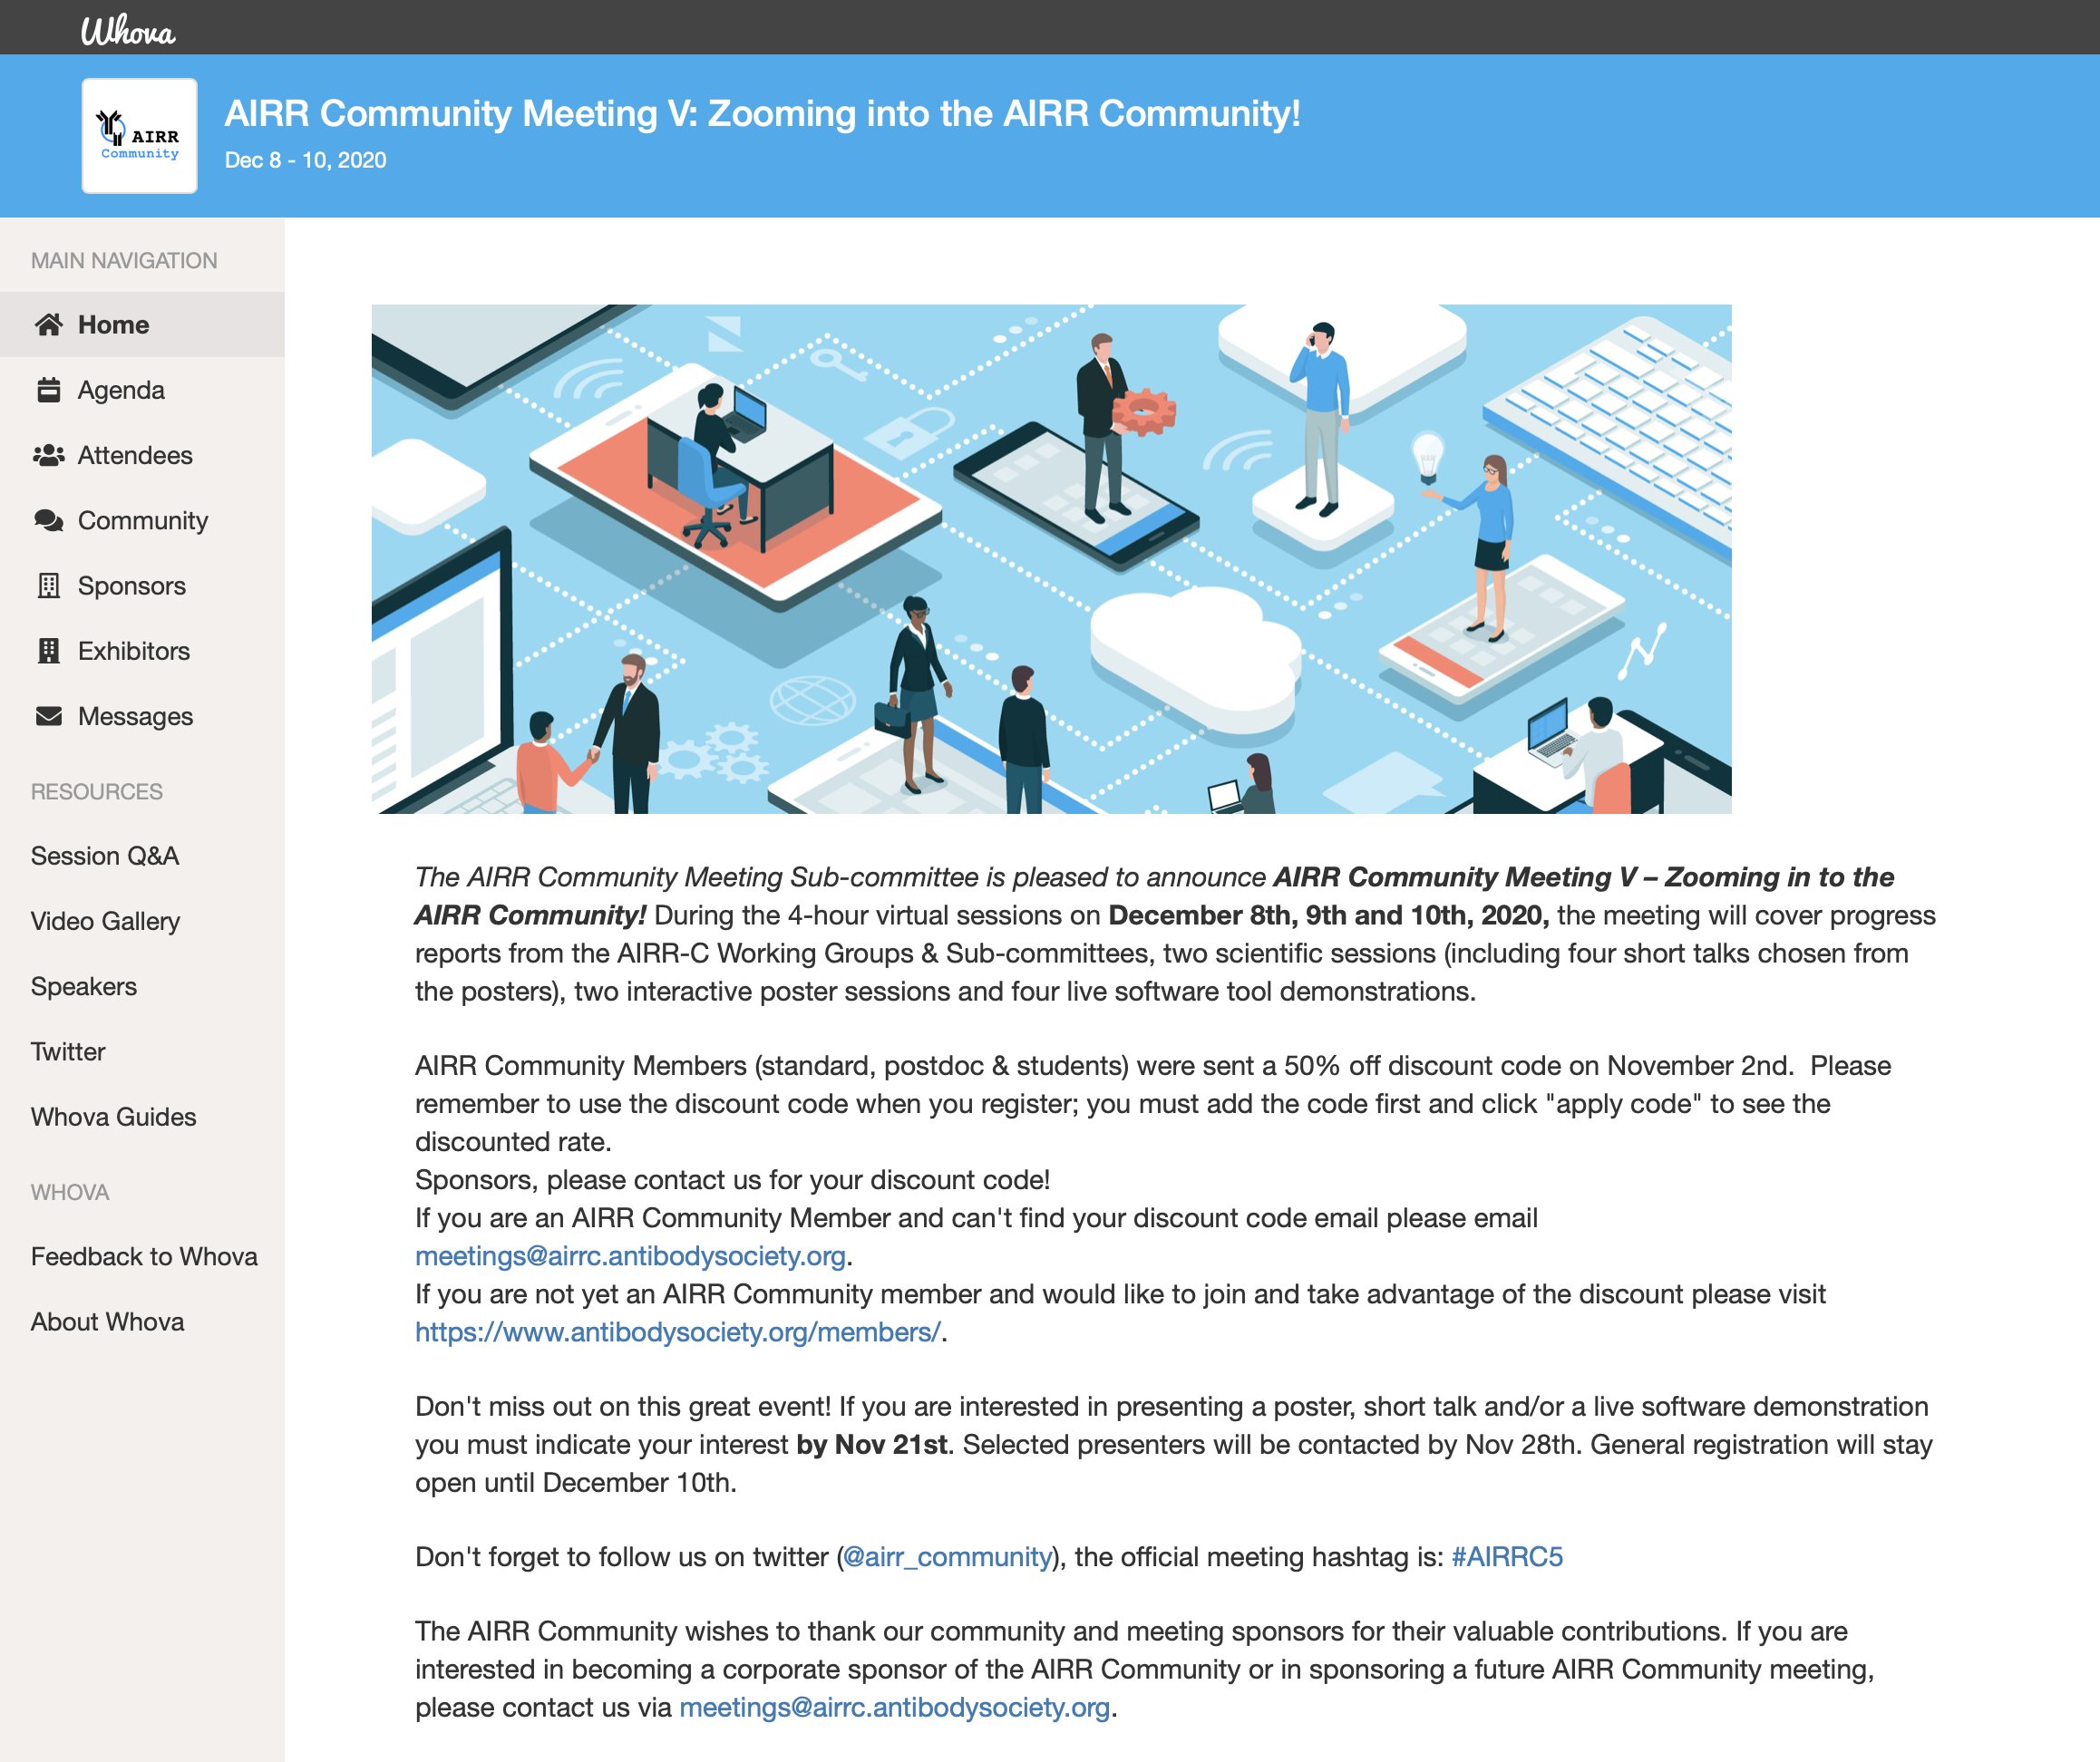

Slide 3
AIRR-C Meeting at a glance
Day 1 (Today!): AIRR-C working group and sub-committee reports
vote to ratify WG and SC proposals
networking
Day 2: (tomorrow, 12/9) basic science talks
software demonstrations
poster session
networking
Day 3: (Thursday, 12/10) translational science talks
poster session
AIRR-C announcements (election results etc.)
networking

Slide 4
AIRR-C Executive Sub-Committee
AIRR-C meeting December 8th 2020 Nina Luning Prak, Chair

Slide 5
Outline
AIRR-C executive SC members
Goals from the 2019 AIRR-C meeting
2019-2020 achievements
Future directions proposed as a motion
Leadership plan

Slide 6
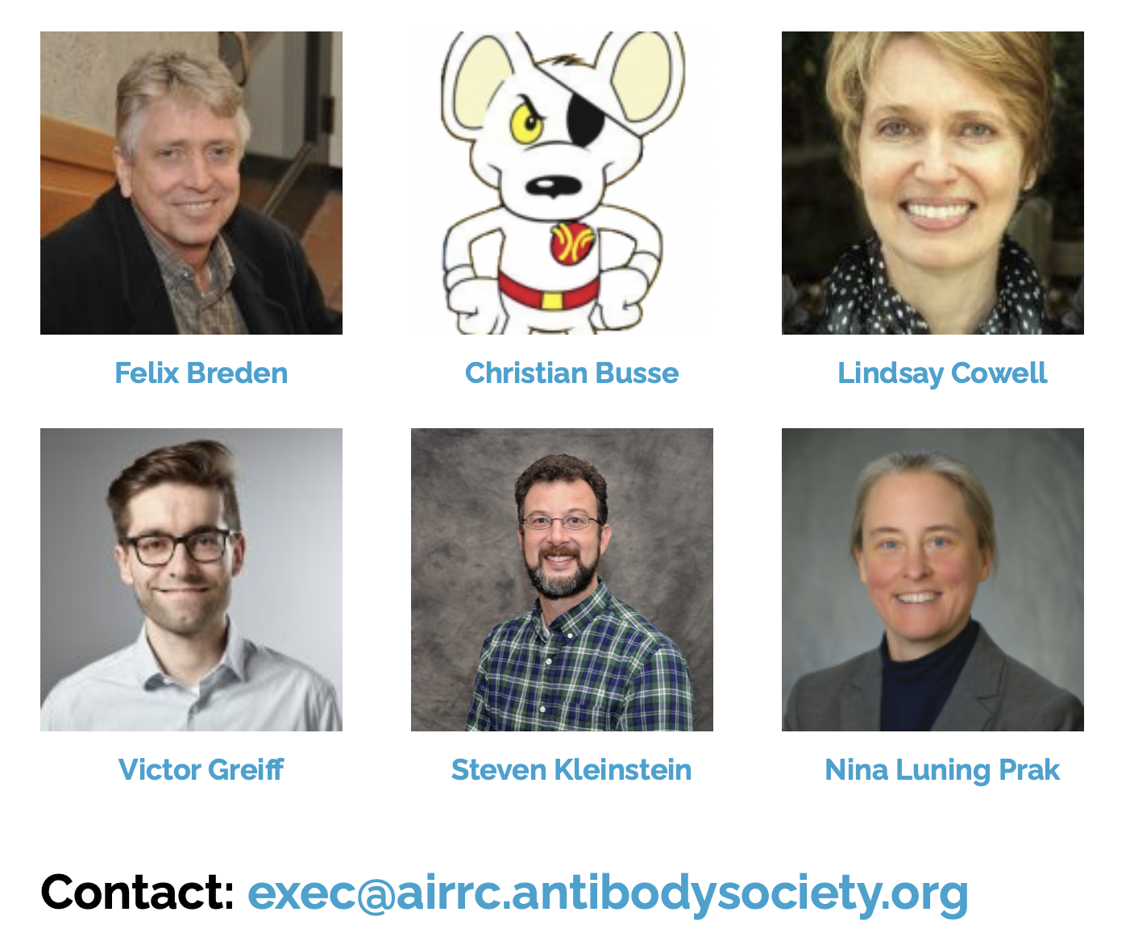
Working Group history & organization
Created in 2017 @ 3rd AIRR-C meeting, NIH Fishers Lane Conference Center, Rockville, MD
6 members: Chair, Chair-elect, Past-Chair, 3 members-at-large
Monthly videoconferences; minutes recorded
…and Pam Borghardt

Slide 7
Only a partial list…
Roles of AIRR-C executive SC members in AIRR-C
Felix Breden- helped organize a pre-meeting workshop between AIRR-C and Tsinghua University, China (December 5-6); membership campaign; outreach to IUIS; active with ADC and leads iReceptor portal project (including publications using the iReceptor plus portal), published paper on FAIR principles and systems immunology; member Data Representation WG
Christian Busse- co-lead Minimal Standards WG, updating MiAIRR standard to include single cell work; member legal and ethics WG; member, Software WG, member of Germline Database WG, published a proposed new nomenclature for Ig genes of Mus musculus, recent AIRRseq publications on CLL and cardiovascular disease, outreach to promote AIRR standards to Euroclonality and other scientific groups in Europe.
Lindsay Cowell- co-lead of Common Repository WG, participate in AIRR standards documentation, VDJserver, published article about AIRRseq TCR data in cancer research, moderator of TCR session in AIRR-C COVID-19 symposium, published ADC API

Slide 8
Roles of AIRR-C executive SC members in AIRR-C
Victor Greiff- co-lead of AIRR-C communications SC (since 2018), logo, compliance badge, twitter feed, website; member of Diagnostics and GLDB WGs; machine learning and other computational approaches to analysis of AIRRseq data; >10 AIRRseq publications in 2020!
Steve Kleinstein- member and former co-lead of minimal standards WG, hosts seminars on AIRRseq data analysis, promotes AIRR-C recommendations for inferred alleles, standardized data representations, recent publications on differential targeting of SHM, responses of MBC and naïve cells to influenza vaccination and 2 papers on B cell responses to SARS-CoV-2; Immcantation framework of computational tools for AIRRseq data analysis; one of the most active twitter feeds in the AIRR Community!
Nina Luning Prak- executive SC chair, worked on governance document, ran monthly meetings, organized WG and SC meetings, manuscript endorsements, LOS for grants and promotions, wrote meeting grant; member Diagnostics WG, Biological Resources WG; moderator and speaker in AIRR-C COVID-19 symposium, speaker in China pre-meeting and Bio Resources mini-symposium; ImmuneDB (AIRR-compliant); published paper on COVID AIRR-seq data sharing, published AIRR-seq paper on COVID (deposited in ADC), AIRR-seq papers in hematologic malignancies; member of SAB and Finance and member of Audit Committee of TAbS

Slide 9
Goals set forth in the 2019 AIRR-C Meeting
Goal
Adopt new Governance Structure and integrate with The Antibody Society (TAbS)
Oversee change in Minimal Standards Working Group to Sub-committee performing oversight of standards for publishing and submitting AIRR-seq data sets to public repositories.
Oversee formal ratification of Inferred Allele Review Committee (IARC) and Communications Sub-committee.
Further integration with TAbS including adding representation of AIRR-C members on TAbS Board of Directors, Meetings Committee, and Finance & Audit Committee.
Completed
YES
NO- Minimal Standards WG remained as a WG
YES
YES

Slide 10
Thanks to
Pam Borghardt
2019-2020 achievements
Convened monthly meetings including 2 meetings with SC and/or WG co-leads
Reviewed all publications presented for AIRR endorsement (ADC API, BioResources, Diagnostics and OGRDB)
Revised and adopted a detailed governance structure
Integrated governance structure with TAbS -- signed by TAbS and AIRR-C Executive SC, document posted on AIRR-C website
Represented on TAbS Board of Directors and TAbS Finance & Audit (budget and audit) Committee, with financial reporting.
Submitted NIH meetings grant application
Oversaw ratification of Diagnostics WG, ratification of IARC and Communications SCs
Switched membership dues to an annual payment cycle
Conducted an election of Chair-elect and members of the AIRR-C Executive SC

Slide 11
Proposed goals for 2020-2021
Communication and organization
Monthly meetings with occasional special meetings involving leadership of WGs and SCs
Facilitate and promote the work of the AIRR-C WGs and SCs
Manuscript endorsements
Writing letters of support for grant applications
Establishing an infrastructure grant for AIRR-C
Establish one or more AIRR-C prizes
Governance
Oversee WG/SC reorganizations, after ratification by the AIRR-C in Meeting V
Update the AIRR-C mission statement, align with the revised TAbS mission statement.
Develop a conflict-of-interest policy
Represent the AIRR-C on the TAbS Board of Directors and Finance & Audit Committee
Junior faculty and student members
Outreach and mentoring for students and other members of the AIRR-C
Questionnaire to determine needs and interests of AIRR-C student members
Promoting the career development of AIRR-C members - letters of recommendation, networking
Outreach- work with others in AIRR-C to promote commercial and academic partnerships that lead to greater sharing, annotation and standardization of AIRR-seq data; encourage adoption of AIRR-C standards by journals and funding agencies

Slide 12
Lindsay Cowell is the Chair-Elect
Nina Luning Prak is the Past Chair
All other elected positions will be announced on Thursday, December 10th.
Election of next Executive SC will follow the same procedure (as specified in the current version of the AIRR-C governance document- available online).

Slide 13
Hot Topics Session– Highlights from WG and SC reports and proposed initiatives
Nina Luning Prak

Slide 14
Thanks to our sponsors
Jacob Glanville and JP Burckert (comm and meetings SC)
Katie Boland, Harlan Robins, David Hamm, Danielle Scheffey, Angie Fu
Jan Reichert, Paul Parren
Nicola Bonzanni, Jos Lunenberg, Josine oude Lohuis
Tania Bubela, Jamie Scott, Felix Breden, Brian Corrie, Pam Borghardt

Slide 15
Proposals for Ratification
Reorganization of Minimal Standards, Data Representation and some data-oriented parts of Common Repository into a single Standards WG
Promote adoption of AIRR-C standards (Communications SC, Executive SC, others?)
Partnerships with companies
Partnerships with other groups (e.g., Euroclonality, IUIS etc.)
Outreach to journals
Outreach to funding agencies

Slide 16
Proposals for Ratification
Promote the incorporation of additional data and databases into the ADC
Develop and AIRR-seq repository registry
Other databases and data uploads can proceed via—
VDJ server, Or can do an iReceptor turnkey repository
Reference implementation as a GitHub repository for more advanced users
Add new databases to the ADC- make more information on how to do this widely available?
Submission of “reference” data sets including synthetic data sets for testing of analysis tools and evaluation of immune repertoire data quality (Software, Biological Resources, Common Repository)
Develop a tool that can query across different AIRR-C repositories (iReceptor, other efforts in progress)
Outreach to other societies
IUIS subcommittee on Big Data
Euroclonality (with Biological Resources WG)

Slide 17
Proposals for Ratification
Work on collaborative chapters for Methods in Mol. Biol (Springer Nature, Anton Langerak, editor)
Special issue on Immunogenetics
Study set up (design considerations (Dx), wet bench, standards (Biol Res WG)
Study data analysis on back end (Common Repo, Software etc.)
Set up a meeting in early 2021 to plan cross-AIRR-C submission and leads for set up and data analysis
Identify leads for study set-up and data analysis chapters
AIRR-C Executive SC will reach out

Slide 18
Proposals for Ratification
Financial initiatives
Support for AIRR-C WG or SC work– executive SC work with TAbS and other sources of funding for
Develop and AIRR-C/TAbS infrastructure grant
IARC
Programmer for ADC, software, Common Repo etc.
Resources for expanding educational outreach, website work and other communications
Biological Resources funding for B cell AIRR-seq comparative study; funding for standard development, dissemination and performance of the sequencing
Prizes to promote AIRR-seq science and data sharing
Data uploads into ADC
New germline genes submitted
Scientific discoveries with AIRR-seq data

Slide 19
Proposals for Ratification
GLDB WG:
Develop and seek ratification of universal principles for nomenclature systems
“Promote certainty, clarity, future-proof and speed for nomenclatures of immune repertoire genes (e.g. TRBV, IGHV etc.)”
Expand mapping efforts to regions outside of the coding region
Work with Legal and Ethics WG on restrictions on data sharing imposed by Directive 96/9/EC

Slide 20
Proposals for Ratification
Educational and other outreach initiatives
Podcasts (Dx WG) in collaboration with Meetings SC
Other web-based learning/outreach (Communications SC)
Questionnaire to student members (AIRR-C exec SC)
More participation of student members in AIRR-C WG and SCs
Job boards
Other special events for early career participants (Meetings SC)
TAbS is a member of FOCIS- to consider the option of running a satellite symposium

Slide 21
Proposals for Ratification
Promoting FAIR and open science
Revising value statements
Creating a forum for discussion for about FAIR, open science etc.
Working with Meetings SC, Legal and Ethics WG and Executive SC
How do we implement things?

Slide 22
Next items- back to Pam
Instructions for voting
Agenda review for Wednesday, December 9th
Networking

