Slide 1
Inferred Allele Review Committee (IARC)
AIRR Community Meeting V
December 8-10, 2020

Slide 2
Mission (AIRR3):
To review human immunoglobulin germline gene inferences from AIRR-Seq datasets, and to communicate affirmed sequences to the IG gene naming authorities

Slide 3
The 2019/2020 IARC team
Andrew Collins (Chair)
Martin Corcoran
William Lees
Mats Ohlin
Cathrine Scheepers
Davide Bagnara
Corey Watson
Gur Yaari

Slide 4
IARC meetings
IARC has held 27 meetings since May 2019
Minutes of meetings are available at the AIRR-C website. Documentation of each sequence affirmation is included in the minutes. More detailed documentation of evidence in support of all affirmed sequences can be found at the OGRDB website.

Slide 5
Goals for AIRR5 Community Meeting:
Continue the evaluation of inferred iGHV sequences and commence the assessment of other human IG loci
Develop OGRDB as a resource for understanding the population genetics of IG/TCR genes
Develop tools and guidelines for the evaluation of the ‘quality’ of submitted datasets
Streamline procedures for the submission and assessment of human IGHV inferences
Develop strategies to make the work of the IARC(s) sustainable.

Slide 6
IARC achievements
IARC has affirmed 32 sequences:
IGHV L0 4 sequences
IGHV L1 6 sequences
IGKV L1 1 sequence
IGLV L0 1 sequence
IGLV L1 6 sequences
IGHV L0 (VDJbase) 3 sequences
IGHV L1 (VDJbase) 11 sequences

Slide 7
IARC achievements
Meeting IV:
IGHV L0 12 sequences
IGHV L1 9 sequences
Meeting V
IGHV L0 7 sequences
IGHV L1 17 sequences
VDJbase sequences still to be finalised and officially named

Slide 8
IARC achievements
IGKV L1 1 sequence
IGLV L0 1 sequence
IGLV L1 6 sequences

Slide 9
Light Chain Challenges
IgM primers easily generate AIRR-Seq datasets that are enriched for sequences from naive B cells. No such simple strategy can produce largely unmutated light chain sequences
Most kappa genes are duplicated, and genes of the distal locus are expressed at low frequency
The IGKV and IGLV contribute many nucleotides to the CDR3. The V gene ends are highly variable, and terminal nucleotides are difficult, even impossible to call.
We hope to publish a manuscript in 2021.

Slide 10
Goals for AIRR5 Community Meeting:
Continue the evaluation of inferred IGHV sequences and commence the assessment of other human IG loci
Develop OGRDB as a resource for understanding the population genetics of IG/TCR genes
Develop tools and guidelines for the evaluation of the ‘quality’ of submitted datasets
Streamline procedures for the submission and assessment of human IGHV inferences
Develop strategies to make the work of the IARC(s) sustainable.

Slide 11
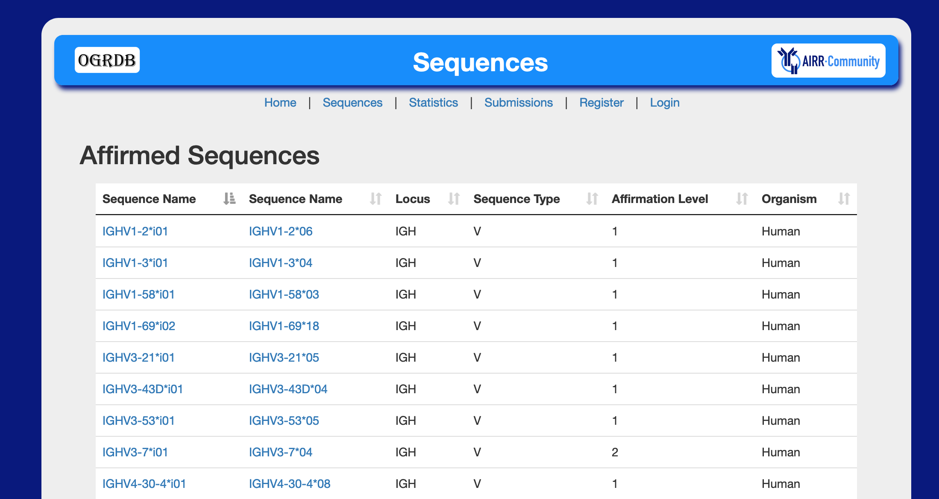

Slide 12
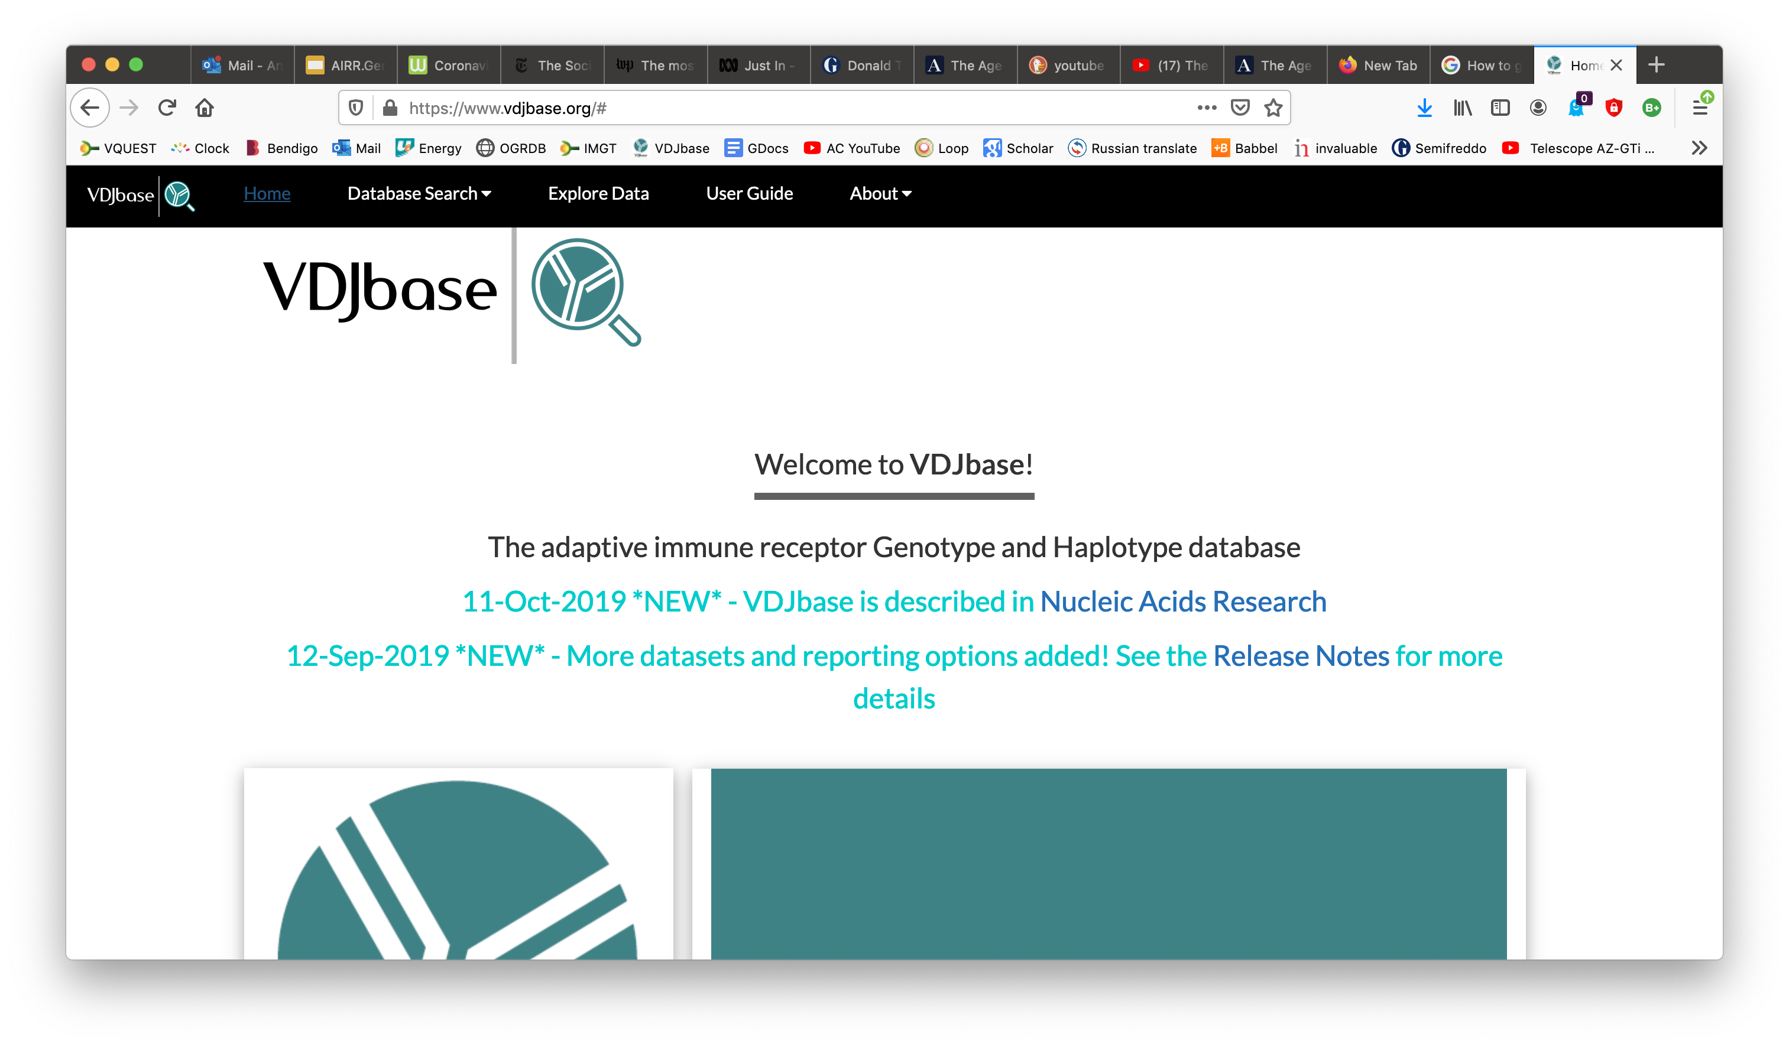
https://www.vdjbase.org/

Slide 13
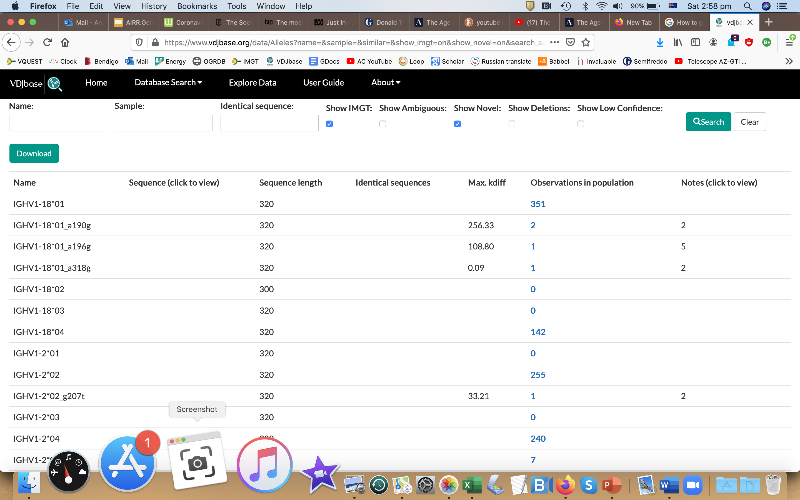
https://www.vdjbase.org

Slide 14
OGRDB: a reference database of inferred immune receptor genes. W Lees, CE Busse, M Corcoran, M Ohlin, C Scheepers, FA Matsen IV, G Yaari, CT Watson, AIRR Community, AM Collins, AJ Shepherd (2020). Nucleic acids research 48 (D1), D964-D970
VDJbase: an adaptive immune receptor genotype and haplotype database. A Omer, O Shemesh, A Peres, P Polak, AJ Shepherd, CT Watson, SD Boyd, AM Collins, W Lees, G Yaari (2020). Nucleic Acids Research 48 (D1), D1051-D1056

Slide 15
Goals for AIRR5 Community Meeting:
Continue the evaluation of inferred IGHV sequences and commence the assessment of other human IG loci
Develop OGRDB as a resource for understanding the population genetics of IG/TCR genes
Develop tools and guidelines for the evaluation of the ‘quality’ of submitted datasets
Streamline procedures for the submission and assessment of human IGHV inferences
Develop strategies to make the work of the IARC(s) sustainable.

Slide 16
Goals for AIRR5 Community Meeting:
Continue the evaluation of inferred iGHV sequences and commence the assessment of other human IG loci
Develop OGRDB as a resource for understanding the population genetics of IG/TCR genes
Develop tools and guidelines for the evaluation of the ‘quality’ of submitted datasets
Streamline procedures for the submission and assessment of human IGHV inferences
Develop strategies to make the work of the IARC(s) sustainable.

Slide 17
How do we make the IARC sustainable
Submissions must continue. VDJbase has emerged as an important source of inferences.
The work should not be overwhelming. Streamlining of procedures and tools to assess the quality of datasets should help.
Members of the IARC should be rewarded. Learn who has done this hard work. Study their work.

Slide 18
Frog TCR
Human IG
Human
IG & TCR
Shark IG
Human TCR
Rabbit
IG & TCR
Trout
IG & TCR
Trout IG
Mouse IG
Dog TCR
Horse IG
Mouse
IG & TCR
Macaque
IG & TCR
How do we expand the IARC’s work beyond human IG genes?

Slide 19
Human TCR
Human IG
Salmonid IG and TCR
Mouse IG
Members of the human IG IARC are keen to advise and assist those who wish to establish new IARCS

Slide 20
Inferred Allele Review Council
Human IG
Human TCR
Salmonid
IG & TCR
Mouse IG
Should the AIRR Community establish a body to coordinate the IARCs?

Slide 21
Few people working on mouse germline IG. If those who generate sequences excuse themselves from deliberations, who will be left on the IARC to make the decisions?
Fear of Making Mistakes: Many IGHV; groups of highly similar genes expressed at low frequency
Without mapping, can your sequence be assigned with confidence as an allelic variant of a previously reported gene?
Mouse IG
How would a mouse IG IARC work?

Slide 22
A Nomenclature Solution
New Sequence
Error discovered
Assign name
Consecutive numbering
Sequence
mothballed
Existing Locus
Mapped
New Locus
Rename. Assign allele number
Retain name

Slide 23
Goals for AIRR Community Meeting VI
Continue to evaluate human IGH, IGK and IGL inferences
Work with others in the WG to establish a human TCR IARC
Work with others in the WG to establish IARCs for non-human species
Develop tools and guidelines for the evaluation of the ‘quality’ of submitted datasets
Streamline procedures for the submission and assessment of human IGHV inferences
Develop strategies to make the work of the IARC(s) sustainable.

Slide 24
Membership and Leadership
Cathy Scheepers is stepping down from the committee
I am stepping down from my position as Chair of the committee
Nominations including self-nominations for the chair should be sent to Pam Borghardt. I will liaise with her, and take nominations to the first meeting in 2021
Corey Watson and Gur Yaari should be offered official membership of the committee
We are seeking new members of the IARC. Please contact me if you would like to join us.

