Slide 1
AIRR Germline Database Working Group
AIRR Community Meeting V
December 8-10, 2020

Slide 2
Mission (AIRR2):
To promote the comprehensive and accurate identification, description, classification, annotation, curation, and consistent use of germline IG and TR genes/alleles across species, strains, and populations.

Slide 3
Who we are:
Davide Bagnara
Pierre Boudinot
Felix Breden
Christian Busse
Scott Christley
Andrew Collins
Martin Corcoran
Victor Greiff
Jamie Heather
Katherine Jackson
Justin Kos
William Lees
Susana Magadan
Serghei Mangul
Susanna Marquez
Ivana Mikocziova
Mats Ohlin
Kerui Peng
Oscar Rodriguez
Cathrine Scheepers
Chaim Schramm
Jamie Scott
Amit Upadhyay
Henk-Jan van den Ham
Corey Watson
Kevin Wu
Gur Yaari
Jian Ye

Slide 4
Goals set at AIRR4 Community Meeting:
Develop strategies to make the work of the IARC(s) sustainable.
Streamline procedures for the submission and assessment of human IGHV inferences
Develop tools and guidelines for the evaluation of the ‘quality’ of submitted datasets
Develop OGRDB as a resource for understanding the population genetics of IG/TCR genes
Commence the assessment of other human IG loci

Slide 5
Goals set at AIRR4 Community Meeting:
6. Continue the development of the salmonid nomenclature
7. Work on improving the nomenclature and databases for mouse IG genes, allowing the inclusion of inferred genes, as well as taking into account the convoluted breeding histories of commonly used mouse strains.
8. Work on improving the nomenclature and databases for macaque IG genes, leveraging both existing genomic and AIRR-seq datasets.

Slide 6
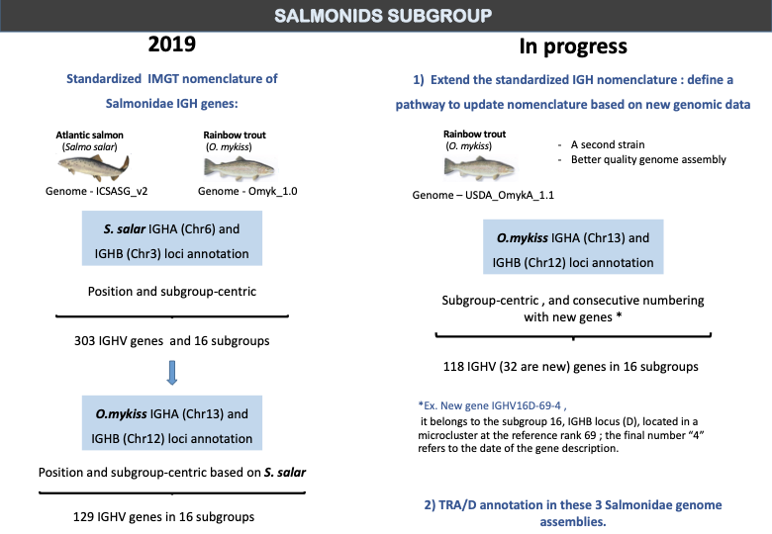

Slide 7
Goals set at AIRR4 Community Meeting:
Continue the development of the salmonid nomenclature
Work on improving the nomenclature and databases for mouse IG genes, allowing the inclusion of inferred genes, as well as taking into account the convoluted breeding histories of commonly used mouse strains.
Work on improving the nomenclature and databases for macaque IG genes, leveraging both existing genomic and AIRR-seq datasets.
✔️
✘
✘

Slide 8
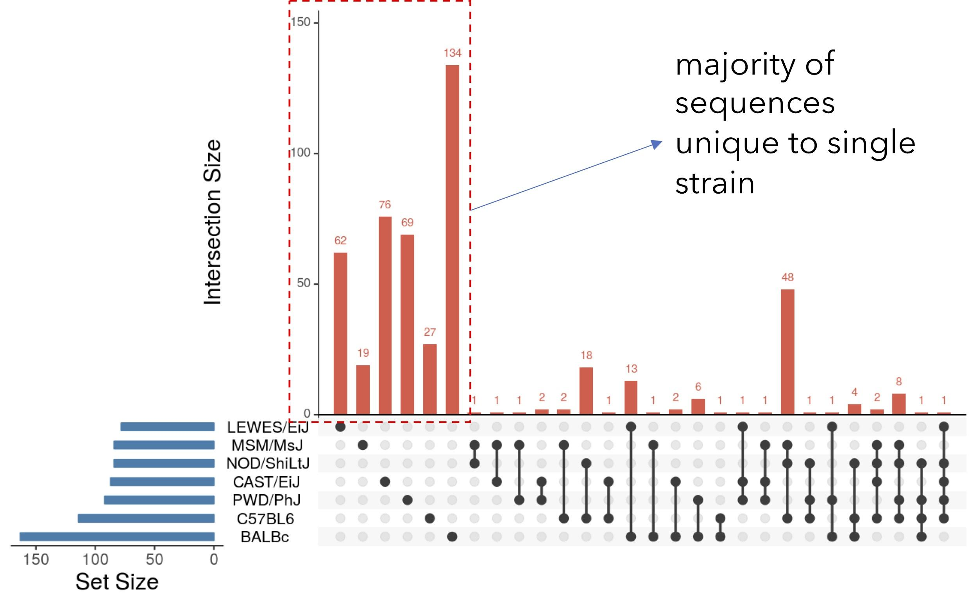
Mouse and macaque germline data highlight issues
Evidence for:
extensive diversity that is missing from current databases
divergent haplotypes between strains (mouse) and individuals (rhesus)
Vázquez Bernat et al. 2020

Slide 9
Mouse and Macaque Sub-Groups
1. Member of the Mouse subgroup published a manuscript in Frontiers in Immunology in late 2019, describing nomenclature solutions that address the reported divergence of IG genes between different mouse strains.
Members of the Macaque subgroup have compiled AIRR-seq data and produced new genomic sequencing data and assemblies that highlight major shortcomings of the old and new rhesus IGHV Reference Directories listed on IMGT

Slide 10
What do we want from a nomenclature?
Certainty: a fixed 1:1 relation between a name and a gene/allele
Clarity: we understand why things carry the names that they do.
Future-proof: the nomenclature will cope with future developments in the field
Speed: the timely assignment of names is possible

Slide 11
Certainty:
The re-naming of sequences destroys the certainty of our understanding, when we read a manuscript that uses these names.
Are they using the old names or the new names?

Slide 12
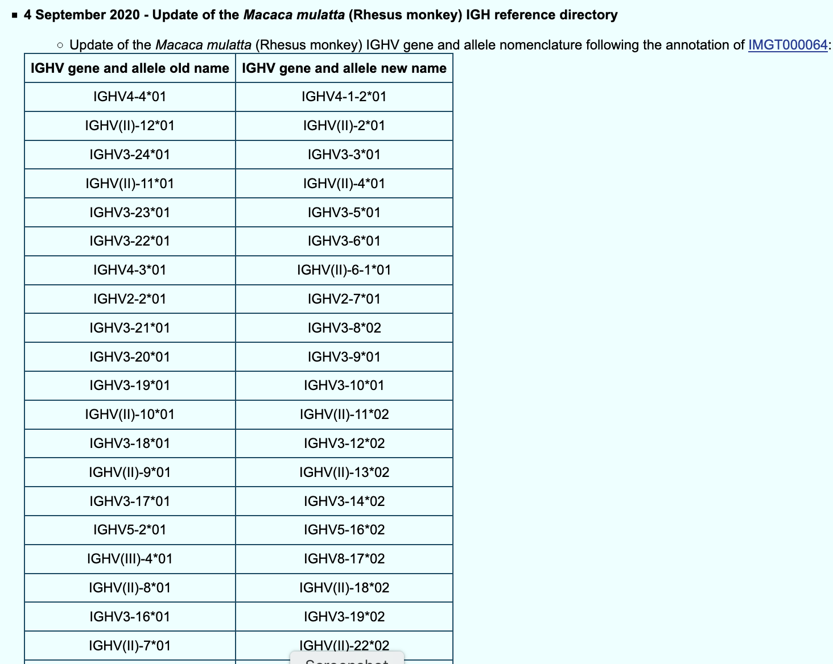
Certainty?

Slide 13
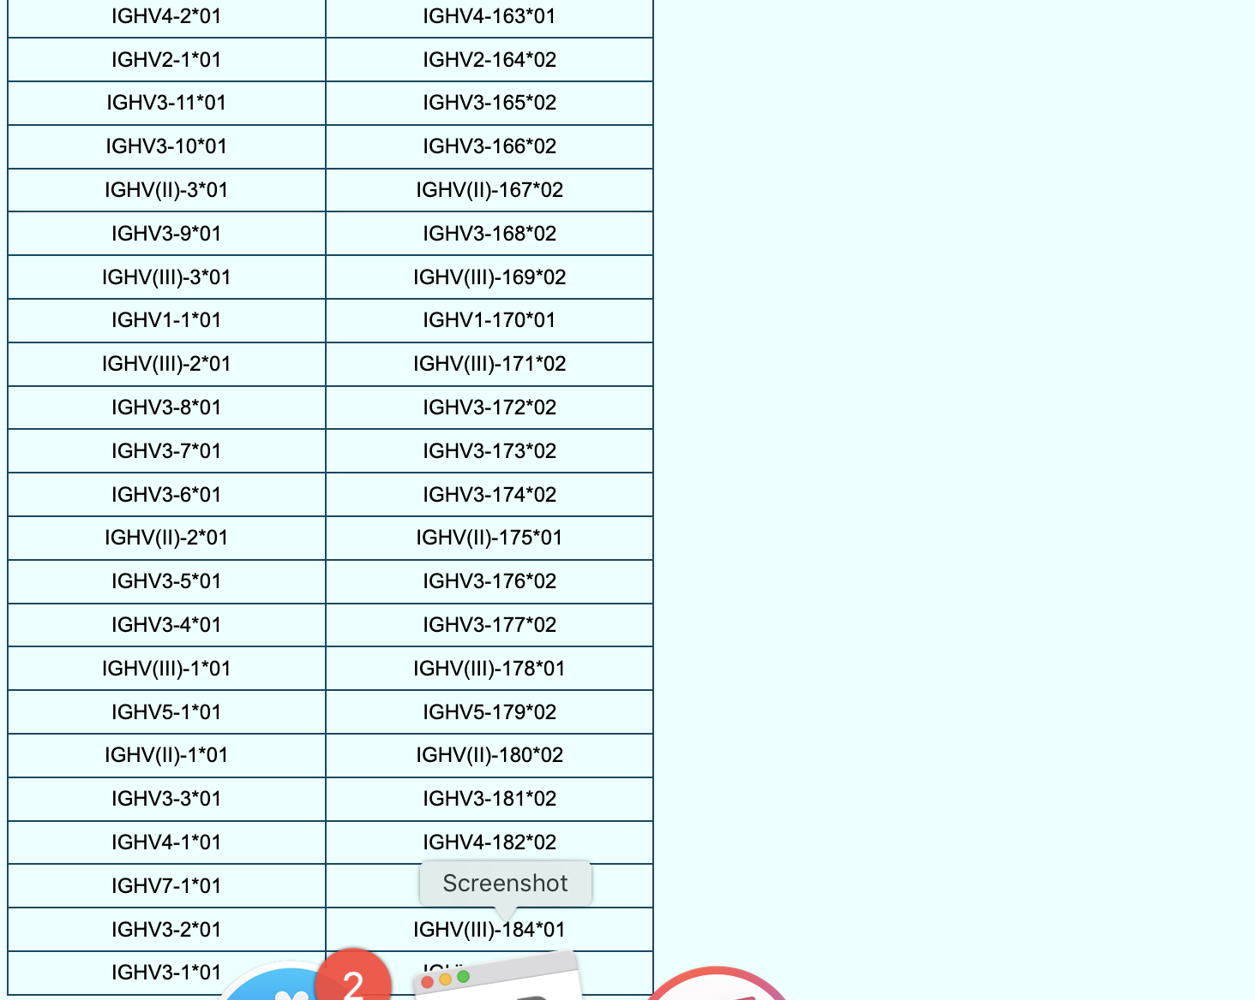

Slide 14
Clarity:
Decisions and policies must be clearly documented. The reasons for the recent name changes to the macaque sequences are not documented.
Other sequences including human sequences have a very confusing and poorly documented history.

Slide 15
Speed: what’s the problem?

Slide 16
Speed: what’s the problem?
There are literally hundreds of mouse and macaque sequences that are un-named, for they do not meet the current requirements for naming. Many of them have been un-named now for over 5 years

Slide 17
Currently, for a gene to be named...
The sequence must be a genomic germline sequence.
The sequence must include the complete coding region, as well as the complete leader sequence and the downstream recombination signal sequence.
The sequence must be mapped to an agreed annotated reference sequence.

Slide 18
High quality sequences that only include the coding regions are of great value and should be incorporated into IGHV Reference Directories.
Variation outside the coding regions is an area of emerging interest and importance.
A system needs to be developed to record variation in non-coding regions.

Slide 20
We will continue to interrogate IG gene names for all species and refine nomenclature strategies for all species that will allow the flexibility that may be needed to accommodate new technologies/data
Some of our working group members (Cathrine Scheepers (co-chair), Corey Watson, Jamie Scott and Felix Breden) are members of the International Union of Immunological Societies (IUIS) IG/TR/MH nomenclature sub-committee and these issues are being raised within this group
We hope to engage the broader scientific community for input in resolving some of the problems we face with IG/TR genes

Slide 21
Goals for the Current Cycle
The WG will develop and seek ratification of universal principles for nomenclature systems that meet the needs of IG and TCR researchers
The WG will work to develop systems to document and report variation in non-coding regions of the IG/TR loci
The WG will develop appropriate IG Reference Sets for mouse strains and for rhesus macaque
An IARC focused on the review of TCR gene inferences will be established.

Slide 22
Goals for the Current Cycle
5. The WG will develop and benchmark tools and systems to improve our capacity to fully leverage data types of the future, while maintaining the quality of Reference Sets
6. The WG will continue to work on questions regarding database versioning, programmatic access and licensing of germline reference databases.

Slide 23
Proposed WG leadership:
Andrew Collins and Corey Watson have called for nominations of new co-chair candidates. Nominations including self-nominations for the chair should be sent to Pam Borghardt. We will liaise with her, and take nominations to the first meeting in 2021.

Slide 24
WG membership:
Please consider joining the WG. We are particularly keen to see new members with interests in non-human species and in TCR genes

